Slide 1

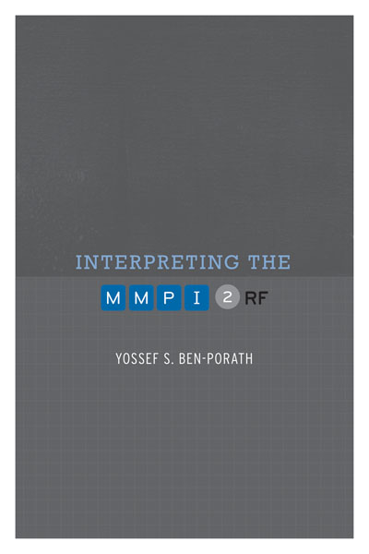

TRAINING SLIDES FOR:
INTERPRETING THE MMPI-2-RF
MMPI-2-RF Training Slides, University of Minnesota Press, 2015. Copyright for all MMPI® and MMPI-2-RF® materials are held by the Regents of the University of Minnesota.

Slide 2
Chapter 1: Background

Slide 3
MMPI Background
Developed in 1930s by Hathaway and McKinley
Intended to function as a differential diagnostic instrument
Clinical scales designed to assess common “Kraepelinian” syndromes
  Hypochondriasis, Depression, Hysteria, Psychopathic Deviate, Paranoia, Psychasthenia, Schizophrenia, Hypomania
Published in 1943

Slide 4
MMPI Background
Theoretical Foundations:
  Kraepelinian descriptive nosology
  Items as stimuli for behavioral responses, the aggregates of which may have certain empirical correlates, including diagnostic group membership
  Rejection of content-based test interpretation as overly susceptible to misleading responding
  #3 notwithstanding, test takers do attend to item content and may intentionally or unintentionally respond in a misleading manner

Slide 5
MMPI Background
Scale Development:
  Follows methodology used by Strong to develop his Vocational Interest Blank
  Responses (to an assembled pool of items) of eight criterion groups diagnosed with the targeted disorders (n=20-50) contrasted with those of a “normal” group
  Result: Eight original Clinical Scales
    Later augmented by Masculinity/Femininity and Social Introversion scales

Slide 6
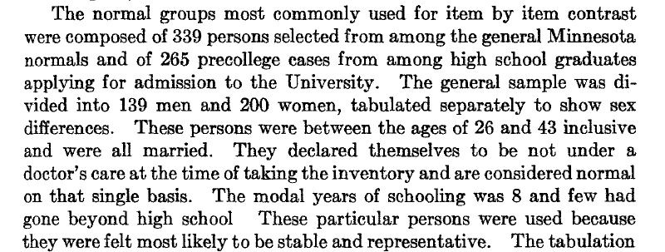
Hathaway & McKinley 1944, p. 155

Slide 7
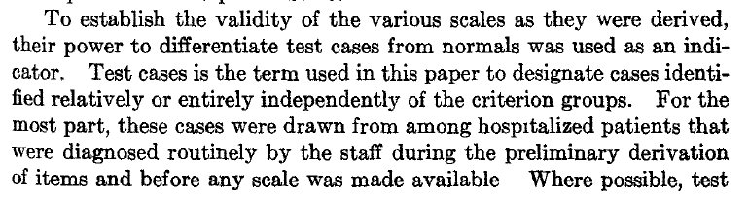
Hathaway & McKinley 1944, p. 155

Slide 8
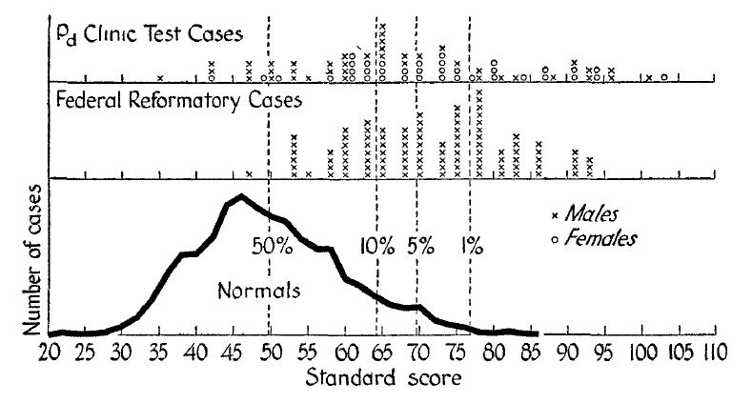
Hathaway & McKinley 1944, p. 170

Slide 9
MMPI Background
By mid-1940s, clear that the scales did not work as intended
  Non-discriminating profiles (i.e., multiple elevations)
  Excessive False Positives
Paradigm Shift 1- Code Types:
  Focus shifts to pattern of scores
  Scales names replaced with numbers to facilitate code typing
  Empirical studies conducted to identify code-type correlates

Slide 10
MMPI Background
Paradigm Shift 2 – Content-Based Assessment
  Item content largely ignored in Clinical Scale construction
  Began to play role in interpretation with several developments in the 1950s:
    Welsh Factor Scales
    Harris-Lingoes subscales
    Weiner-Harmon subscales
  Content used by Wiggins to construct a set of scales in the 1960s

Slide 11
MMPI Background
Appraisals and Thoughts about Revision:
  By late 1950s, MMPI becomes most widely used and studied objective measure of personality
  Scholarly appraisals are more negative
  Including Hathaway himself:

Slide 12
MMPI Background
Hathaway (1960)
  Our most optimistic expectation was that the methodology of the new test would be so clearly effective that there would soon be better devices with refinements of scales and general validity. We rather hoped that we ourselves might, with five years experience, greatly increase its validity and clinical usefulness, and perhaps even develop more solidly based constructs or theoretical variables for a new inventory.

Slide 13
MMPI Background
Hathaway (1972)
  If another twelve years were to go by without our having gone on to a better instrument or procedure for the practical needs [it fulfills,] I fear that the MMPI, like some other tests, might have changed from a hopeful innovation to an aged obstacle.

Slide 14
MMPI Background
Appraisals and Thoughts about Revision:
  In 1970, Fifth Annual MMPI Research Symposium, convened in honor of Hathaway, devoted to discussion of whether and, if so, how to revised the MMPI
    Produces book: Objective Personality Assessment: Changing Perspectives (Butcher, 1972)
    Includes chapters by conference attendees
    Jackson (1971) also weighs in
    Meehl responds in final chapter (his last word on the MMPI)

Slide 15
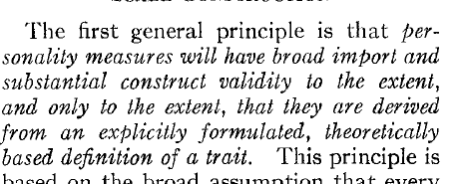
Jackson (1971, p. 232)

Slide 16
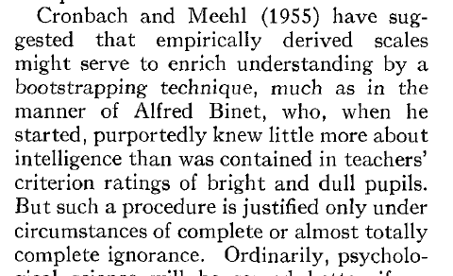
Jackson (1971, p. 232)

Slide 17
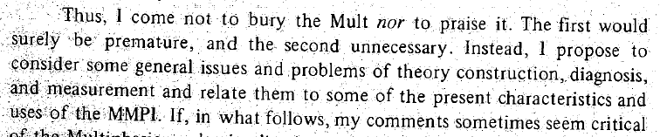
Norman (1972, p. 60)

Slide 18
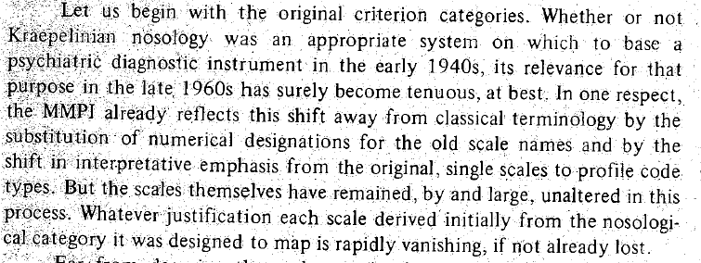
Norman (1972, p. 64)

Slide 19
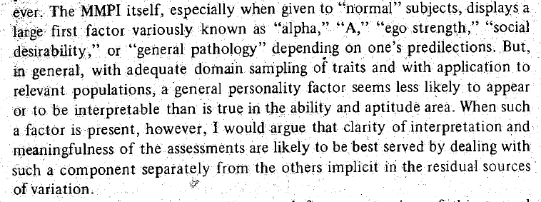
Norman (1972, p. 82)

Slide 20
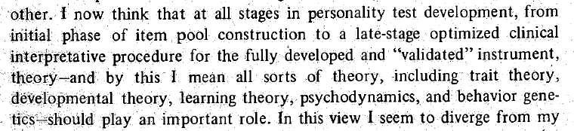
Meehl (1972, p. 150)

Slide 21
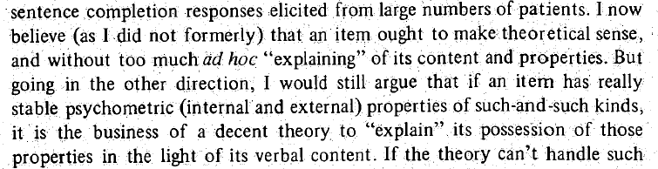
Meehl (1972, p. 155)

Slide 22
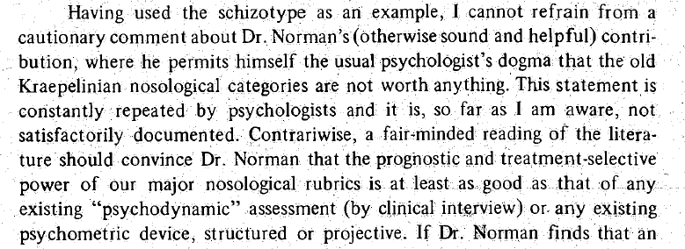
Meehl (1972, p. 157)

Slide 23

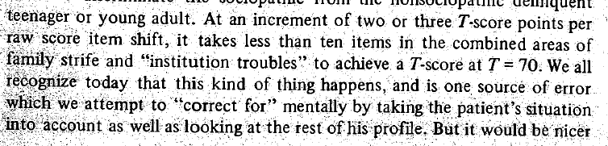
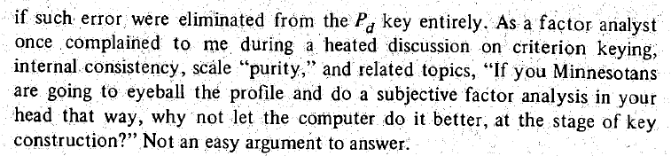
Meehl (1972, pp. 170-171)

Slide 24
MMPI-2 (1989)
New Norms
Clinical Scales left intact
New items introduced via Content Scales
New Validity Scales
Initial Skepticism
Relatively quick acceptance by clinicians
Disappointment by (some of) the scholarly community

Slide 25
Chapter 2:
Restructured Clinical
(RC) Scales

Slide 26
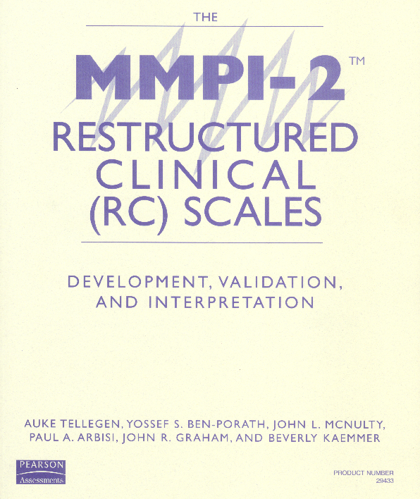

Slide 27
Why Restructure the Clinical Scales?
While they contain compelling informative items, it has long been recognized that as aggregate measures the Clinical Scales are not psychometrically optimal:
  Excessive intercorrelations
  Item overlap
  Over-inclusive content (including “subtle” items)
Pre-RC Scale Solutions:
  Code types
  Subscales
  Supplementary Scales

Slide 28
Developing the RC Scales
Step 1: Defining and Capturing Demoralization
    it is generally the case that correlations between measures of adjustment tend to be substantial, giving rise to a large—sometimes very large—general demoralization or subjective discomfort factor in such inventories as the MMPI. . . . One challenge in developing new self-report scales is to find ways of not measuring this general factor. (Tellegen, 1985, p. 692)

Slide 29
Developing the RC Scales
Step 1: Defining and Capturing Demoralization
  Tellegen’s concept of Demoralization similar to that of Jerome Frank:
    only a small proportion of persons with psychopathology come to therapy; apparently something else must be added that interacts with their symptoms. This state of mind, which may be termed “demoralization,” results from persistent failure to cope with internally or externally induced stresses. . . . Its characteristic features, not all of which need to be present in any one person, are feelings of impotence, isolation, and despair. ( Frank, 1974 p. 271)
  Capturing Demoralization guided by Tellegen’s research on Mood

Slide 30
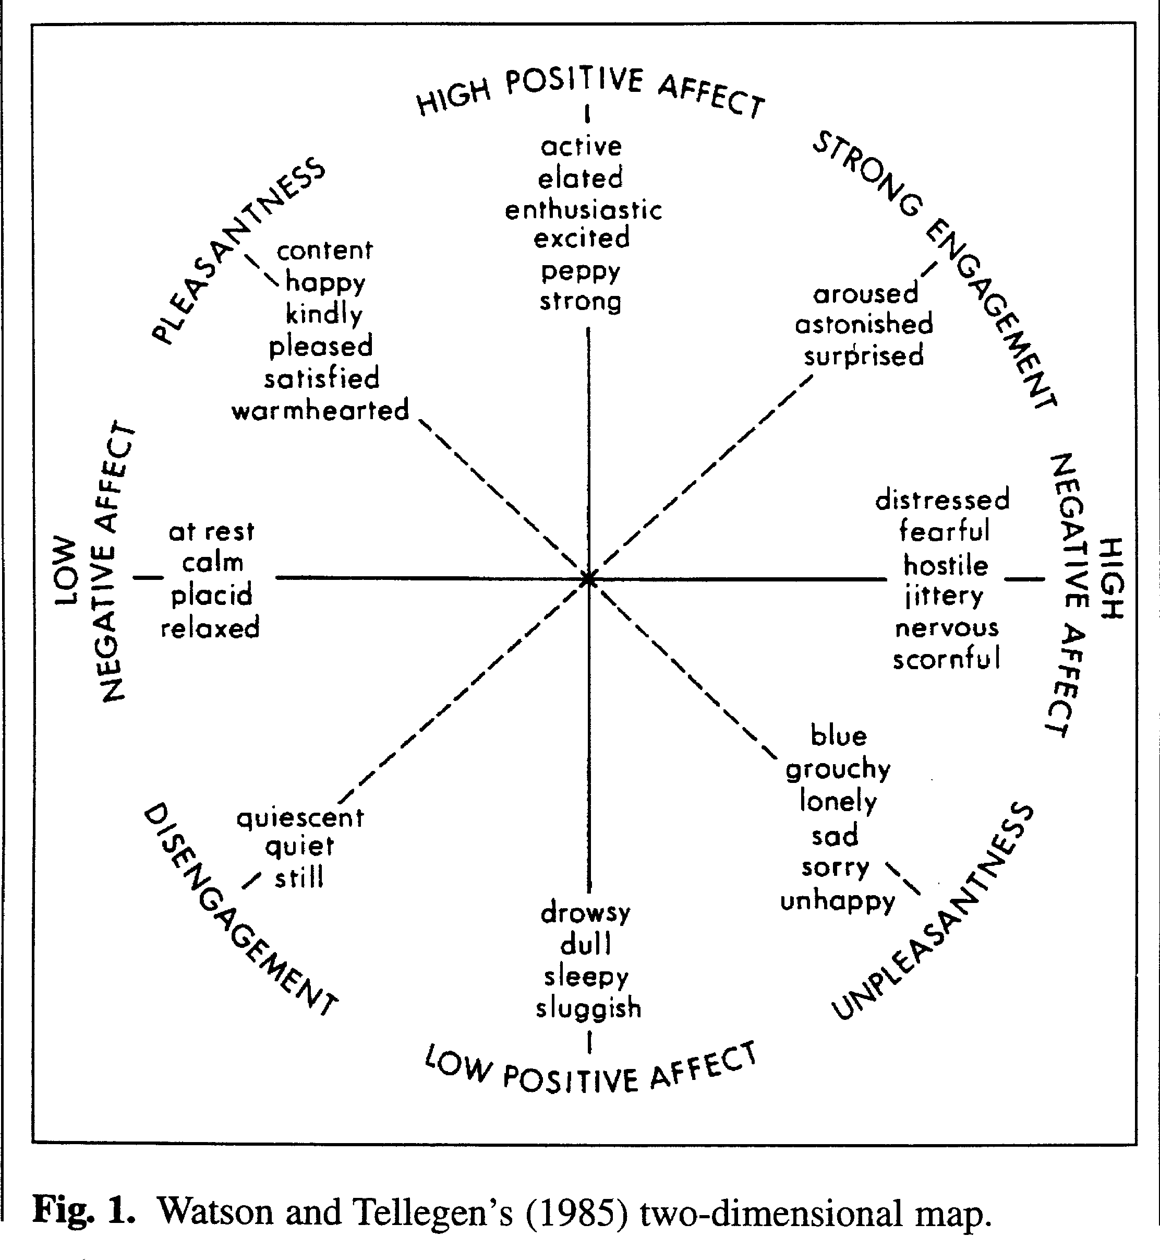

Slide 31
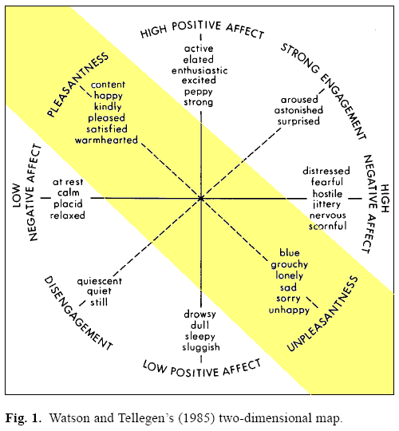

Slide 32
Developing the RC Scales
Step 1: Defining and Capturing Demoralization
  Factor analysis of items of Clinical Scales 2 and 7 (measures of depression and anxiety) leads to identification of a set of items that load on a common factor
  Identified items denote features of demoralization:
    Unhappiness
    Poor self-concept
    Feeling overwhelmed
    Desire to give up
  Consistent with Tellegen’s and Frank’s conceptualizations

Slide 33
Developing the RC Scales
Step 2: Identifying Clinical Scale Core Components
  Assumption: Each clinical scale includes at least one major distinctive core component
  Method: Factor analyses of the items of each of the ten Clinical Scales along with the Demoralization markers identified in Step 1
  Outcome: Subset of Clinical Scale items marking a major distinctive core component of each scale of the ten scales (2 sets for Scale 5)

Slide 34
Developing the RC Scales
Step 3: Deriving Seed Scales
  Goal: Optimize internal coherence and mutual distinctiveness of eventual RC Scales
  Method:
    Only items with highest loading on the component marker for which they were designated are retained (yields 11 non-overlapping provisional seed scales)
    Deletion of items that did not correlate sufficiently, or consistently highest with designated provisional seed scale
    Addition of 12th seed scale representing Demoralization (deleting 4 weakest items from demoralization markers used in Step 2)
  Outcome: 12 Seed Scales made up of relatively small, mutually exclusive subsets of original Clinical Scale items

Slide 35
Developing the RC Scales
Step 4: Deriving the Final RC Scales
  Goal: Build on structural changes attained in Steps 1-3 by recruiting additional items from the entire MMPI-2 pool (including new MMPI-2 items)
  Method:
    Calculate correlations between the 12 Seed Scales and 567 MMPI-2 items in four samples
    Add item to Seed Scale if:
      Correlation with that seed higher than the 11 others
      Correlation with that seed was “high enough”
      Correlations with the remaining seeds were “low enough”
    Calculate correlations between resulting items and available external criteria for some scales (small number deleted at this point)
  Outcome: 9 RC Scales (Seeds for Clinical Scales 5 and 0 not used to derive final RC Scales)

Slide 36
Delineating the RC Scale Constructs
RCd – Demoralization
  Happy/Unhappy Pleasant/Unpleasant dimension of mood
  Dohrendwend: Analogous to taking patient’s temperature in medicine (i.e., indicates a problem and its severity, but not etiology)
  Items reflect dysphoric affect, distress, self-attributed inefficacy, low self esteem, and a sense of having given up
  Associated with increased risk for suicidal ideation and recent suicide attempt

Slide 37
Delineating the RC Scale Constructs
RCd – Demoralization
  Considerable phenotypic overlap with depression, however
    Vegetative symptoms such as poor sleep, low appetite, and anhedonia are more specific to depression
    Dysphoric affect found in medical patients more likely to be a product of demoralization, than depression
    When asked about their mood, patients/clients who are demoralized are more likely to complain about depression and anxiety

Slide 38
Delineating the RC Scale Constructs
RC1 – Somatic Complaints
  Unexplained somatic complaints long a focus of medicine (e.g., Hysteria=wandering uterus in ancient Egypt)
  19th century French psychiatrist Briquet attributes symptoms to nervous system
  Charcot and Janet, after collaborating with Freud conceptualize as a disease of the mind, adopting his notion of conversion – psychological trauma converted into physical symptoms
  In DSM-IV conditions labeled Somatoform Disorders
  DSM-5 rebranded Somatic Symptom Disorders

Slide 39
Delineating the RC Scale Constructs
RC2 – Low Positive Emotions
  Lack of positive emotional responsiveness, anhedonia, is a core personological risk factor for depression
  But not unique to depression; can also occur in Schizophrenia, PTSD, and certain medical conditions
  In depression, low positive emotions associated with greater likelihood of biologically (rather than situationally)-linked depression, and hence may be more amenable to treatment with antidepressant medication (Klein, 1974)

Slide 40
Delineating the RC Scale Constructs
RC3 – Cynicism
  Degree to which individual holds misanthropic, negativistic, and mistrusting view of others
  Beliefs are non-self-referential
  Dysfunction is largely interpersonal
  “Active ingredient” in Type A Personality associated with increased risk for cardiovascular disease
  Risk factor for burnout and misconduct in law enforcement officers

Slide 41
Delineating the RC Scale Constructs
RC4 – Antisocial Behavior
  Core feature of Antisocial Personality Disorder and, depending upon model, either core feature or consequence of Psychopathy
  Item pool includes several elements of diagnostic criteria for ASPD, but not all
  Also includes substance abuse and familial discord items that are not associated with specific ASPD diagnostic criteria
  Hence, Antisocial Behavior and ASPD are not veridical

Slide 42
Delineating the RC Scale Constructs
RC6 – Ideas of Persecution
  Self-referential beliefs that one is being singled out for mistreatment
  Persecutory beliefs are a feature of Paranoia, but can stem from other causes as well
    Actually being persecuted (refugees, racial minorities)
    Projection of blame for shortcomings or difficulties onto others
    Alienation

Slide 43
Delineating the RC Scale Constructs
RC6 – Ideas of Persecution
  Freeman (2007) characterized paranoia as a hierarchical phenomenon, characterized by five levels of perceived threat ranging from
    Social evaluative concerns (fear of rejection and feelings of vulnerability)
    Ideas of reference (being talked about or watched by others)
    Mild threat (people trying to cause minor distress such as irritation)
    Moderate threat (people going out of their way to get at the individual)
    Severe threat (people trying to cause significant physical, psychological, or social harm to the individual)
  RC6 items fall mainly in mild to severe range

Slide 44
Delineating the RC Scale Constructs
RC7 – Dysfunctional Negative Emotions
  A personality trait characterized by a tendency to worry, be anxious, feel victimized and resentful, be angry, and appraise situations generally in ways that foster negative emotions
  Is correlated with, but distinct from Demoralization, which is associated more specifically with dissatisfaction, unhappiness, and distress
  Associated with increased risk for anxiety-related psychopathology

Slide 45
Delineating the RC Scale Constructs
RC8 – Aberrant Experiences
  Sensory, perceptual, cognitive, and motor experiences that fall well outside the range of normal experiences
  Associated with, but not unique to thought disturbance
  Items include positive symptoms of Schizophrenia, such as hallucinations (e.g., visual, auditory), and non-persecutory delusions (e.g., thought broadcasting)
  Associated with increased risk for psychotic disorder, but can co-occur with other conditions (e.g., dissociative symptoms of PTSD)

Slide 46
Delineating the RC Scale Constructs
RC9 – Hypomanic Activation
  Focuses primarily on Kraepelin’s:
    Manic Temperament, marked by constitutional excitability, carelessness, and marked self-confidence
    Irritable Temperament, marked by irritability, volatility, and occasional outbursts of violence
  Some items also focus on Kraepelin’s manic states, associated with pressure of activity
  Most individuals with hypomanic personality traits do not go on to develop a full fledged bi-polar disorder, but it is associated with elevated risk for this condition

Slide 47
Empirical Findings with the RC Scales
Reported in MMPI-2-RF Technical Manual and an extensive peer-reviewed literature
  Adequate reliability
  Good evidence of construct validity
  Broad range of replicable empirical correlates reflected in interpretive recommendations in MMPI-2-RF Manual for Administration, Scoring, and Interpretation

Slide 48
Appraisals of the RC Scales
Positive appraisals based on data analyses that included external criteria
Negative appraisals based on beliefs about the nature of the constructs assessed by the Clinical Scales and “internal” analyses limited to correlations between subsets of MMPI-2 items
  Smaller number of elevated scales does not reflect low sensitivity, but rather greater discriminant validity
  “Construct Drift” is actually “Construct Shift”

Slide 49
Chapter 3:
MMPI-2-RF Substantive Scales

Slide 50
MMPI-2-RF Substantive Scales
The introduction of the RC Scales may stimulate additional MMPI-2 scale development. It may prove worthwhile to search for and measure distinctive core features of important MMPI-2 scales other than the MMPI-2 Clinical Scales, some of which may also be confounded with a strong Demoralization component. Investigations along these lines may lead to additional measures that are incrementally informative beyond the RC Scales. Through such efforts it may be possible eventually to capture the full range of attributes represented by the large body of MMPI-2 constructs with a set of new scales more transparent and effective than those currently available. (Tellegen, Ben-Porath, McNulty, Arbisi, Graham & Kaemmer, 2003, pp. 85–86)

Slide 51
MMPI-2-RF Substantive Scales
RC Scales not intended to assess everything that can be measured with the MMPI-2 item pool
Goal in completing the MMPI-2-RF:
  A comprehensive set of measures representing the clinically significant substance of the entire MMPI-2 item pool
Five additional sets of scales:
  Higher-Order
  Specific Problems
  Interest
  PSY-5
  Validity

Slide 52
MMPI-2-RF Substantive Scales
Higher-Order Scales – Background:
  Ongoing search for meaningful structural model to provide an organizing descriptive framework for psychological assessment and psychodiagnosis
  Factor analyses of “normal” and clinical personality measures yield similar structures:
    Primary constructs to emerge from factor analyses:
      Clinical: Internalizing and Externalizing Psychopathology
      Normal: Positive Emotionality, Negative Emotionality, Constraint
    Missing Construct: Thought Dysfunction

Slide 53
MMPI-2-RF Substantive Scales
Higher-Order Scales – Development:
  RC Scales provide an opportunity for a “fresh” analysis
  Factor analyses of the RC Scales identify three higher-order dimensions marked by
    RCd, RC2, RC7
    RC6, RC8
    RC4, RC9
  Combined items of these scales factor analyzed and three factor scores generated
  Three factor scores correlated with 567 MMPI-2 items
  A set of items selected for each scale to produce diverse and distinctive markers associated statistically and conceptually with one, but not the other two higher-order factors

Slide 54
MMPI-2-RF Substantive Scales
Higher-Order Scales - Outcome:
  EID - Emotional/Internalizing Dysfunction
  THD – Thought Dysfunction
  BXD – Behavioral/Externalizing Dysfunction
Two applications of H-O Scales:
  Dimensional measures allow for identification of more than one broad domains of dysfunction (and indication of relative prominence)
  Organizing framework for MMPI-2-RF interpretation

Slide 55
MMPI-2-RF Substantive Scales
Specific Problems and Interest Scales - Objectives:
  Augment H-O and RC Scales with measures needed to achieve comprehensive instrument that assesses the broad range of constructs measurable with the MMPI-2 item pool:
    Constructs assessed by Clinical Scales 5 and 0
    Clinical Scale components not assessed by the RC Scales (e.g., a “social anxiety” component contained in the items of Clinical Scale 3)
    More narrowly-focused facets of some RC Scales (e.g., substance abuse within the item pool of RC4)
    Clinically significant attributes not represented in either the Clinical or RC Scales (e.g., suicidality)

Slide 56
MMPI-2-RF Substantive Scales
Specific Problems and Interest Scales – Development:
  Iterative process relying on methods similar to those used in developing the RC Scales
  A set of items representing targeted constructs factor analyzed along with Demoralization markers
  Seed Scales assembled by selecting items not overly correlated with Demoralization or other targeted item sets
  Seed scales correlated with 567 MMPI-2 items to identify ones sufficiently correlated with a specific seed and more so than with the others
  Deletion of items that reduced internal consistency
  Examination of empirical correlates

Slide 57
MMPI-2-RF Substantive Scales
Specific Problems and Interest Scales – Outcome:
  5 Somatic/Cognitive Scales
  9 Internalizing Scales
  4 Externalizing Scales
  5 Interpersonal Functioning Scales
  2 Interest Scales

Slide 58
MMPI-2-RF Substantive Scales
Somatic/Cognitive
  MLS: Malaise – Overall sense of physical
  debilitation, poor health (perceived functional incapacity)
  GIC: Gastrointestinal Complaints – Nausea,
  recurring upset stomach, and poor appetite
  HPC: Head Pain Complaints – Head and
  neck pain
  NUC: Neurological Complaints – Dizziness,
  weakness, paralysis, loss of balance, etc.
  COG: Cognitive Complaints – Memory problems,
  difficulties concentrating

Slide 59
MMPI-2-RF Substantive Scales
Internalizing (RCd Facets):
  SUI: Suicidal/Death Ideation – Direct reports of
  suicidal ideation and recent attempts
  HLP: Helplessness/Hopelessness – Belief that goals
  cannot be reached or problems solved
  SFD: Self-Doubt -- Lack of self-confidence, feelings
  of uselessness
  NFC: Inefficacy – Belief that one is indecisive
  and inefficacious

Slide 60
MMPI-2-RF Substantive Scales
Internalizing (RC7 Facets):
  STW: Stress/Worry -- Preoccupation with
  disappointments, difficulty with time pressure
  AXY: Anxiety – Pervasive anxiety, frights, frequent
  nightmares
  ANP: Anger Proneness -- Becoming easily angered,
  impatient with others
  BRF: Behavior-Restricting Fears -- Fears that
  significantly inhibit normal behavior
  MSF: Multiple Specific Fears -- Fears of blood, fire,
  thunder, etc.

Slide 61
MMPI-2-RF Substantive Scales
Externalizing:
RC4 Facets
  JCP: Juvenile Conduct Problems – Difficulties
  at school and at home, stealing
  SUB: Substance Abuse – Current and past misuse of alcohol and drugs
  RC9 Facets
  AGG: Aggression – Physically aggressive,
  violent behavior
  ACT: Activation – Heightened excitation
  and energy level

Slide 62
MMPI-2-RF Substantive Scales
Interpersonal:
  FML: Family Problems – Conflictual family relationships
  IPP: Interpersonal Passivity – Being unassertive and submissive
  SAV: Social Avoidance – Avoiding or not enjoying social events
  SHY: Shyness – Bashful, prone to feel inhibited
  and anxious around others
  DSF: Disaffiliativeness – Disliking people and being around them

Slide 63
MMPI-2-RF Substantive Scales
Interests:
  AES: Aesthetic-Literary Interests – Literature, music, the theater
  MEC: Mechanical-Physical Interests – Fixing and building things, the outdoors, sports

Slide 64
MMPI-2-RF Substantive Scales
PSY-5 – Personality Psychopathology-5
  Developed by Harkness and McNulty (1994) as a dimensional model of Axis II features
  Began with DSM-III-R Axis II criteria
  Augmented with items describing psychopathy features and Tellegen’s higher-order dimensions of Negative Emotionality, Positive Emotionality, and Constraint
  Data reduction analyses identify five dimensions
  Harkness, McNulty, and Ben-Porath (1995) develop MMPI-2 PSY-5 Scales using replicated rational selection
    Lay judges select MMPI-2 items guided by descriptions of the five dimensions

Slide 65
MMPI-2-RF Substantive Scales
MMPI-2-RF PSY-5 Scales
  Revised versions of their MMPI-2 measures of the PSY-5 dimensional model of personality (Axis II) pathology developed by Harkness and McNulty:
  AGGR-r: Aggressiveness-Revised – Instrumental, goal-directed aggression
  PSYC-r: Psychoticism-Revised – Disconnection
  from reality
  DISC-r: Disconstraint-Revised – Under-controlled behavior
  NEGE-r: Negative Emotionality/Neuroticism-Revised – Anxiety, insecurity, worry, and fear
  INTR-r: Introversion/Low Positive Emotionality-Revised – Social disengagement and anhedonia

Slide 66
MMPI-2-RF Substantive Scales
MMPI-2-RF PSY-5 Scales
  Provide a validated, dimensional perspective on personality disorder features
    Very similar to PID-5 model considered for DSM-5 (now designated as needing further research):
      Negative Affectivity
      Detachment
      Antagonism
      Disinhibit ion vs. Compulsivity
      Psychoticism

Slide 67
MMPI-2-RF Substantive Scales
MMPI-2-RF PSY-5 Scales
    Can be linked to clusters of DSM-5 Personality disorders:
      Aggressiveness – Cluster B
      Psychoticism – Cluster A
      Disconstraint – Custer B
      Negative Emotionality/Neuroticism – Cluster C
      Introversion/Low Positive Emotionality – Cluster C

Slide 68
Empirical Findings Substantive Scales
Reported in MMPI-2-RF Technical Manual and peer-reviewed literature
  Adequate reliability

Slide 69
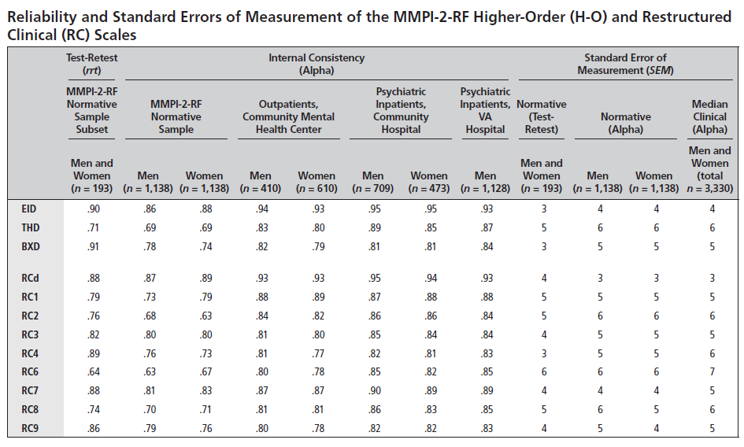

Slide 70
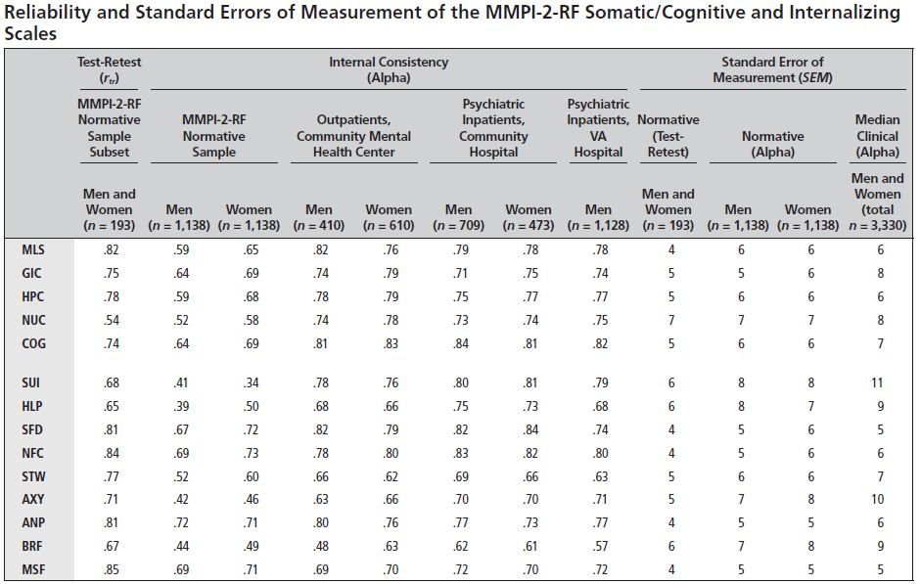

Slide 71
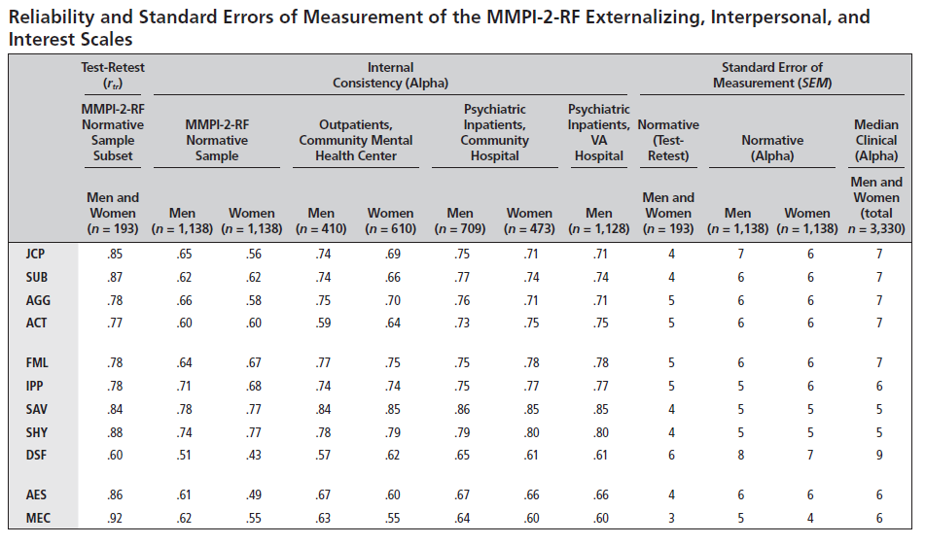

Slide 72
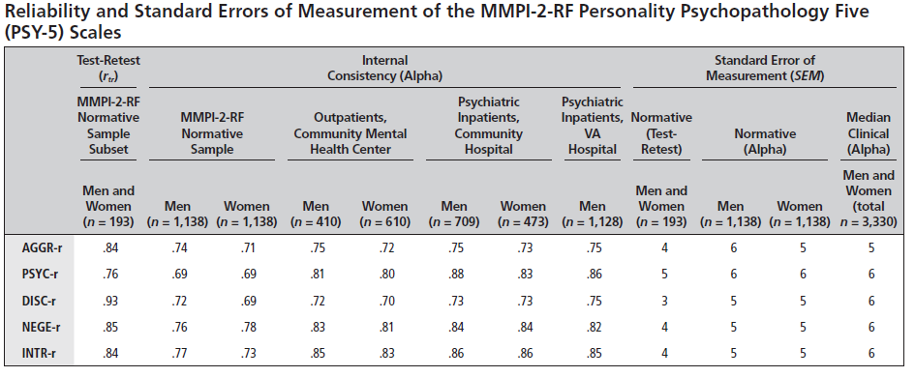

Slide 73
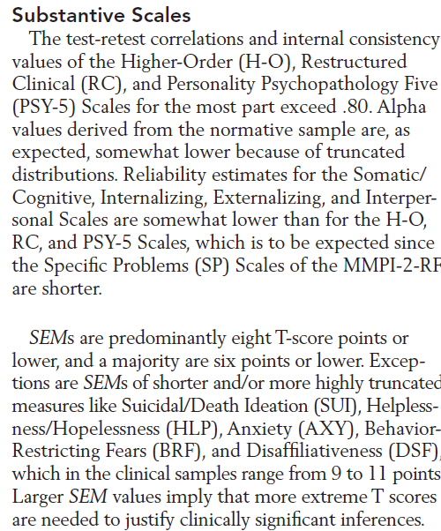

Slide 74
Empirical Findings Substantive Scales
Reported in MMPI-2-RF Technical Manual and peer-reviewed literature
  Adequate reliability
  Good evidence of construct validity
  Broad range of replicable empirical correlates reflected in interpretive recommendations in MMPI-2-RF Manual for Administration, Scoring, and Interpretation

Slide 75
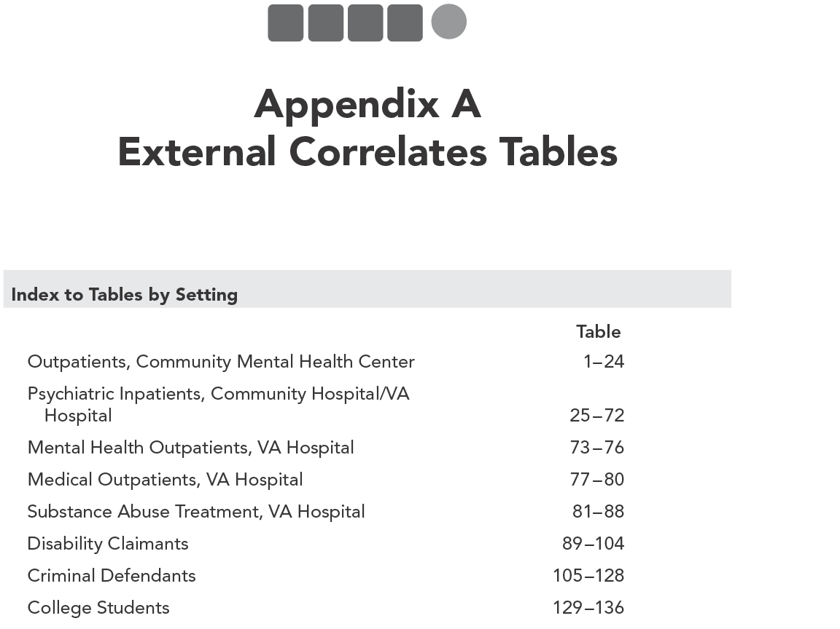

Slide 76
MMPI-2-RF Technical Manual:
Appendix A
Empirical Correlates in
  Mental Health
    Outpatient
    Inpatient
  Medical
  Substance Abuse Treatment
  Forensic- Civil
  Forensic- Criminal
  Non-Clinical
N= 4,336 Men; 2,337 Women
605 Criteria
53,970 Correlations

Slide 77
Chapter 4: Validity Scales

Slide 78
MMPI-2-RF Validity Scales
Protocol Validity versus Instrument Validity
Threats to Protocol Validity
  Non-Content-Based Invalid Responding
    Non-responding
    Random Responding
      Intentional
      Unintentional
        Reading Difficulties
        Comprehension Deficits
          Low verbal abilities
          Non-native English speaker
        Disorganization
        Mismarked answer sheets
    Fixed Responding
      Acquiescence or Counter-acquiescence
      Problems with double negatives

Slide 79
MMPI-2-RF Validity Scales
Threats to Protocol Validity
  Content-Based Invalid Responding
    Over-reporting
      Intentional
        Malingering
        Factitious Disorder
      Unintentional
        Catastrophizing
        Somatoform Disorder
    Under-reporting
      Intentional
        Denial or minimization
      Unintentional
        Distorted self-concept

Slide 80
MMPI Validity Scales
Original MMPI Validity Scales (1943)
  “It is almost as though we inventory-makers were afraid to say too much about the problem because we had no effective solution for it, but it was too obvious a fact to be ignored so it was met by a polite nod.” (Meehl & Hathaway, 1946, p. 526)
  Cannot Say (CNS) – Non-responding
    Changes dramatically with switch to Group Form
  Lie (L) – Under-reporting
    Fashioned after Hartshorne and May Honesty Research
  Infrequency (F) – Random Protocol
    Initially designed as a measure of random responding or clerical error
    Found by military psychologists to be sensitive to over-reporting

Slide 81
MMPI Validity Scales
Original MMPI Validity Scales - K
  K-correction and K Scale added in 1946
  Developed by Meehl and Hathaway (1946) to serve only as a correction factor to account for under-reporting and over-reporting
  K Scale adopted as the final standard validity scale of the MMPI in 1946

Slide 82
MMPI Validity Scales
Original MMPI Validity Scales and Threats to Protocol Validity:
  CNS
    Non-responding
  L
    Under-reporting
      Intentional and unintentional
  F
    Content non-responsiveness
    Over-reporting
      Intentional and unintentional
  K
    Under-reporting
      Intentional and unintentional

Slide 83
MMPI-2 Validity Scales
MMPI-2 Validity Scales:
  MMPI Validity Sales carried over:
    CNS, L, F, K carried over
      F loses four items
  MMPI-2 Validity Scales introduced in 1989:
    Variable Response Inconsistency – VRIN – Random Responding
    True Response Inconsistency – TRIN – Fixed Responding
    F Back (F_{B}) – Over-reporting
  MMPI-2 Validity Scales added later:
    Infrequency Psychopathology – F_{P} - Over-reporting
    Superlative Self-Presentation – S – Under-reporting
    Symptom Validity Scale – FBS (previously Fake Bad Scale) – Over-reporting

Slide 84
MMPI-2-RF Validity Scales: Development
VRIN-r/TRIN-r
  Based on inconsistent responses to item pairs
  Pairs selected in the basis of statistical and semantic analyses of possible response combinations (composites):
    Both True (TT)
    Both False (FF)
    First True and the second False (TF)
    First False and the second True (FT)

Slide 85
MMPI-2-RF Validity Scales: Development
VRIN-r/TRIN-r
  Each composite chosen for VRIN-r or TRIN-r had to meet five criteria:
    The items had to be sufficiently correlated with each other (positively for VRIN-r, negatively for TRIN-r) in two clinical samples (seeking statistical inconsistency)
    The observed frequency of the composite had to be low when compared to the frequency expected by chance if the two responses making up the composite were independent (seeking unlikely response combinations)
    The combination of responses in a composite had to be judged by the authors to be inconsistent (seeking semantic inconsistency)
    The correlation between a composite and a mini-scale made up of the two items keyed in the direction they were scored on the composite was low (seeking “content-free” composites)
    Neither item in a composite could belong to another composite of the same type (eliminate overlap)

Slide 86
MMPI-2-RF Validity Scales: Development
TRIN-r Example:
    269. When things get really bad, I know I can count on my family for help.
    314. I hate my whole family
  Responses are negatively correlated (-.23)
  Observed/Expected .27 for TT and .93 for FF (TT combination much more unlikely than FF)
  TT combination is semantically inconsistent
  Correlation with mini-scale reflecting family problems is -.10 for TT and -.70 for FF (indicating TT combination is content-free)
  Neither 269 nor 314 could be scored in another TT combination

Slide 87
MMPI-2-RF Validity Scales: Development
Over-reporting Scales:
  F-r (Infrequent Responses):
    32 items answered infrequently (10% or less) of the men and women in the normative sample
  Fp-r (Infrequent Psychopathology Responses):
    21 items answered infrequently (20% or less) by psychiatric inpatients, outpatients, and non-clinical samples
  Fs (Infrequent Somatic Responses):
    16 items with somatic content answered infrequently (25% or less) of medical samples
  FBS-r (Symptom Validity):
    30 of 43 FBS items included in 338-item booklet
  RBS (Response Bias Scale):
    28 items correlated with failure on performance validity tests

Slide 88
MMPI-2-RF Validity Scales: Development
Under-reporting Scales:
  L-r (Uncommon Virtues):
    14 items describing uncommon moral virtues
  K-r (Adjustment Validity):
    14 items describing good psychological adjustment

Slide 89
MMPI-2-RF Validity Scales:
Empirical Findings

Slide 90
Psychometric Findings with the
MMPI-2-RF Validity Scales

Slide 91
Reliability
Reported in Chapter 3 of MMPI-2-RF Technical Manual

Slide 92
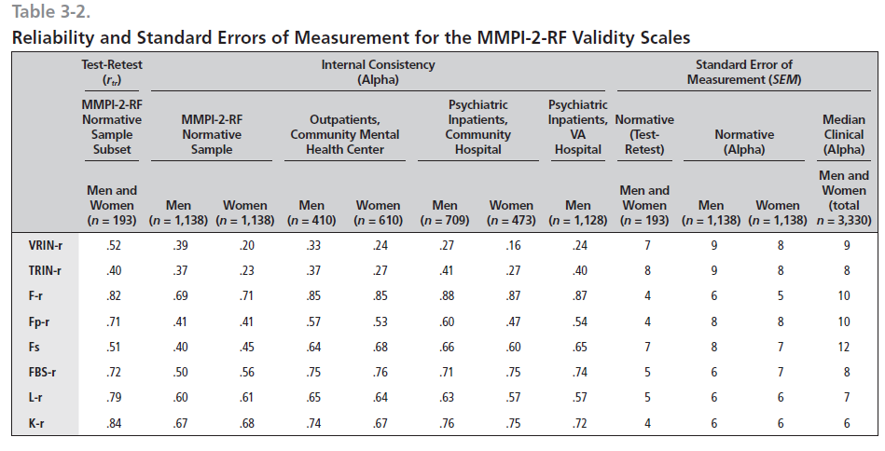

Slide 93
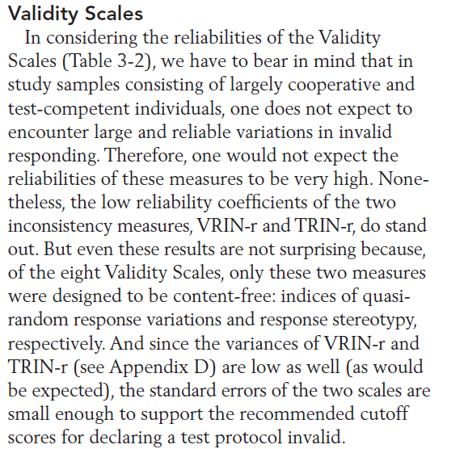

Slide 94
Validity
Validation studies reported in peer-reviewed literature
Examples:

Slide 95
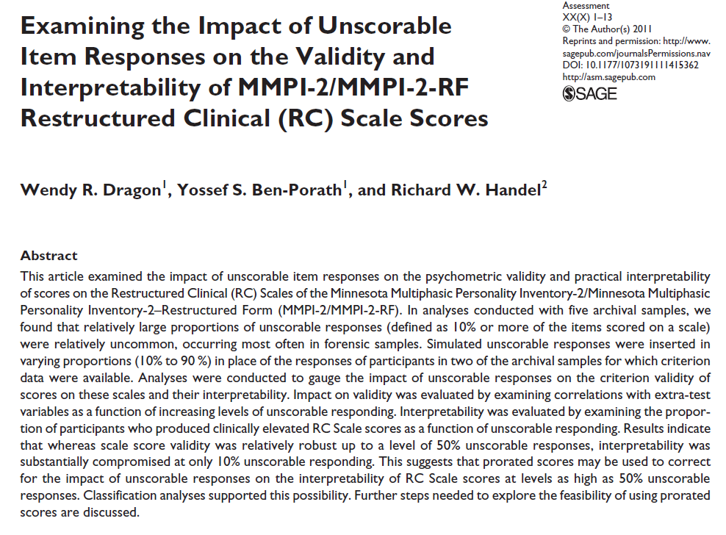

Slide 96
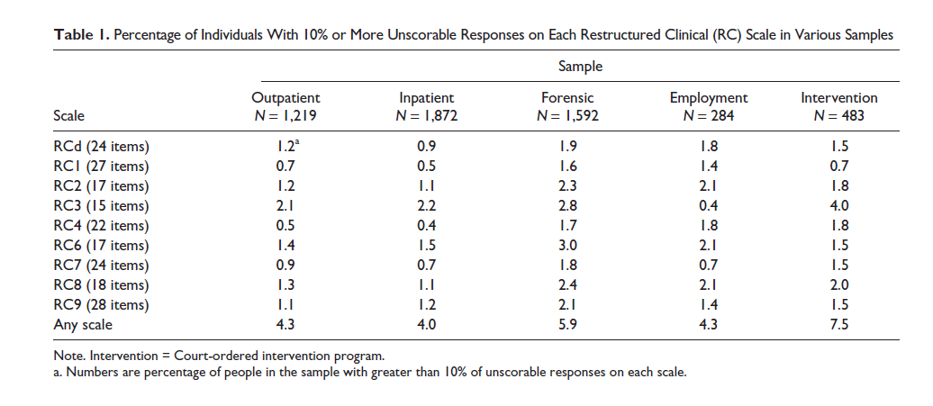

Slide 97
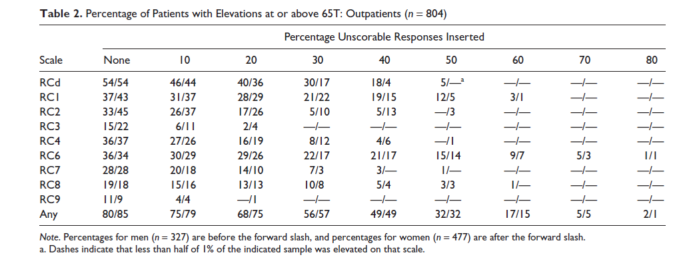

Slide 98
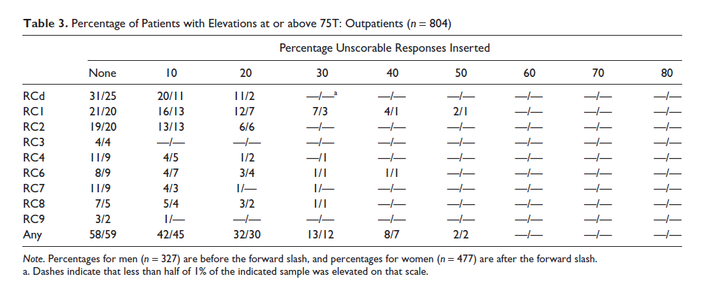

Slide 99
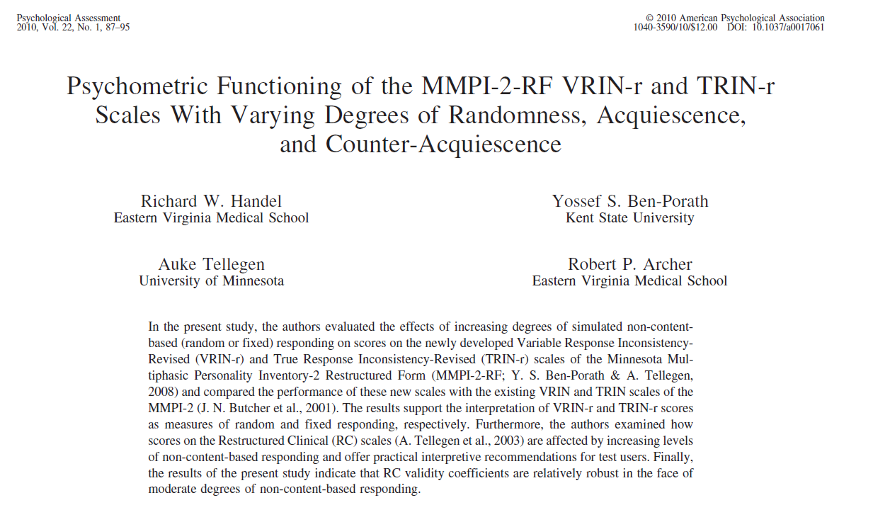

Slide 100
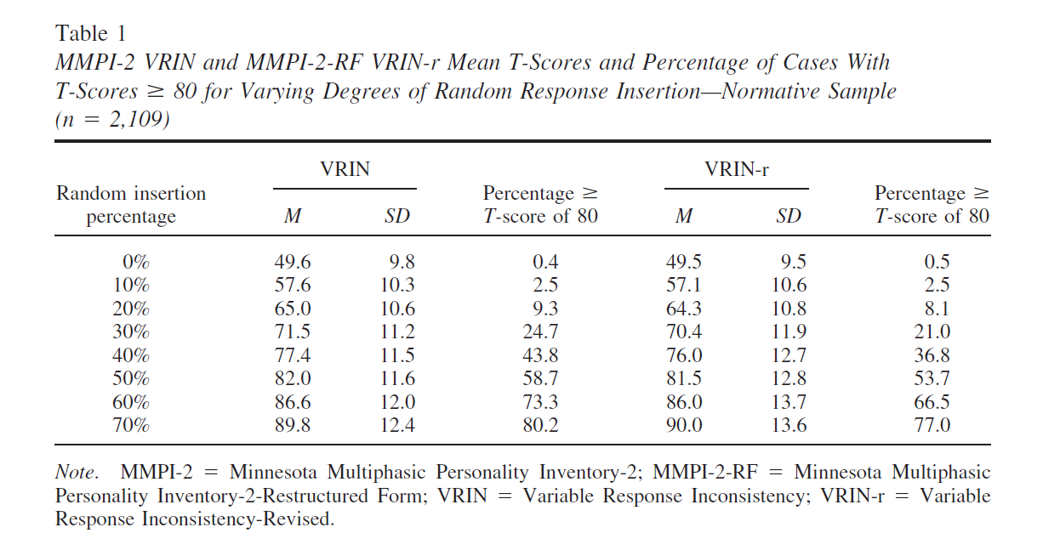

Slide 101
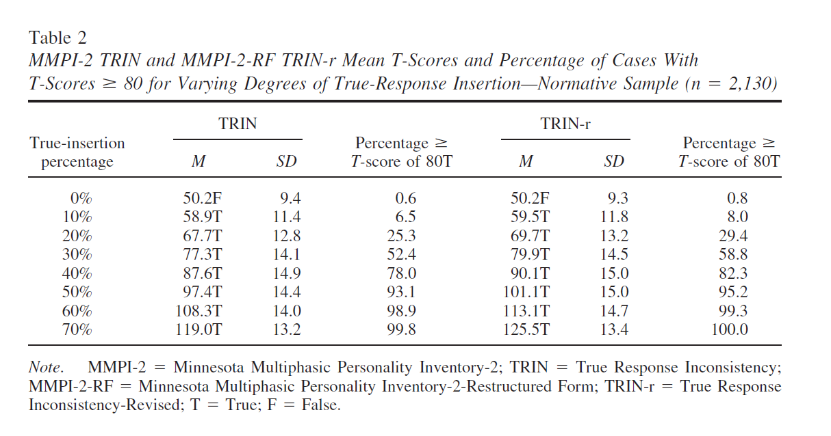

Slide 102
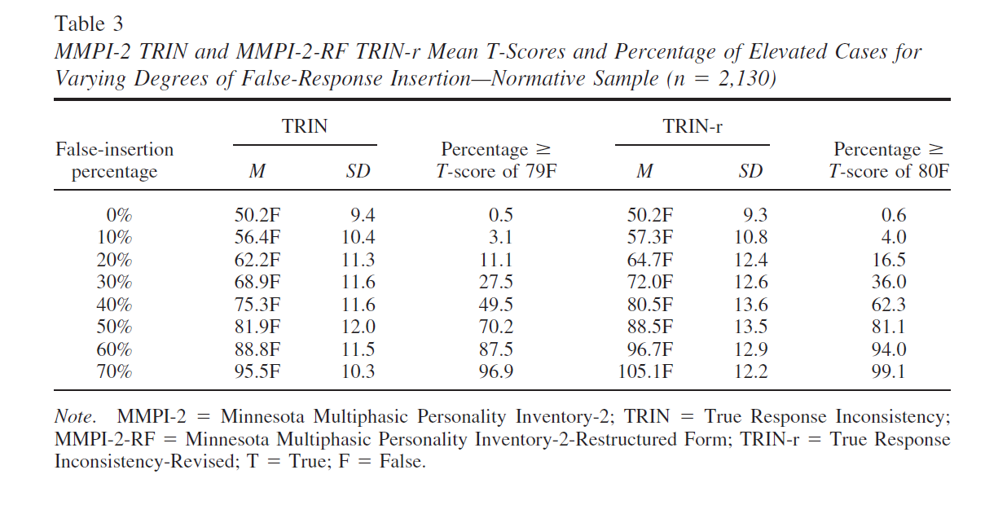

Slide 103
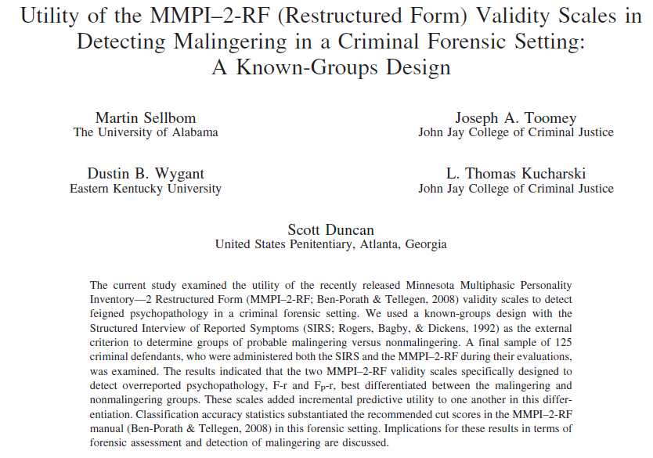

Slide 104
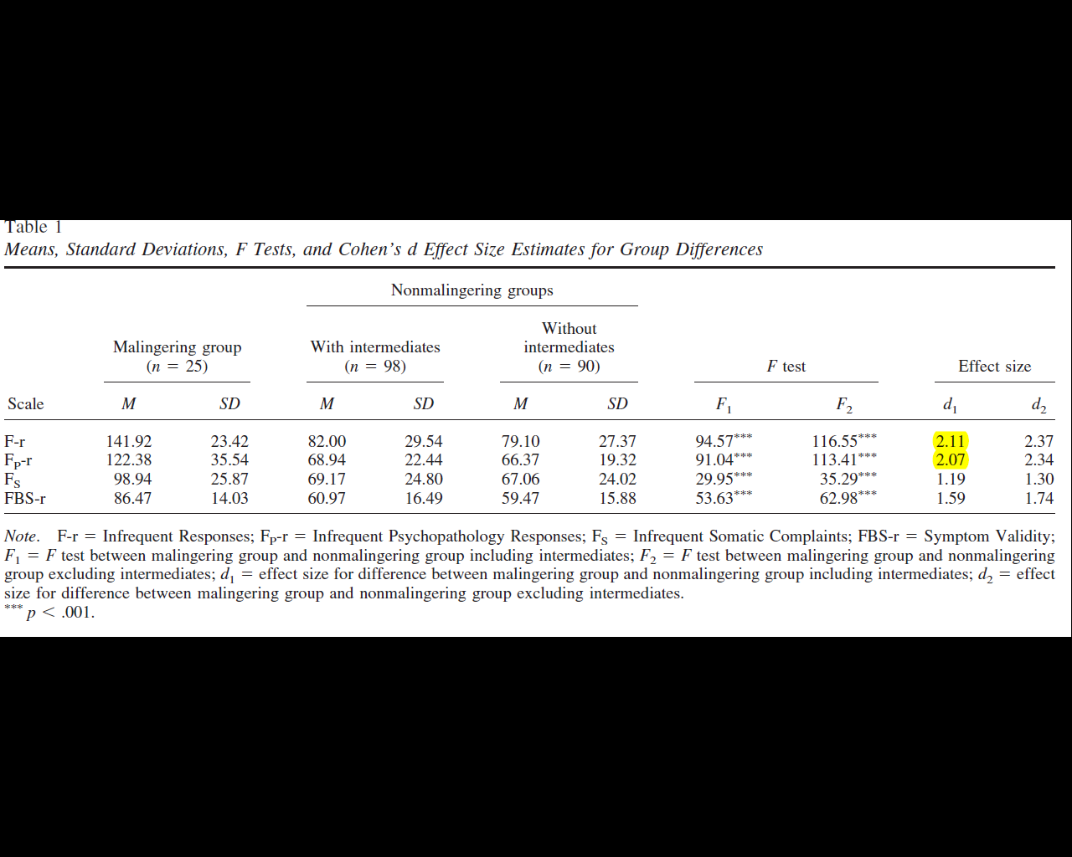

Slide 105
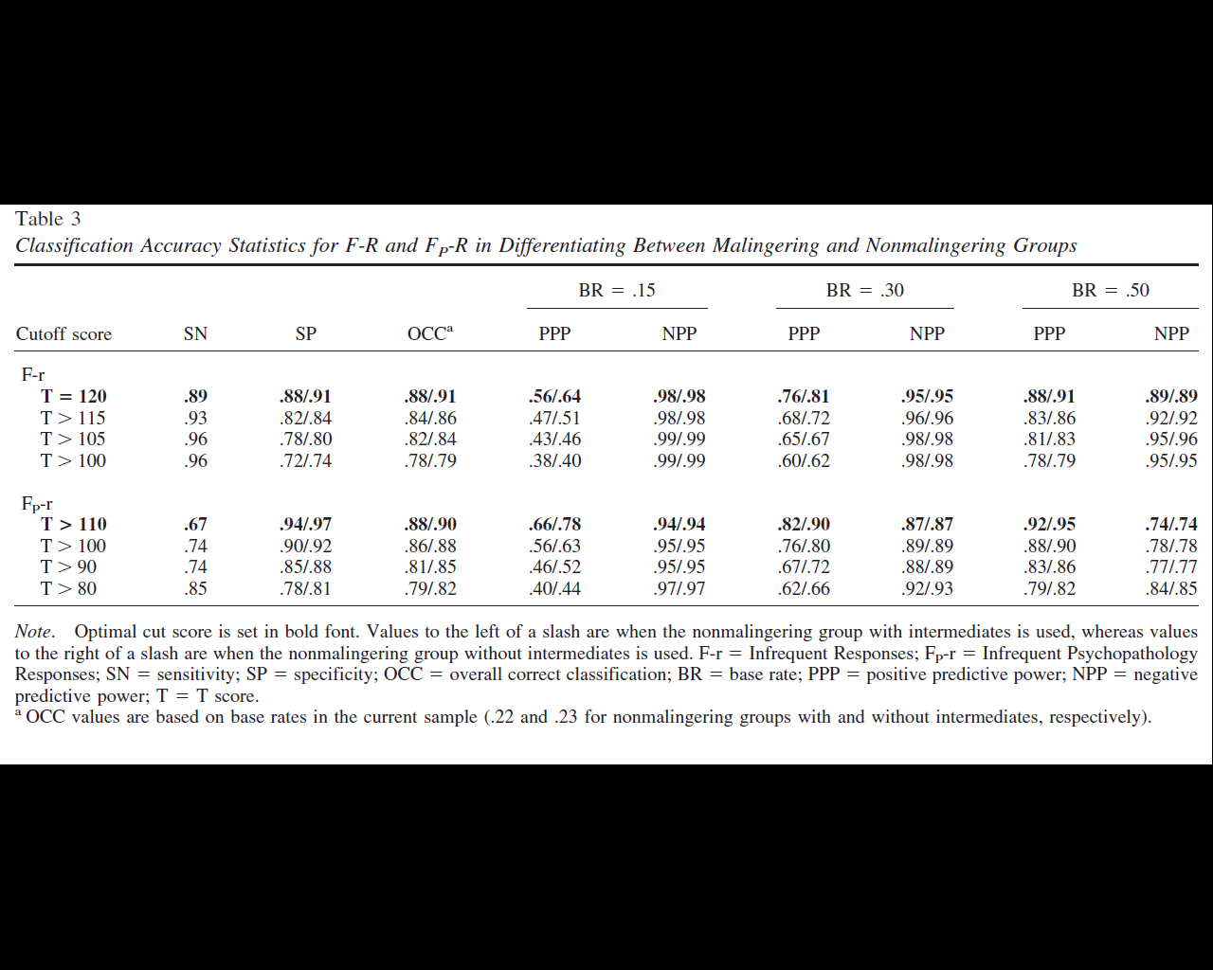

Slide 106
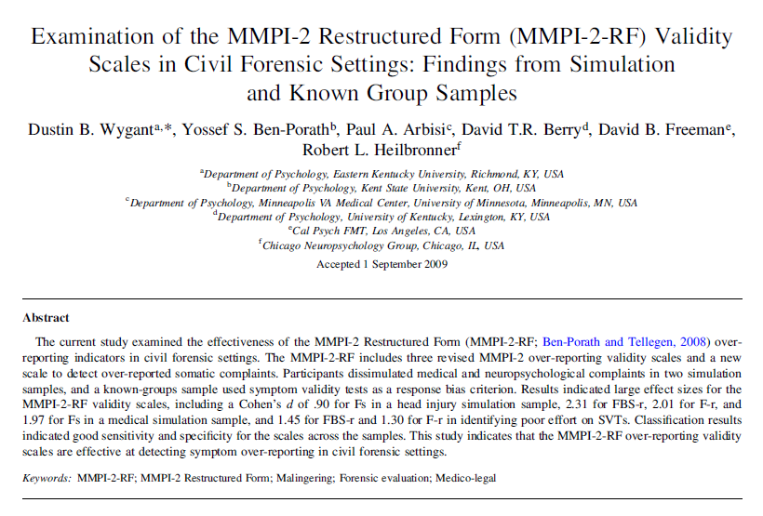

Slide 107
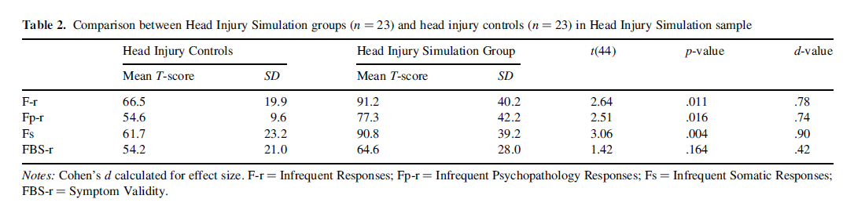
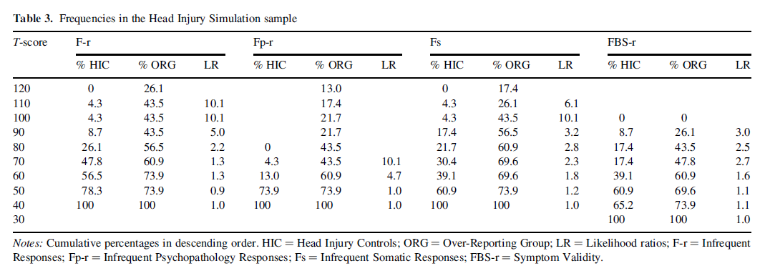

Slide 108
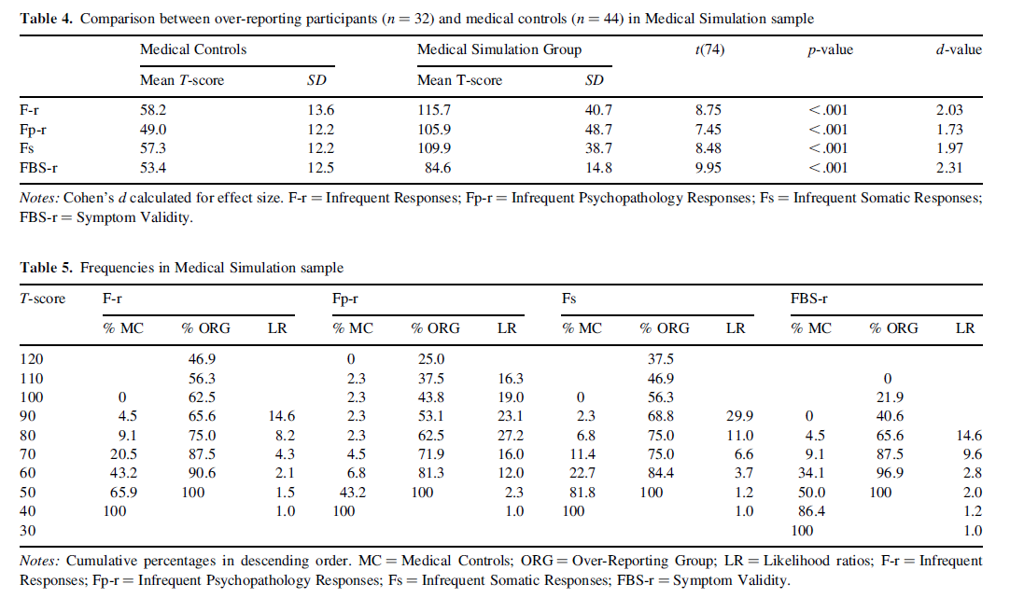

Slide 109
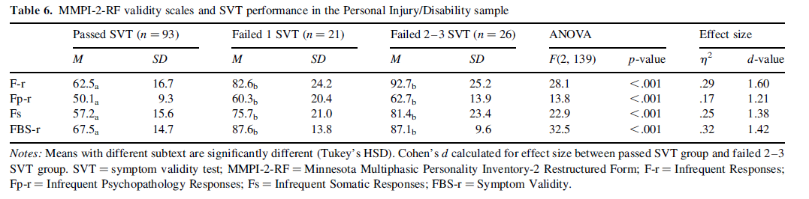
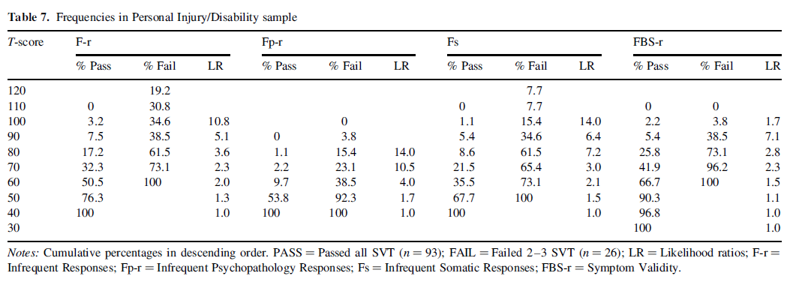

Slide 110
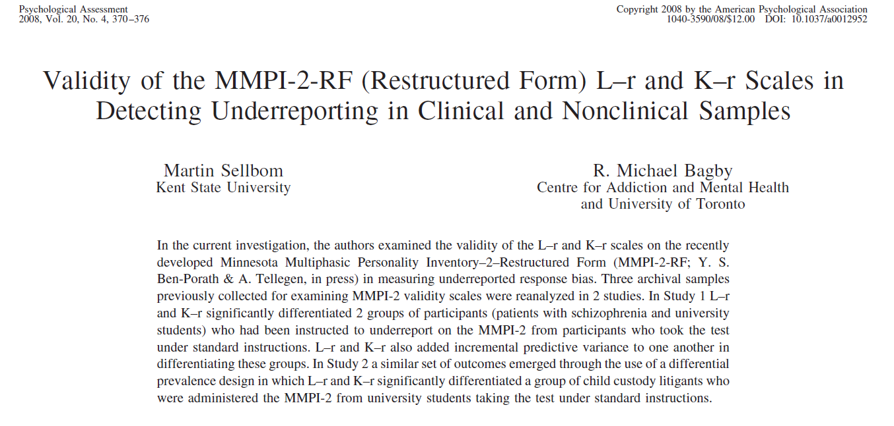

Slide 111
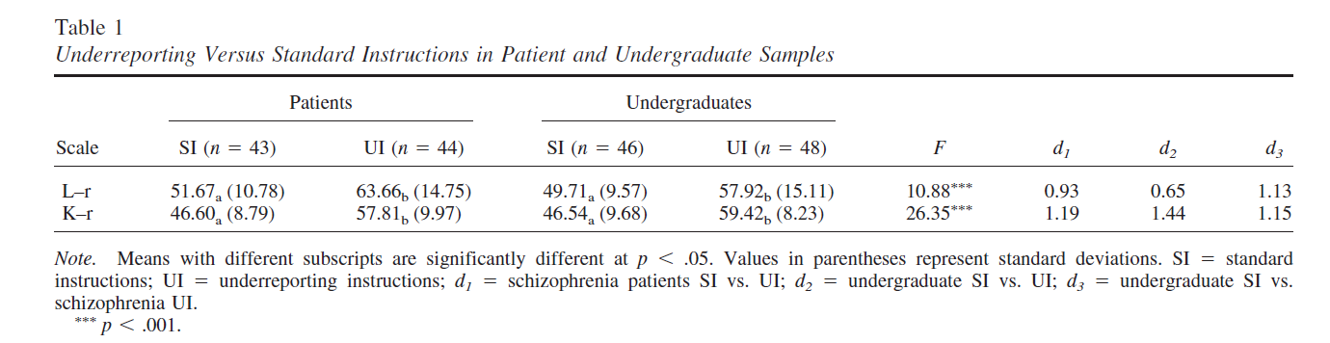
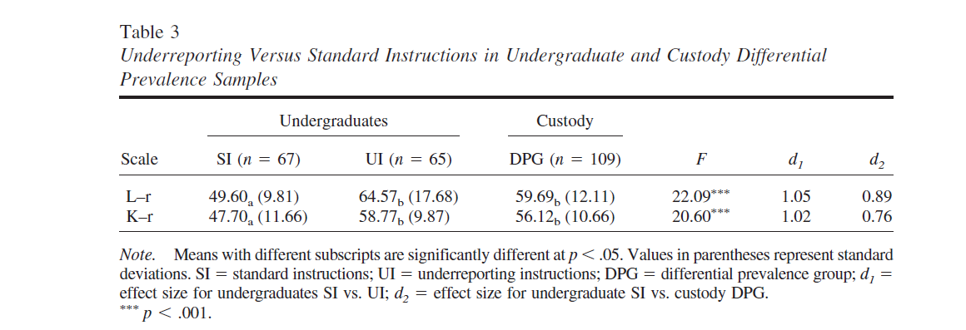

Slide 112
Malingering

Slide 113
Malingering
Cannot be determined by self-report alone
  External incentive?
  Factitious disorder?
When integrated with other sources
  Collateral information
  PVTs
  Other testing
  Interview
MMPI-2-RF indications of over-reporting can support the evaluator’s conclusions about malingering
MMPI-2-RF over-reporting indicators have been validated primarily in the context of identifying malingering

Slide 114
Malingering
Malingering and psychopathology are not mutually exclusive
  i.e., malingering is not an indication of the absence of psychopathology
Regardless of malingering, MMPI-2-RF findings of significant over-reporting
  Raise questions about the validity of scores on the substantive scales
  And therefore indicate that scores on the substantive scales cannot be relied upon to assess for psychological dysfunction
  Raise general questions about the validity of the test-taker’s self-reported symptoms

Slide 115
Chapter 5: Administration and Scoring

Slide 116
Administering and Scoring the
MMPI-2-RF
Standard Procedures delineated in Manual for Administration, Scoring, and Interpretation
Administration:
  Before Testing
    Consider age
    Inquire about prior testing experience
    Assess Testability
      Cognitive wherewithal
      Vision
      Reading Level
  Use Standard Administration Modalities
    Booklet and answer sheet
    Computer

Slide 117
Administering and Scoring the
MMPI-2-RF
Scoring:
  Normative Sample:
    MMPI-2 Normative Sample Collected in mid-1980s
    Non-gendered norms (1,138 men, 1,138 women)

Slide 118
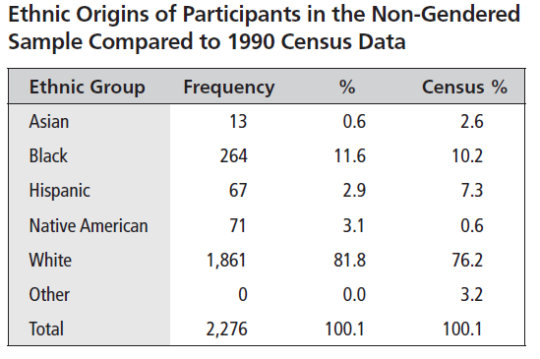
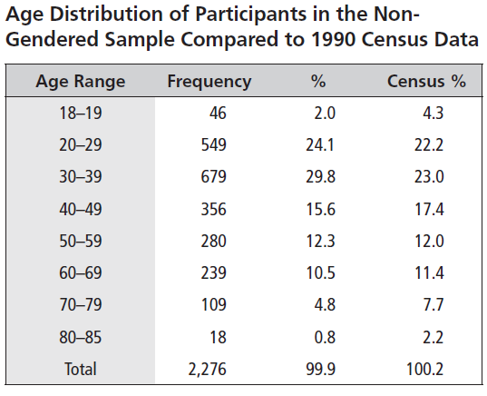
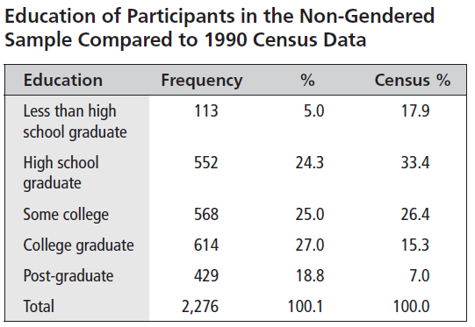

Slide 119
Administering and Scoring the
MMPI-2-RF
Scoring:
  Normative Sample:
    MMPI-2 Normative Sample Collected in 1980s
    Non-gendered norms (1,138 men, 1,138 women)
    Norms appear to be holding up well (Technical Manual Appendix C)

Slide 120
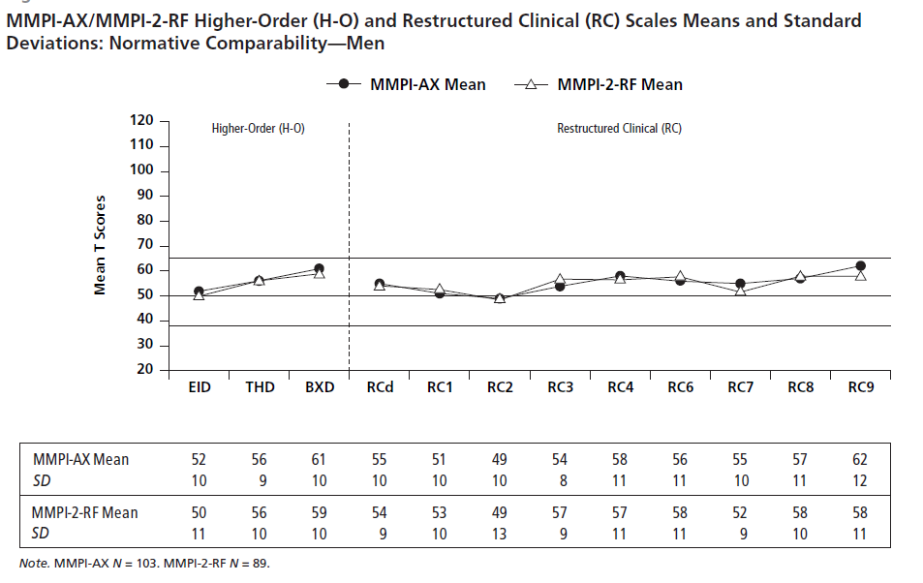

Slide 121
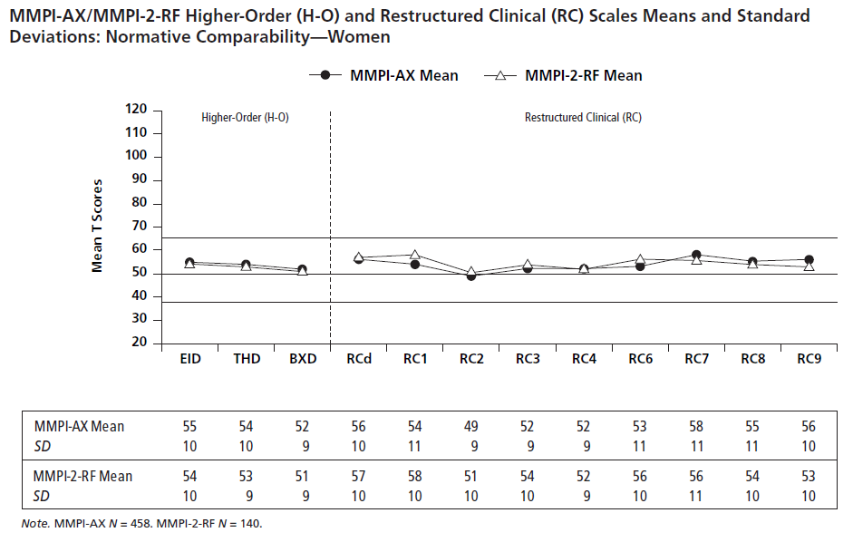

Slide 122
Administering and Scoring the
MMPI-2-RF
Scoring:
  Normative Sample:
    MMPI-2 Normative Sample Collected in 1980s
    Non-gendered norms (1,138 men, 1,138 women)
    Norms appear to be holding up well (Technical Manual Appendix C)
    Uniform T scores

Slide 123


Slide 124


Slide 125
Administering and Scoring the
MMPI-2-RF
Scoring:
  Normative Sample:
    MMPI-2 Normative Sample Collected in 1980s
    Non-gendered norms (1,138 men, 1,138 women)
    Norms appear to be holding up well (Technical Manual Appendix C)
    Uniform T scores
  Comparison Groups
    Technical Manual Appendix D

Slide 126
MMPI-2-RF:
Standard Comparison Groups
MMPI-2-RF Normative (Men & Women)
Outpatient, Community Mental Health Center (Men & Women)
Outpatient, Independent Practice (Men & Women)
Psychiatric Inpatient, Community Hospital (Men & Women)
Psychiatric Inpatient, VA Hospital (Men)
Substance Abuse Treatment, VA (Men)
Bariatric Surgery Candidate (Men & Women)
Spine Surgery/Spinal Cord Stimulator Candidates (Men & Women)
Chronic Pain (Men & Women)
College Counseling Clinic (Men & Women)
College Student (Men & Women)
Forensic, Disability Claimant (Men & Women)
Forensic, Independent Neuropsychological Examination (Men & Women)
Forensic, Pre-trial Criminal (Men & Women)
Forensic, Child Custody (Men & Women)
Forensic, Parental Fitness Evaluees (Men & Women)
Prison Inmate (Men & Women)
Personnel Screening, Law Enforcement (Men, Women & Combined)
Personnel Screening, Corrections Officer (Men, Women & Combined)
Personnel Screening, Clergy Candidates (Men, Women, & Combined)

Slide 127


Slide 128
Administering and Scoring the
MMPI-2-RF
Scoring:
  Standard Scoring Modalities:
    Hand scoring
    Computer
      Score Report

Slide 129


Slide 130


Slide 131


Slide 132


Slide 133


Slide 134


Slide 135


Slide 136



Slide 137


Slide 138


Slide 139


Slide 140


Slide 141
Administering and Scoring the
MMPI-2-RF
Scoring:
  Standard Scoring Modalities:
    Hand scoring
    Computer
      Score Report
        Comparison Groups (Standard and Custom)

Slide 142


Slide 143


Slide 144


Slide 145


Slide 146


Slide 147


Slide 148
Comparison Group Generator

Slide 149


Slide 150


Slide 151


Slide 152


Slide 153


Slide 154


Slide 155


Slide 156


Slide 157


Slide 158


Slide 159


Slide 160


Slide 161


Slide 162
Administering and Scoring the
MMPI-2-RF
Scoring:
  Standard Scoring Modalities:
    Hand scoring
    Computer
      Score Report
        Comparison Groups
      Interpretive Report

Slide 163


Slide 164


Slide 165


Slide 166


Slide 167


Slide 168


Slide 169


Slide 170


Slide 171


Slide 172
Administering and Scoring the
MMPI-2-RF
Scoring:
  Standard Scoring Modalities:
    Hand scoring
    Computer
      Score Report
        Comparison Groups
      Interpretive Report
        Comparison Groups (Do not alter interpretation)

Slide 173
Chapters 6-8:
- Interpreting the mmpi-2-rf validity scales
- interpreting the mmpi-2-rf substantive scales
- interpreting the mmpi-2-rf: recommended framework and process

Slide 174
MMPI-2-RF Interpretation
Scale-by-scale interpretive recommendations in:
  Chapter 6 - Validity Scales

Slide 175


Slide 176
MMPI-2-RF Interpretation
Scale-by-scale interpretive recommendations in:
  Chapter 6 - Validity Scales
  Chapter 7 - Substantive Scales

Slide 177


Slide 178
MMPI-2-RF Interpretation
Scale-by-scale interpretive recommendations in:
  Chapter 6 - Validity Scales
  Chapter 7 - Substantive Scales
Framework and Process for MMPI-2-RF Interpretation (Chapter 8)
  Framework and Sources

Slide 179


Slide 180
MMPI-2-RF Interpretation
Scale-by-scale interpretive recommendations in:
  Chapter 6 - Validity Scales
  Chapter 7 - Substantive Scales
Framework and Process for MMPI-2-RF Interpretation (Chapter 8)
  Framework and Sources
  Interpretation Worksheet

Slide 181


Slide 182


Slide 183


Slide 184


Slide 185
MMPI-2-RF Interpretation
Scale-by-scale interpretive recommendations in:
  Chapter 6 - Validity Scales
  Chapter 7 - Substantive Scales
Framework and Process for MMPI-2-RF Interpretation (Chapter 8)
  Framework and Sources
  Interpretation Worksheet
Validity Scale Interpretation
  Threats to Protocol Validity and Confounds

Slide 186


Slide 187


Slide 188


Slide 189


Slide 190


Slide 191
MMPI-2-RF Interpretation
Scale-by-scale interpretive recommendations in:
  Chapter 6 - Validity Scales
  Chapter 7 - Substantive Scales
Framework and Process for MMPI-2-RF Interpretation (Chapter 8)
  Framework and Sources
  Interpretation Worksheet
Validity Scale Interpretation
  Threats to Protocol Validity and Confounds
  Examples

Slide 192


Slide 193


Slide 194


Slide 195


Slide 196


Slide 197


Slide 198


Slide 199


Slide 200


Slide 201


Slide 202


Slide 203


Slide 204


Slide 205


Slide 206


Slide 207
MMPI-2-RF Interpretation
Substantive Scale Interpretation
  Begin with Higher-Order Scales
    If only one is elevated, use it as starting point then interpret all RC, Specific Problems, PSY-5 scales in that area
      When interpreting RC Scales:
        proceed in order of elevation
        incorporate relevant SP Scales and PSY-5

Slide 209
MMPI-2-RF Interpretation
Substantive Scale Interpretation
  Begin with Higher-Order Scales
    If only one is elevated, use it as starting point then interpret all RC, Specific Problems, PSY-5 scales in that area
      When interpreting RC Scales:
        proceed in order of elevation
        incorporate relevant SP Scales and PSY-5
    If more than one H-O Scale is elevated, use highest as starting point, then proceed to next highest
    If no H-O Scale is elevated, proceed to RC Scales and interpret by domain in order of elevation incorporating relevant SP and PSY-5 scales

Slide 210
MMPI-2-RF Interpretation
Substantive Scale Interpretation
  Once all H-O and RC Scales are covered:
    Interpret any remaining elevated SP Scales
    Interpret Interpersonal and Interest scales
    If relevant, add diagnostic and treatment considerations

Slide 211


Slide 212


Slide 213


Slide 214


Slide 215


Slide 216


Slide 217


Slide 218


Slide 219


Slide 220


Slide 221


Slide 222


Slide 223
Chapter 9:
MMPI-2-RF Case Studies

Slide 224
Ms. G: Obsessive-Compulsive Symptoms
35 year old, single, woman
Self-referred for outpatient treatment at a community mental health center
Recently lost her job owing to obsessive-compulsive behavior
Preoccupied with worry that her apartment will catch fire or be burglarized
Engaged to repeated checking behavior of increasing intensity that interfered with job performance (tardiness, productivity)
After repeated warnings, let go

Slide 225
Ms. G: Obsessive-Compulsive Symptoms
Raised in an intact family with no reported abuse history
Had been involved in long-term relationship that ended a few moths prior to seeking services
Had resided with ex-boyfriend most of her adult life
No prior contact with the mental health system
At intake, reported feeling anxious, depressed, embarrassed, and guilty over job loss

Slide 234
Mr. P: Chronic and Severe Disorder
49 year old, single, male
Assessed at intake to an inpatient psychiatric unit of a community hospital
Long standing diagnosis of Schizophrenia, Paranoid Type
Diagnosed during later teens and resided with parents most of his adult life
Father passed away when Mr. P was in his late 20s
Continues to reside with mother, now in her late 70s
Receives case management services in the community

Slide 235
Mr. P: Chronic and Severe Disorder
Periodically employed as an unskilled laborer under the auspices of local community mental health agency
Several weeks prior to hospitalization, became embroiled in conflict with co-worker
Employment suspended following physical altercation
Because upset and discontinued medication
Mother reported fairly rapid deterioration, marked by preoccupation with government conspiracy to deprive him of disability benefits
Threatened retaliation against supervisor and co-worker

Slide 244
Ms. L: An Abusive Relationship Ends
20 year old, single, female college student
Presented at college counseling center complaining of academic difficulties following breakup
Reported involvement in an abusive relationship for over a year
Frequent arguments culminated in physical altercations
Often triggered by Ms. L’s suspicions regarding boyfriend’s infidelity
Altercations would often leave both with bruises
Typically occurred when both were intoxicated
Boyfriend terminated relationships three weeks prior to intake

Slide 245
Ms. L: An Abusive Relationship Ends
Ms. L went on a two-week drinking binge following breakup
Had sexual relationships with several men she met at bars while using forged identification
Stopped attending classes and missed several exams
After friend threatened to inform her parents about activities, she stopped going to bars and started attending classes
When she explained her absence to one of her professors, she recommended that Ms. L seek assistance at the counseling clinic

Slide 255
Mr. E: Substance-Induced Psychotic Symptoms
28 year old, single male
Admitted to inpatient psychiatric unit of community hospital after presenting with suspected psychotic symptoms
Extensive history of alcohol and drug abuse and unsuccessful treatments
Assault led to arrest and current evaluation
At intake described as still intoxicated following recent cocaine binge
Thinking characterized as paranoid and suspicious, with religious preoccupation and obsessive rumination

Slide 256
Mr. E: Substance-Induced Psychotic Symptoms
No prior involvement with mental health system, but several failed substance abuse treatment programs
Recent breakup
Arrest followed altercation at a bar
Caused serious injuries to stranger who had asked him to lower his voice
Arresting officer noted Mr. P’s religious preoccupation
Taken to crisis stabilization unit where staff diagnosed intoxication following crack cocaine binge
Possibly independent psychotic symptoms noted, with recommendation for inpatient observation

Slide 265
Chapter 10:
MMPI-2-RF Appraisals

Slide 266
MMPI-2-RF Appraisals
Generally favorable
Test adopted for routine use in mental health, medical, forensic, and personnel screening evaluations
Key advantages:
  Length
  Modernity
  String Empirical Foundations

Slide 267
MMPI-2-RF Appraisals
Graham (2012) and Greene (2011) provide extensive coverage of the MMPI-2-RF
Provide detailed recommendations for use as well as appraisals of the inventory, including some advantages and disadvantages.
Advantages include brevity, ease of interpretation, and links to the contemporary literature on personality and psychopathology.

Slide 268
MMPI-2-RF Appraisals
Both authors mention the loss of information from Clinical Scale code types as a potential disadvantage of the MMPI-2-RF.
However, Graham (2012) notes that
  “one could argue that code types evolved largely as a way to deal with the heterogeneity of the Clinical Scales and are not necessary because of the homogeneity of the RC Scales and other MMPI-2-RF scales” (p. 414).

Slide 269
MMPI-2-RF Appraisals
Both authors also discuss the absence of specific supplementary MMPI-2 measures as disadvantages.
Graham (2012) lists the Mac-R, Ho and Es scales
As noted earlier, the MMPI-2-RF Technical Manual reports correlations between MMPI-2 and MMPI-2-RF scales.
Examination of these statistics indicates that MAC-R is most closely associated with the Higher-Order BXD Scale of the MMPI-2-RF
RC3 assesses the cynical hostility component of the Ho scale.
Es is a more heterogeneous measure that does not have a direct parallel in the MMPI-2-RF

Slide 270
MMPI-2-RF Appraisals
Greene (2011):
  “The “MMPI-2” in MMPI-2-RF is a misnomer because the only relationship to the MMPI-2 is its use of a subset of the MMPI-2 item pool, its normative group, and similar validity scales. The MMPI-2-RF should not be conceptualized as a revised or restructured form of the MMPI-2, but as a new self-report inventory that chose (sic) to select its items from the MMPI-2 item pool and use its normative group.” (p. 22)
However, naming this instrument, made up exclusively of MMPI-2 items and standardized on the MMPI-2 norms, anything but a restructured version of the MMPI-2 would in fact be misleading.

Slide 271
MMPI-2-RF Appraisals
Greene (2011):
  “clinicians who use the MMPI-2-RF should realize that they have forsaken the MMPI-2 and its 70 years of clinical and research history, and they are learning a new inventory” (p. 22).
Nonetheless, he provides detailed recommendations on how to use the MMPI-2-RF, which span roughly one-fourth of his book and include several case studies.
Greene has also developed a commercially available computer-based interpretive report for the MMPI-2-RF.
It can, therefore, reasonably be inferred that Greene does not view his expressed concerns as cause for not using the test.

Slide 272
MMPI-2-RF Appraisals
Butcher (2011) provides an exclusively negative appraisal of the MMPI-2-RF and recommends against its use.
Much of Butcher’s appraisal consists of repetition of criticisms of the RC Scales without consideration of the substance of published responses to these criticisms (Tellegen et al., 2006, 2009).
Butcher’s claim that the RC Scales “underpathologize” is contradicted by data (Sellbom, et al., 2006, Tellegen et al., 2006)

Slide 273
MMPI-2-RF Appraisals
Butcher (2011) also lists some new concerns, including:
  The relatively low reliability estimates for some Specific Problems Scales
    However, as discussed earlier, the reliability estimates reported in the Technical Manual need to be considered in the context of the associated measurement error statistics, which are also reported
  “the majority of the scales incorporated in the MMPI-2-RF are insufficiently validated to provide the practitioner with confidence in assessment” (p. 189)
    This is belied by the unparalleled quantity and quality of external correlate data reported in the Technical Manual (discussed earlier).

Slide 274
MMPI-2-RF Appraisals
Butcher (2011) expresses concern about the loss of items related to work adjustment and treatment readiness that resulted from pruning the item pool from 567 to 338 statements.
  The items alluded to here are scored on two of the MMPI-2 Content Scales, Work Interference (WRK) and Negative Treatment Indicators (TRT).
  Data reported in the Technical Manual indicate that both these scales are oversaturated with demoralization variance and their distinctive features are assessed on the MMPI-2-RF with the Inefficacy (NFC) and Helplessness/Hopelessness (HLP) Scales, respectively.
  Treatment considerations are included in the interpretive recommendations for most of the MMPI-2-RF substantive scales.

Slide 275
MMPI-2-RF Appraisals
Butcher (2011) remarks that “it is likely that the interpretations and conclusions drawn from the MMPI-2-RF will differ substantially from an MMPI-2 interpretation” (p. 190) and expresses concern that this may create confusion.
  However, because the two MMPI versions are scored from the test-taker’s responses to the same set of items, it is unlikely that two conflicting clinical pictures will emerge.
  The more likely outcome is that the picture portrayed by the MMPI-2-RF may be more readily and clearly discerned.
  Confusion can be avoided by being clear about which version of the MMPI was used in a given assessment.

Slide 276
MMPI-2-RF Appraisals
Elsewhere, Butcher (2010) is critical of use of non-gendered norms with the MMPI-2-RF, stating:
  Unlike the original MMPI and MMPI-2, in which separate gender norms were provided, the MMPI-2-RF authors combined genders into one comparison sample. This situation may result in different standards being applied for men and women in assessment and prediction. Further study of this potential bias needs to be conducted. However, the MMPI-2-RF manuals do not provide the information necessary for exploring this question because raw score data by gender are not reported. (p. 14)

Slide 277
MMPI-2-RF Appraisals
This criticism reflects a fundamental misunderstanding of group-specific norms.
Contrary to Butcher’s assertion, gender-based norms create different standards for men and women, which can mask meaningful gender differences (cf., Reynolds & Kamphaus, 2002, 2004; Reynolds & Livingston, 2012).
Non-gendered norms apply the same standard to men and women’s test scores and reflect rather than mask actual gender differences.

Slide 278
MMPI-2-RF Appraisals
Butcher’s (2010) assertion that the MMPI-2-RF manuals do not provide information necessary to explore this question is also incorrect.
As noted earlier, means and standard deviations of scores on the 51 MMPI-2-RF scales are reported in the Technical Manual by gender for a wide range of samples, including the normative sample.
Gender-based norms would have gender differences reflected in these data by setting the mean T score for each gender at 50.
Moreover, inclusion of extensive, gender-specific descriptive data in the Technical Manual allows MMPI-2-RF users to compare a test-taker’s results with samples of men and women tested in a wide range of mental health, medical, forensic, personnel screening, and non-clinical settings.

Slide 279
MMPI-2-RF Appraisals
Nichols (2011) mainly repeats Butcher’s (2010, 2011) criticisms, focusing mostly on his own previous (Nichols, 2006) critique of the RC scales.
Detailed responses to Nichols’s earlier RC Scale critiques are provided by Tellegen and colleagues (2006, 2009).

Slide 280
For additional information, please reference:
Ben-Porath, Y.S. (2012). Interpreting the MMPI-2-RF. Minneapolis: University of Minnesota Press.

