Slide 1
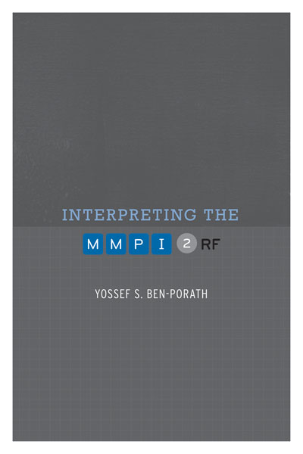
TRAINING SLIDES FOR:
INTERPRETING THE MMPI-2-RF
MMPI-2-RF Training Slides, University of Minnesota Press, 2015. Copyright for all MMPI® and MMPI-2-RF® materials are held by the Regents of the University of Minnesota.

Slide 2
Chapters 6-8: - Interpreting the mmpi-2-rf validity scales - interpreting the mmpi-2-rf substantive scales - interpreting the mmpi-2-rf: recommended framework and process

Slide 3
MMPI-2-RF Interpretation
Scale-by-scale interpretive recommendations in:
Chapter 6 - Validity Scales

Slide 4
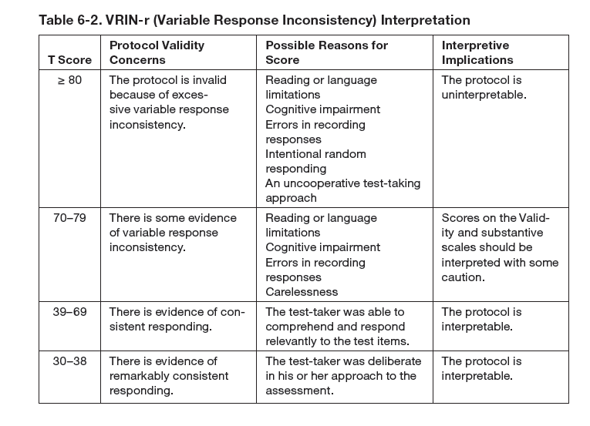

Slide 5
MMPI-2-RF Interpretation
Scale-by-scale interpretive recommendations in:
Chapter 6 - Validity Scales
Chapter 7 - Substantive Scales

Slide 6
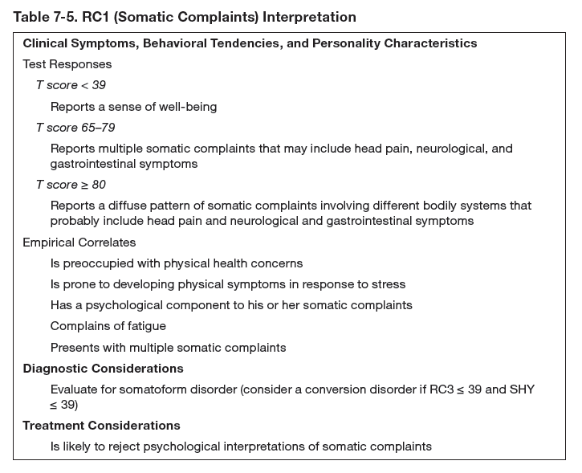

Slide 7
MMPI-2-RF Interpretation
Scale-by-scale interpretive recommendations in:
Chapter 6 - Validity Scales
Chapter 7 - Substantive Scales
Framework and Process for MMPI-2-RF Interpretation (Chapter 8)
Framework and Sources

Slide 8
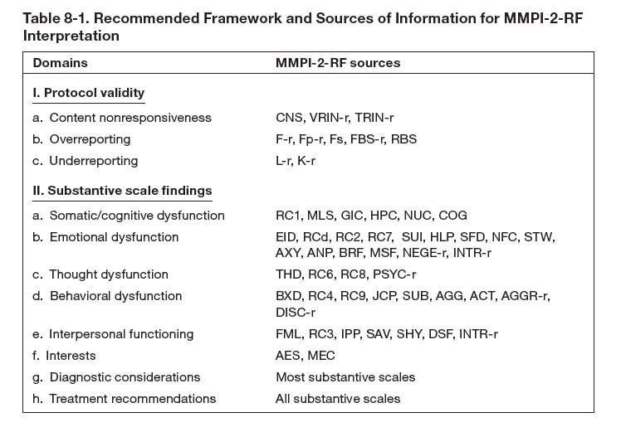

Slide 9
MMPI-2-RF Interpretation
Scale-by-scale interpretive recommendations in:
Chapter 6 - Validity Scales
Chapter 7 - Substantive Scales
Framework and Process for MMPI-2-RF Interpretation (Chapter 8)
Framework and Sources
Interpretation Worksheet

Slide 10
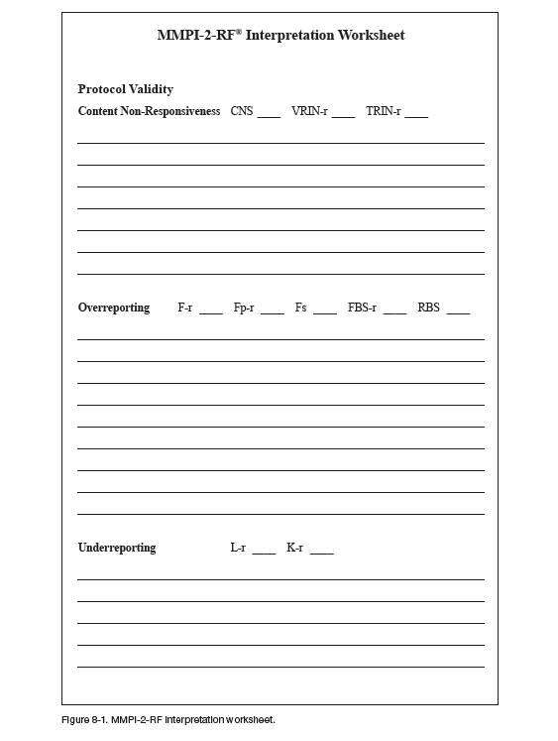

Slide 11
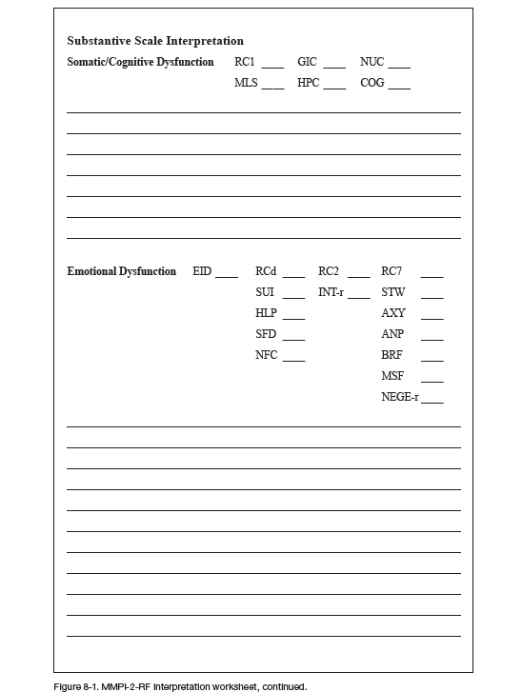

Slide 12
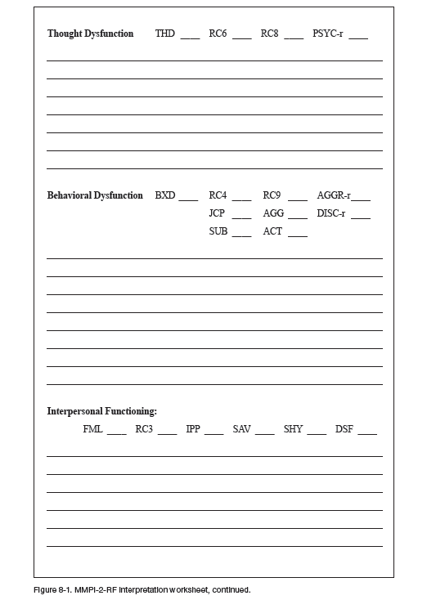

Slide 13
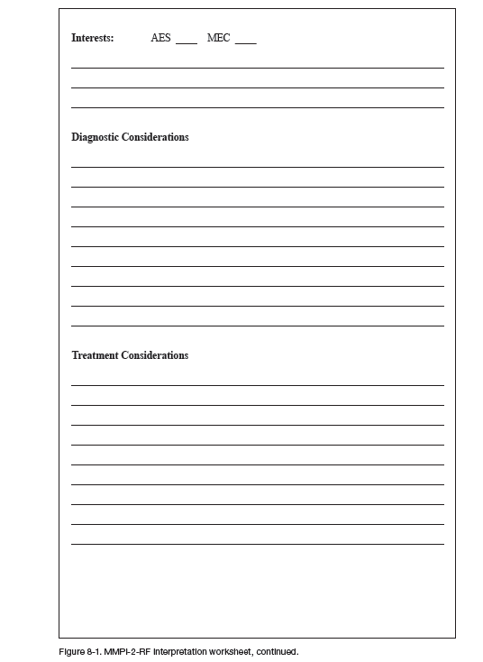

Slide 14
MMPI-2-RF Interpretation
Scale-by-scale interpretive recommendations in:
Chapter 6 - Validity Scales
Chapter 7 - Substantive Scales
Framework and Process for MMPI-2-RF Interpretation (Chapter 8)
Framework and Sources
Interpretation Worksheet
Validity Scale Interpretation
Threats to Protocol Validity and Confounds

Slide 15
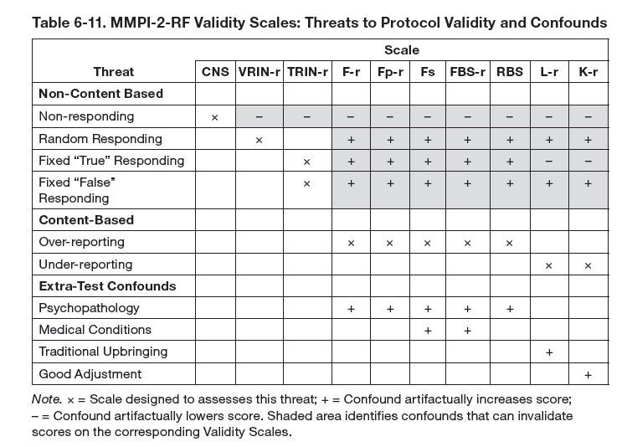

Slide 16
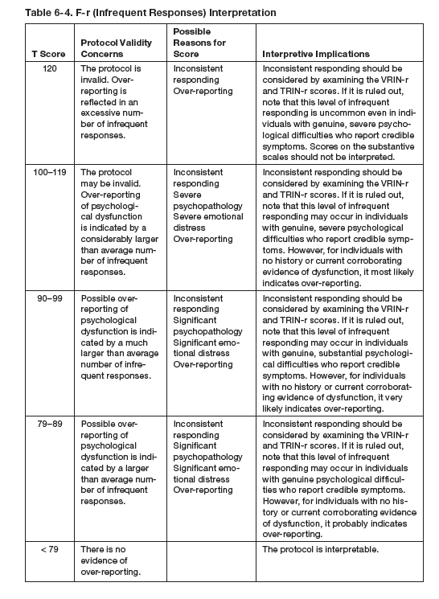

Slide 17
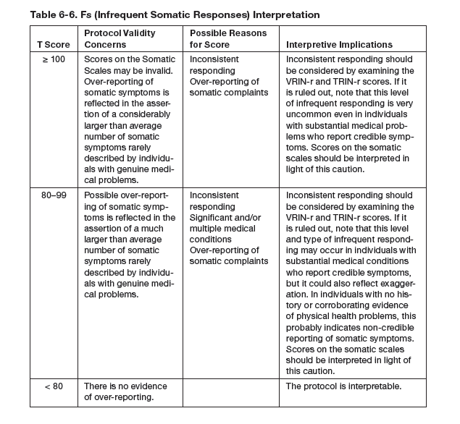

Slide 18
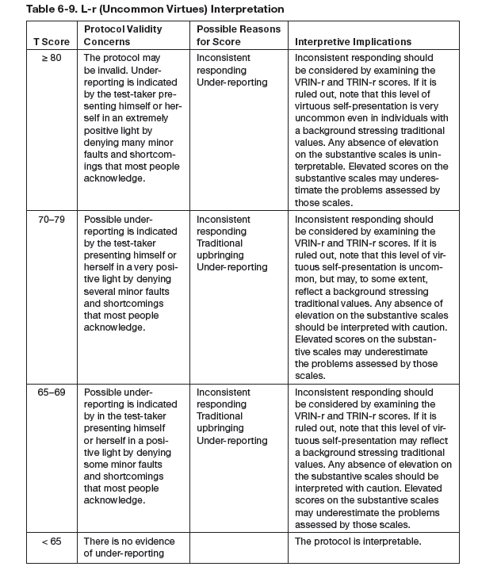

Slide 19
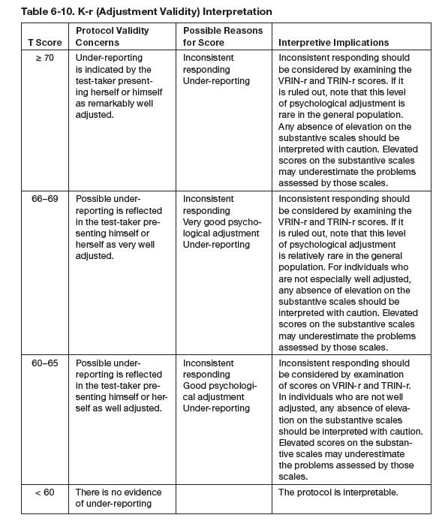

Slide 20
MMPI-2-RF Interpretation
Scale-by-scale interpretive recommendations in:
Chapter 6 - Validity Scales
Chapter 7 - Substantive Scales
Framework and Process for MMPI-2-RF Interpretation (Chapter 8)
Framework and Sources
Interpretation Worksheet
Validity Scale Interpretation
Threats to Protocol Validity and Confounds
Examples

Slide 21
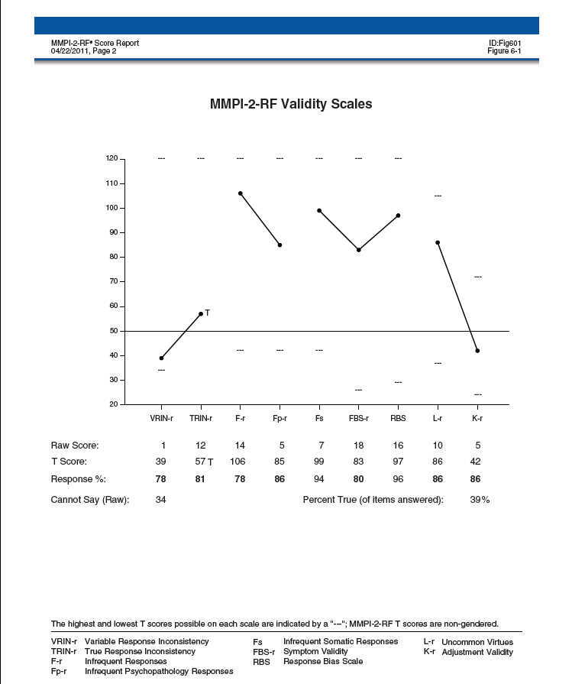

Slide 22
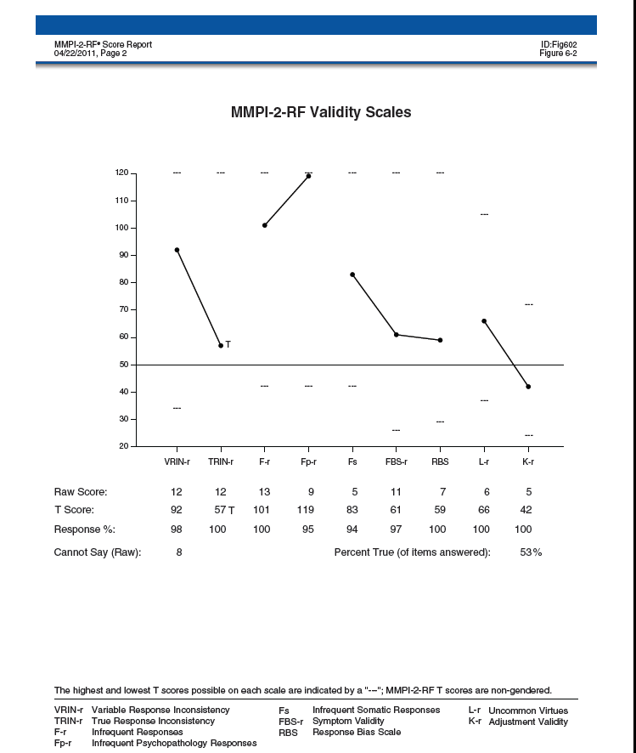

Slide 23
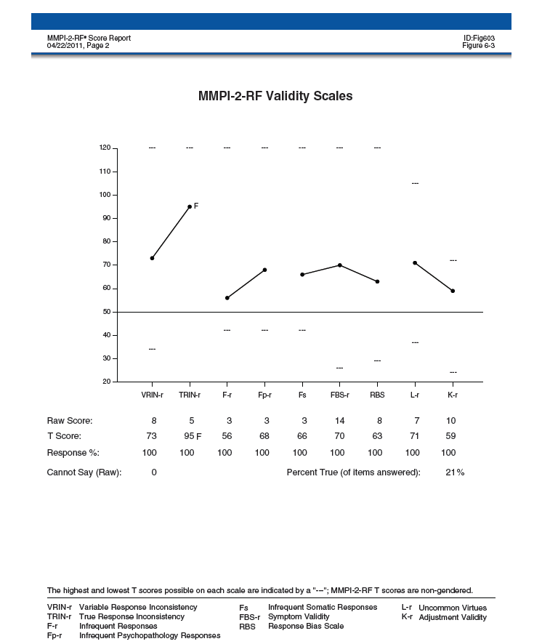

Slide 24
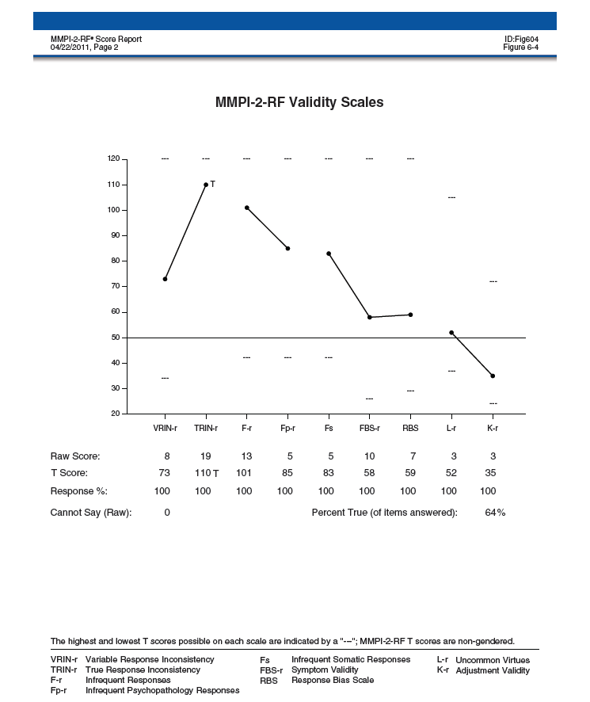

Slide 25
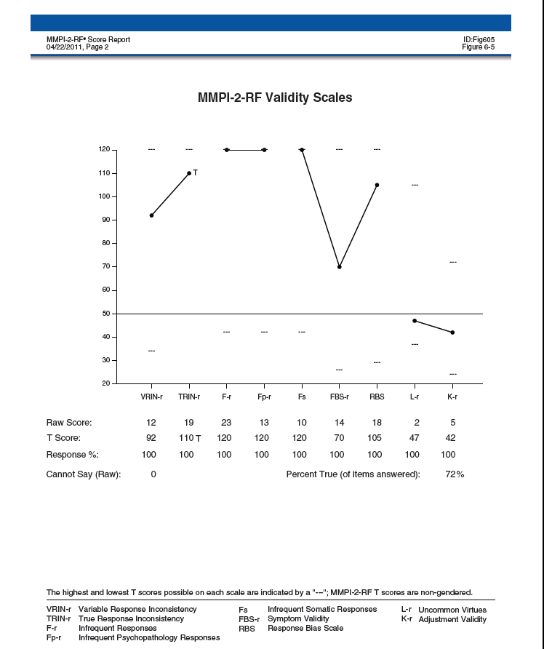

Slide 26
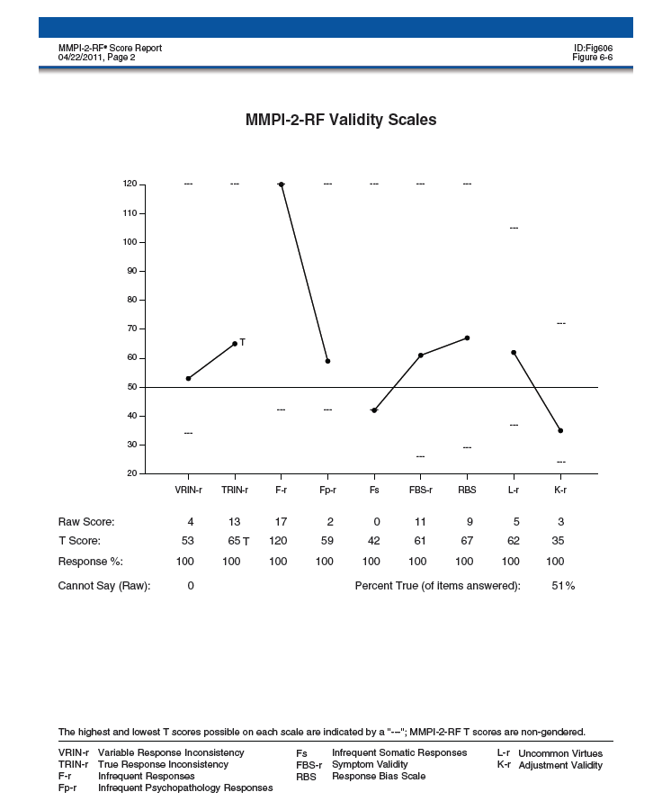

Slide 27
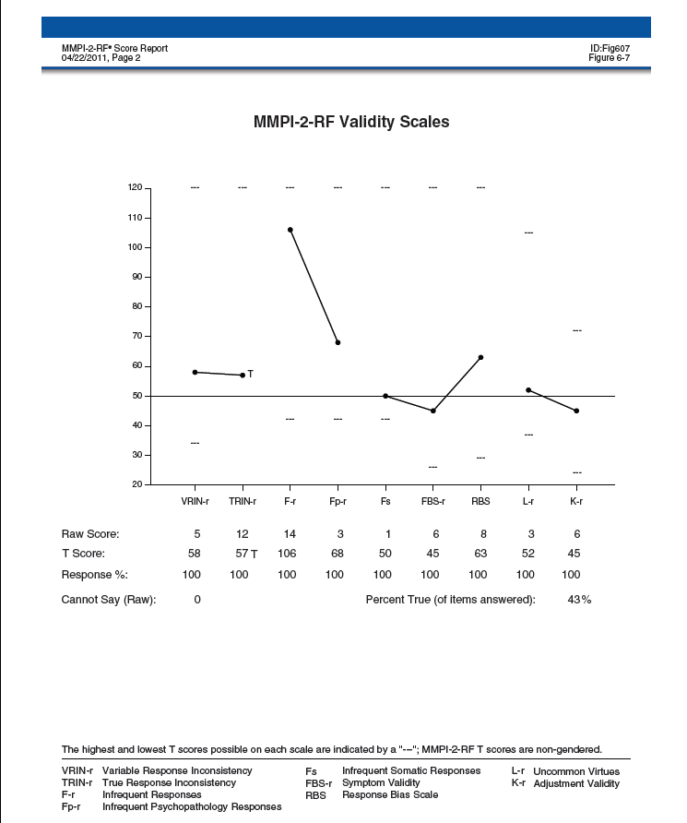

Slide 28
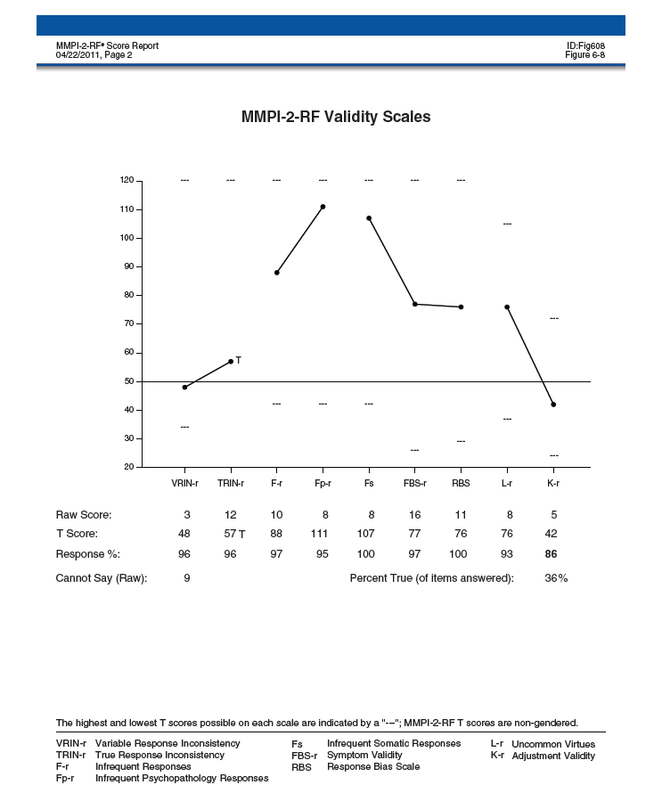

Slide 31
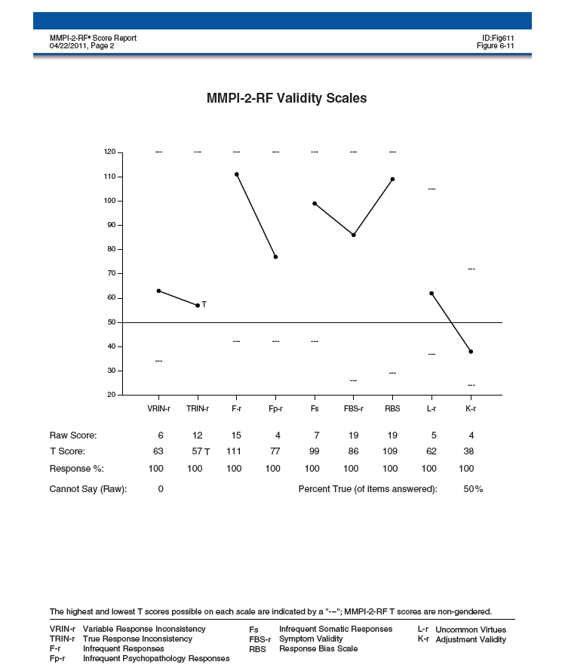

Slide 32
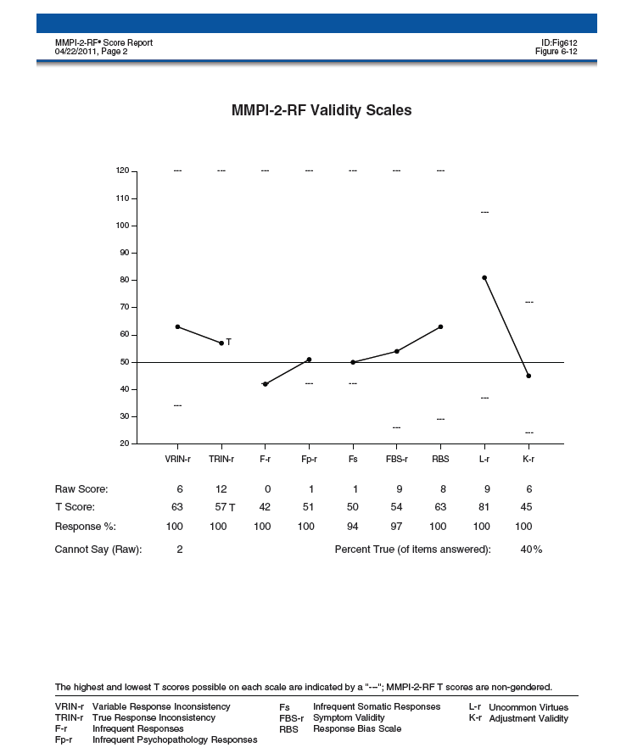

Slide 33
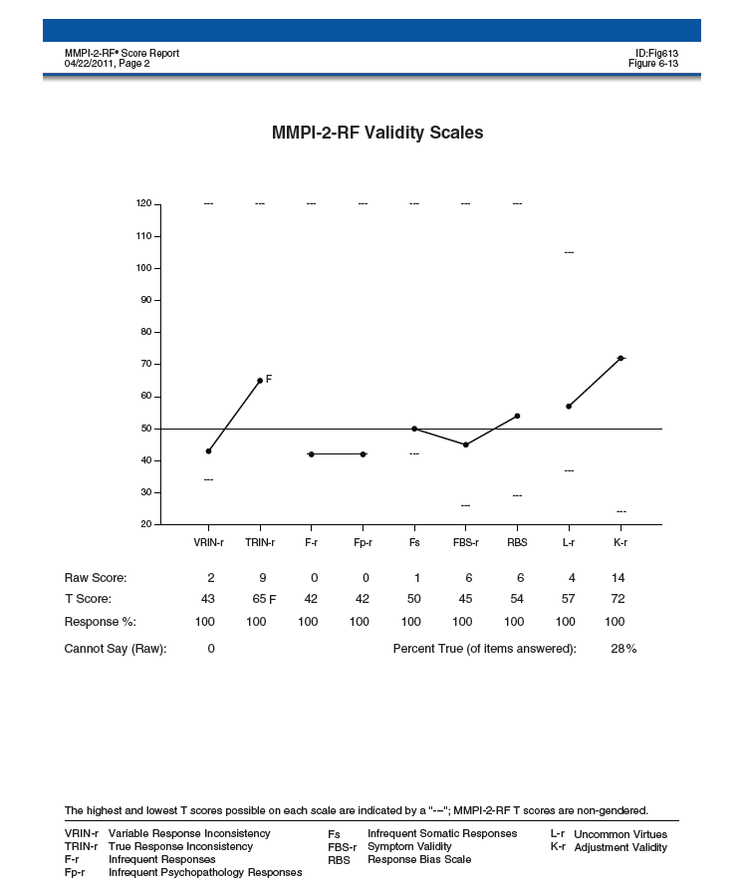

Slide 34
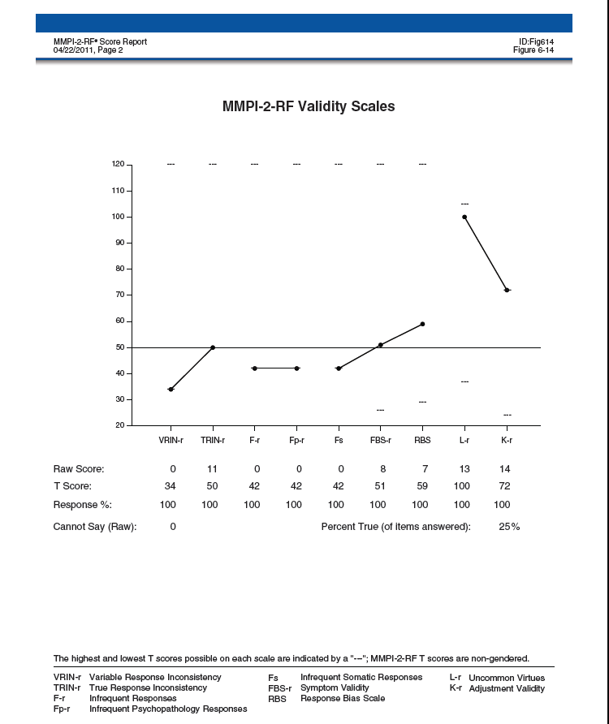

Slide 35
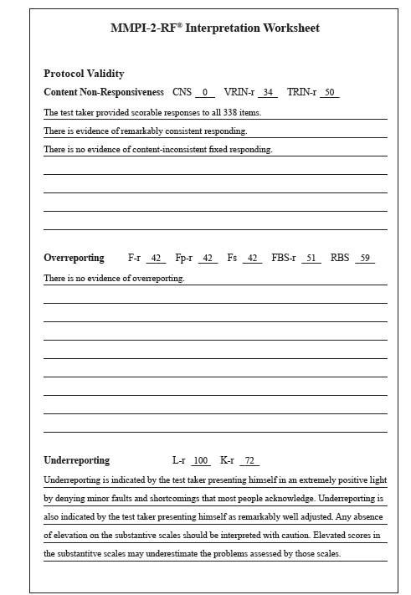

Slide 36
MMPI-2-RF Interpretation
Substantive Scale Interpretation
Begin with Higher-Order Scales
If only one is elevated, use it as starting point then interpret all RC, Specific Problems, PSY-5 scales in that area
When interpreting RC Scales:
proceed in order of elevation
incorporate relevant SP Scales and PSY-5

Slide 38
MMPI-2-RF Interpretation
Substantive Scale Interpretation
Begin with Higher-Order Scales
If only one is elevated, use it as starting point then interpret all RC, Specific Problems, PSY-5 scales in that area
When interpreting RC Scales:
proceed in order of elevation
incorporate relevant SP Scales and PSY-5
If more than one H-O Scale is elevated, use highest as starting point, then proceed to next highest
If no H-O Scale is elevated, proceed to RC Scales and interpret by domain in order of elevation incorporating relevant SP and PSY-5 scales

Slide 39
MMPI-2-RF Interpretation
Substantive Scale Interpretation
Once all H-O and RC Scales are covered:
Interpret any remaining elevated SP Scales
Interpret Interpersonal and Interest scales
If relevant, add diagnostic and treatment considerations

Slide 40
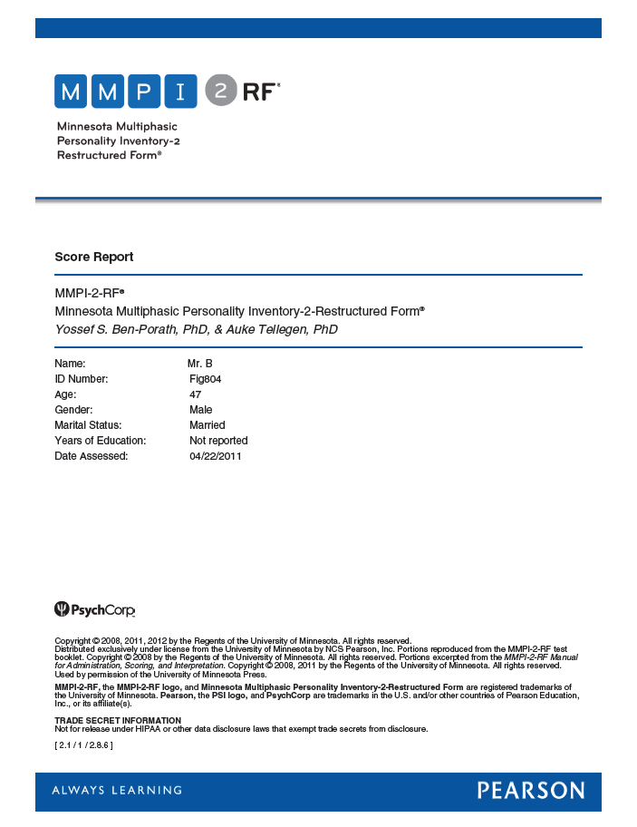

Slide 41
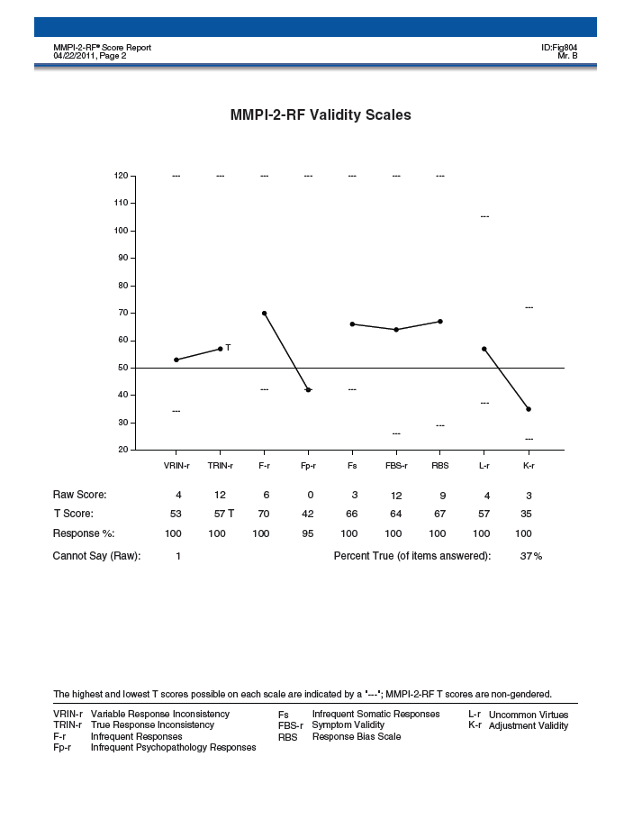

Slide 42
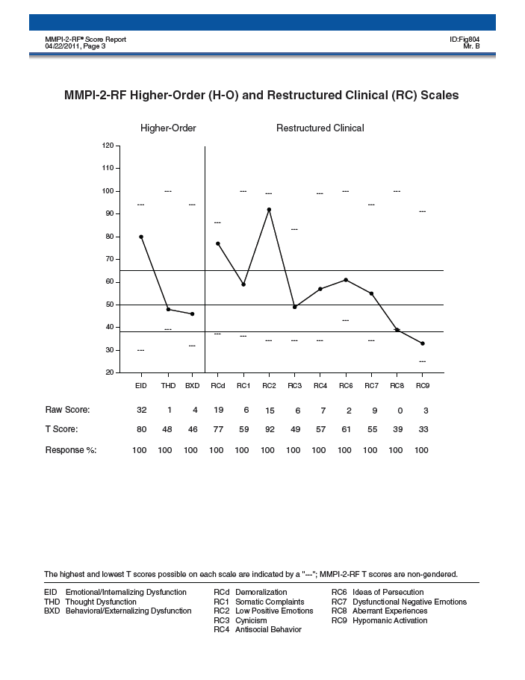

Slide 43
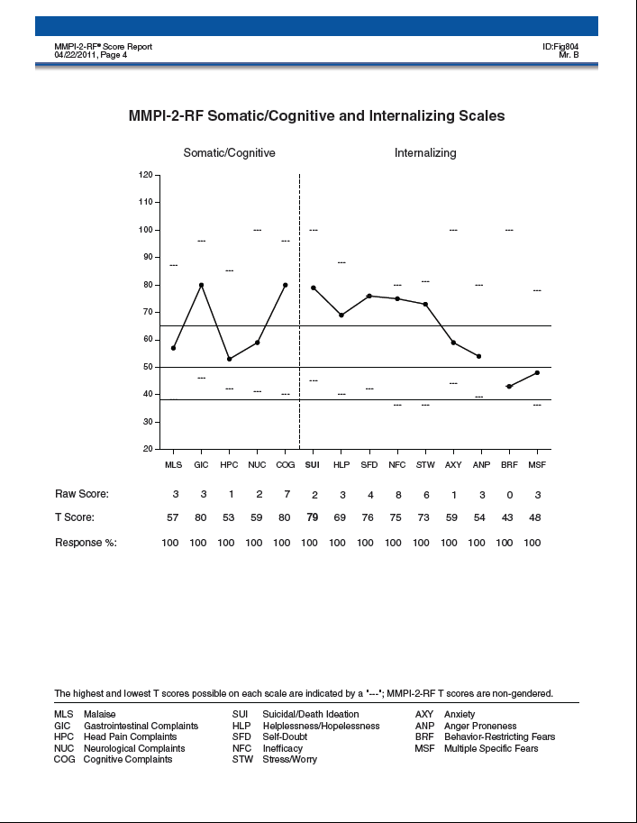

Slide 44
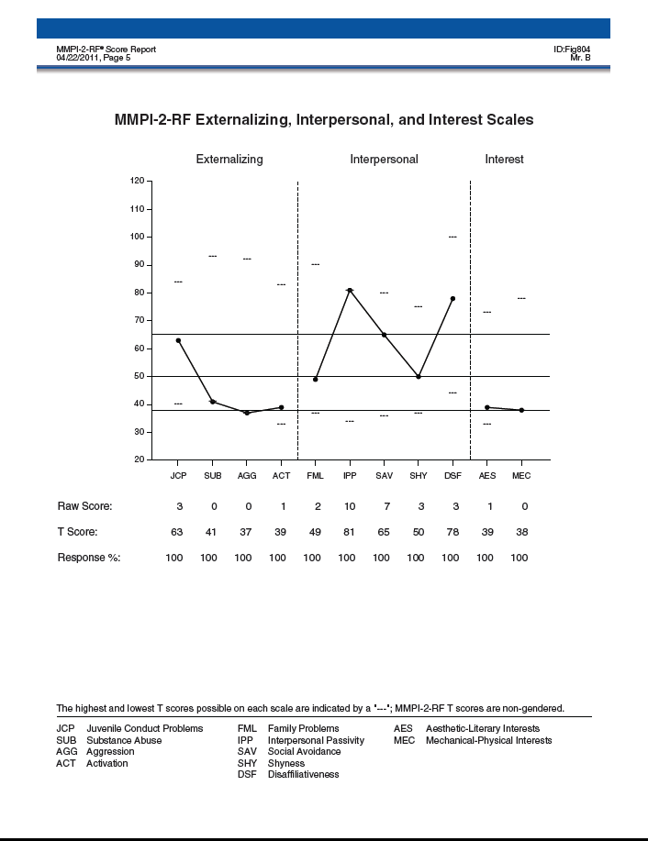

Slide 45
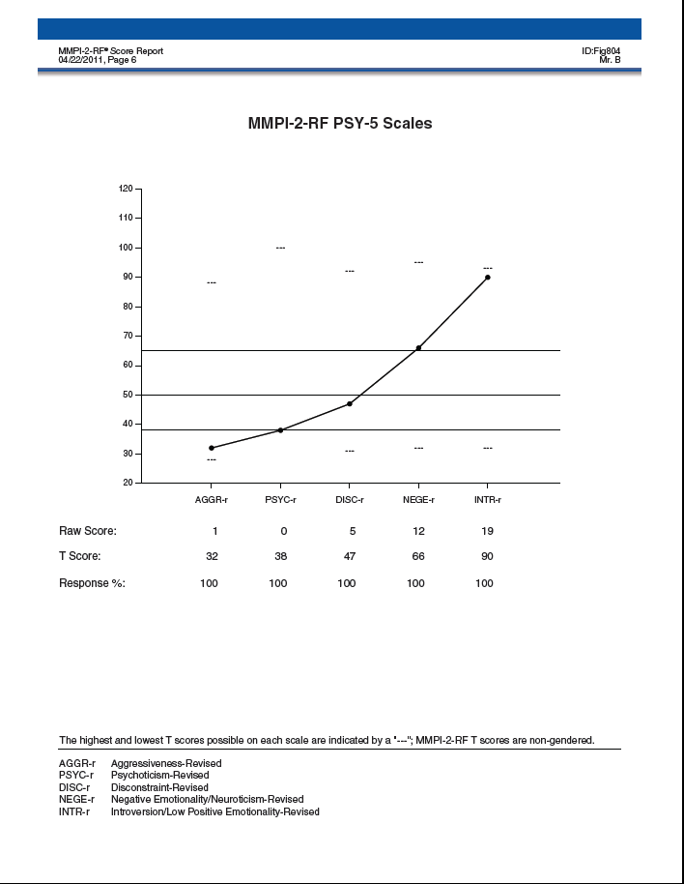

Slide 46
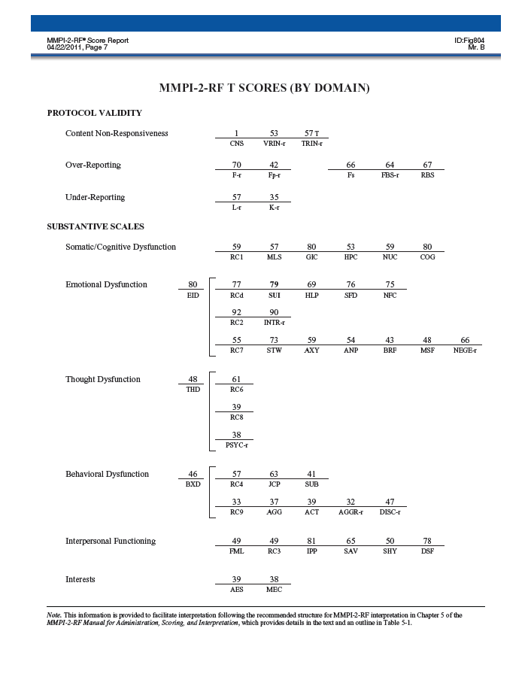

Slide 47
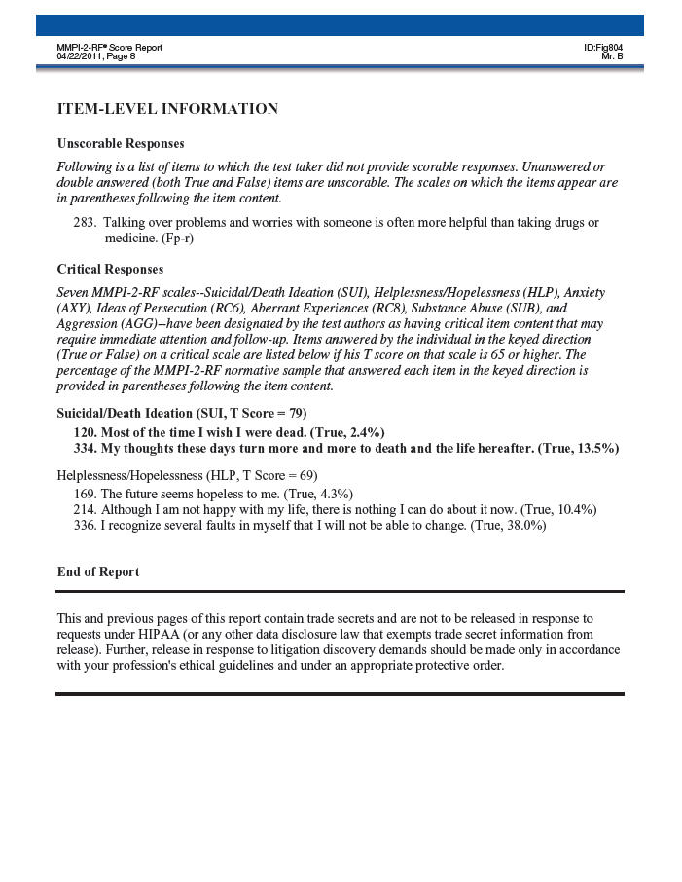
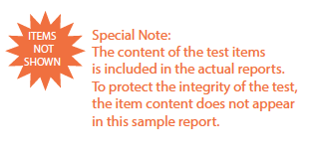

Slide 48
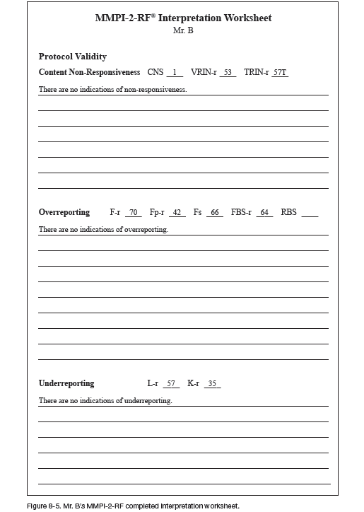

Slide 49
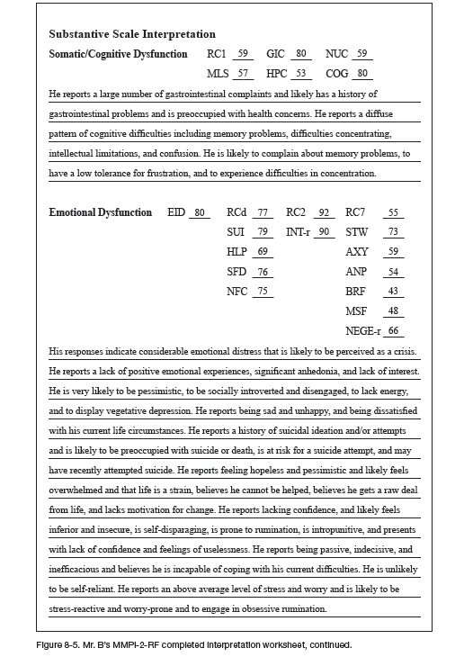

Slide 50
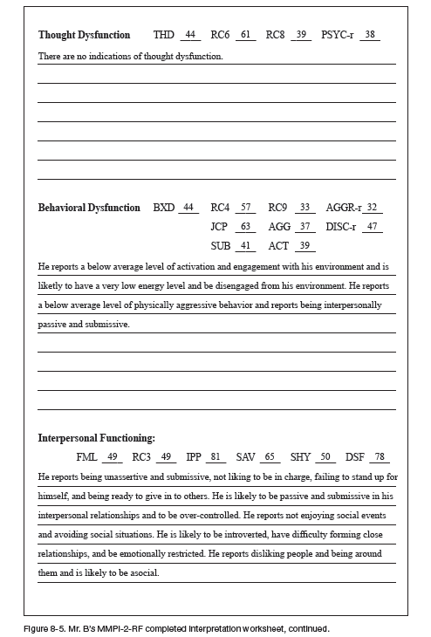

Slide 51
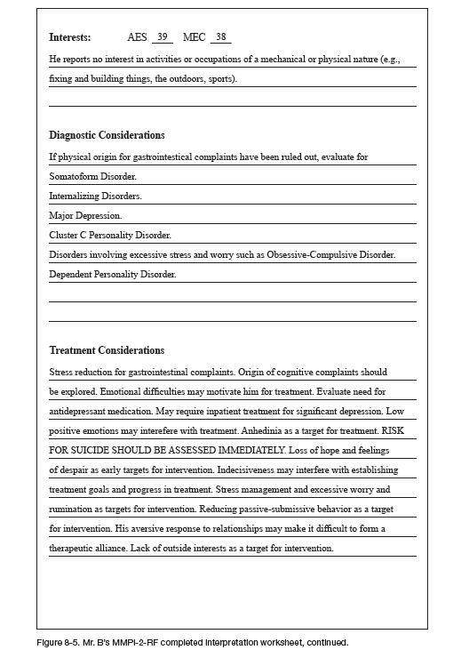

Slide 52
For additional information on this chapter, please reference:
Ben-Porath, Y.S. (2012). Interpreting the MMPI-2-RF. Minneapolis: University of Minnesota Press.

