Slide 1
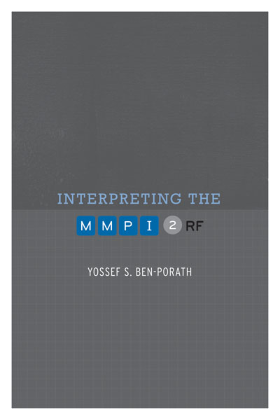
TRAINING SLIDES FOR:
INTERPRETING THE MMPI-2-RF
MMPI-2-RF Training Slides, University of Minnesota Press, 2015. Copyright for all MMPI® and MMPI-2-RF® materials are held by the Regents of the University of Minnesota.

Slide 2
Chapter 5: Administration and Scoring

Slide 3
Administering and Scoring the MMPI-2-RF
Standard Procedures delineated in Manual for Administration, Scoring, and Interpretation
Administration:
Before Testing
Consider age
Inquire about prior testing experience
Assess Testability
Cognitive wherewithal
Vision
Reading Level
Use Standard Administration Modalities
Booklet and answer sheet
Computer

Slide 4
Administering and Scoring the MMPI-2-RF
Scoring:
Normative Sample:
MMPI-2 Normative Sample Collected in mid-1980s
Non-gendered norms (1,138 men, 1,138 women)

Slide 5
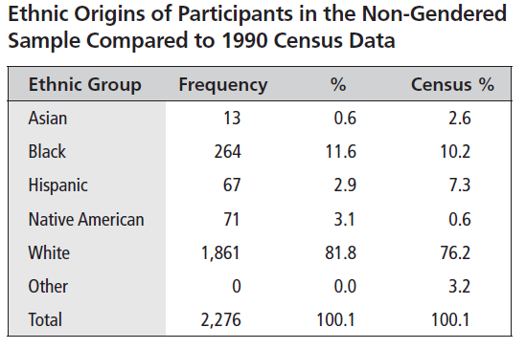
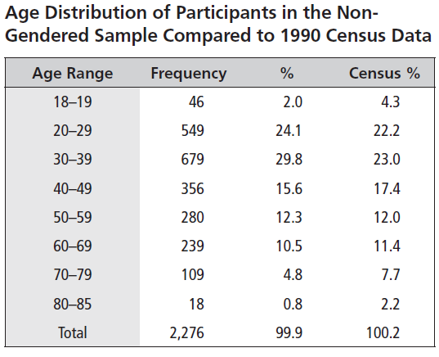
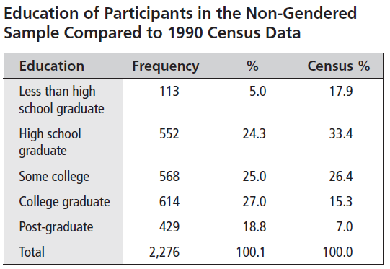

Slide 6
Administering and Scoring the MMPI-2-RF
Scoring:
Normative Sample:
MMPI-2 Normative Sample Collected in 1980s
Non-gendered norms (1,138 men, 1,138 women)
Norms appear to be holding up well (Technical Manual Appendix C)

Slide 7
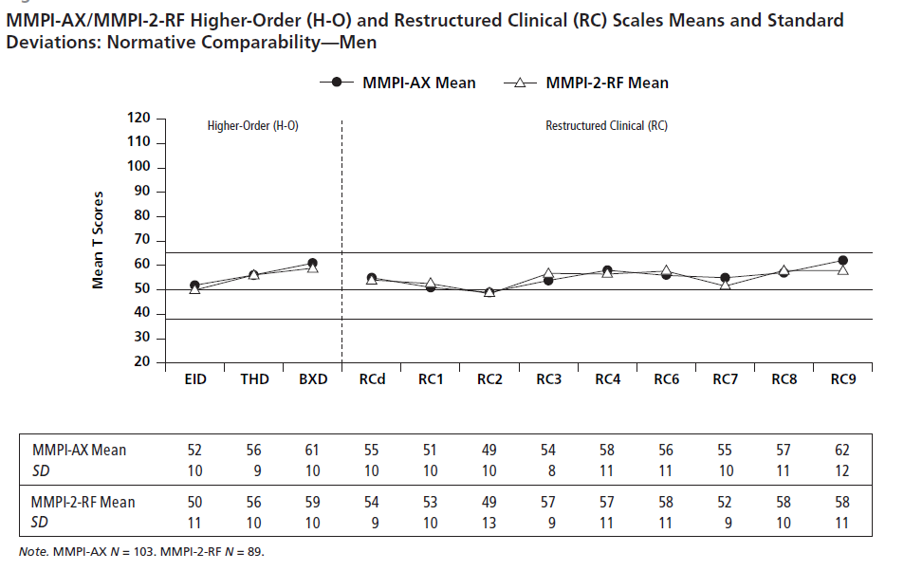

Slide 8
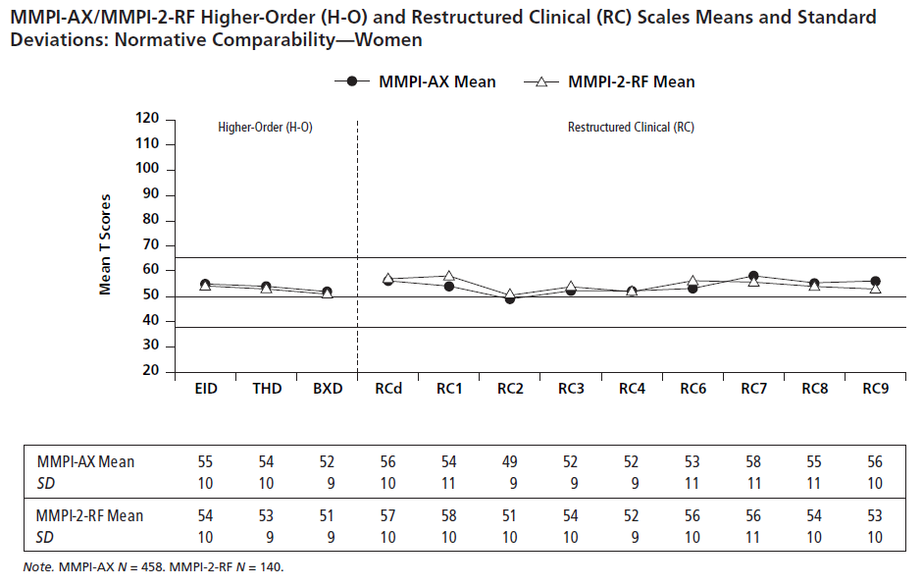

Slide 9
Administering and Scoring the MMPI-2-RF
Scoring:
Normative Sample:
MMPI-2 Normative Sample Collected in 1980s
Non-gendered norms (1,138 men, 1,138 women)
Norms appear to be holding up well (Technical Manual Appendix C)
Uniform T scores

Slide 10
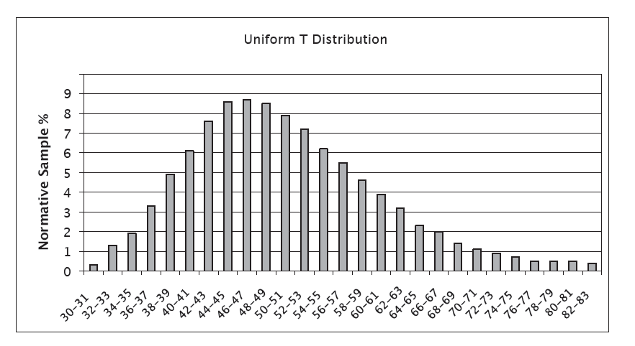

Slide 11
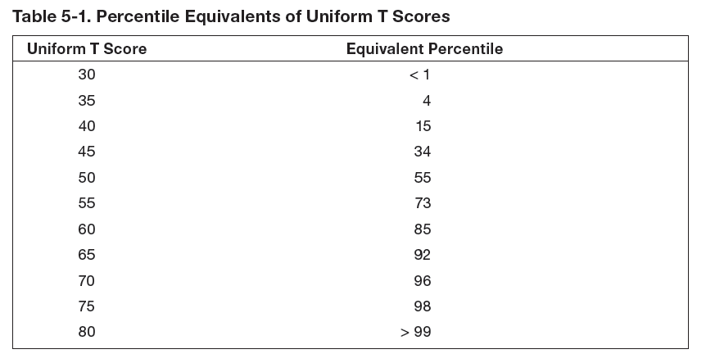

Slide 12
Administering and Scoring the MMPI-2-RF
Scoring:
Normative Sample:
MMPI-2 Normative Sample Collected in 1980s
Non-gendered norms (1,138 men, 1,138 women)
Norms appear to be holding up well (Technical Manual Appendix C)
Uniform T scores
Comparison Groups
Technical Manual Appendix D

Slide 13
MMPI-2-RF: Standard Comparison Groups
MMPI-2-RF Normative (Men & Women)
Outpatient, Community Mental Health Center (Men & Women)
Outpatient, Independent Practice (Men & Women)
Psychiatric Inpatient, Community Hospital (Men & Women)
Psychiatric Inpatient, VA Hospital (Men)
Substance Abuse Treatment, VA (Men)
Bariatric Surgery Candidate (Men & Women)
Spine Surgery/Spinal Cord Stimulator Candidates (Men & Women)
Chronic Pain (Men & Women)
College Counseling Clinic (Men & Women)
College Student (Men & Women)
Forensic, Disability Claimant (Men & Women)
Forensic, Independent Neuropsychological Examination (Men & Women)
Forensic, Pre-trial Criminal (Men & Women)
Forensic, Child Custody (Men & Women)
Forensic, Parental Fitness Evaluees (Men & Women)
Prison Inmate (Men & Women)
Personnel Screening, Law Enforcement (Men, Women & Combined)
Personnel Screening, Corrections Officer (Men, Women & Combined)
Personnel Screening, Clergy Candidates (Men, Women, & Combined)

Slide 14
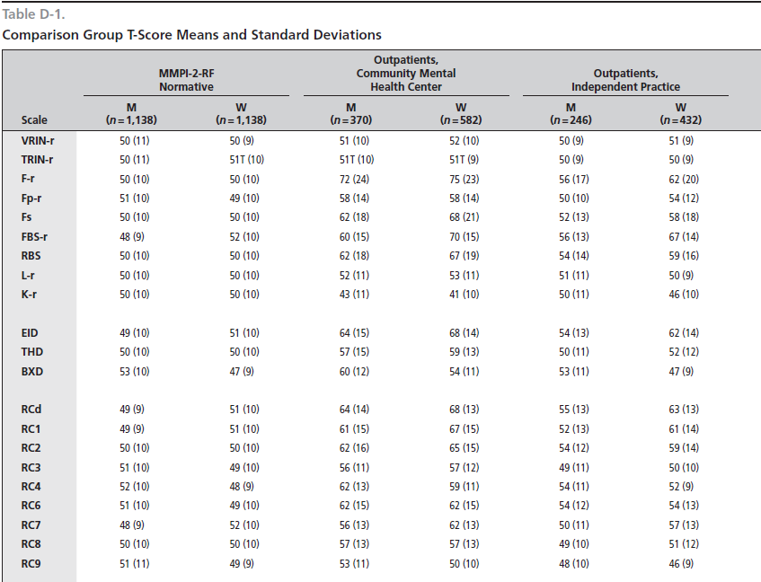

Slide 15
Administering and Scoring the MMPI-2-RF
Scoring:
Standard Scoring Modalities:
Hand scoring
Computer
Score Report

Slide 16
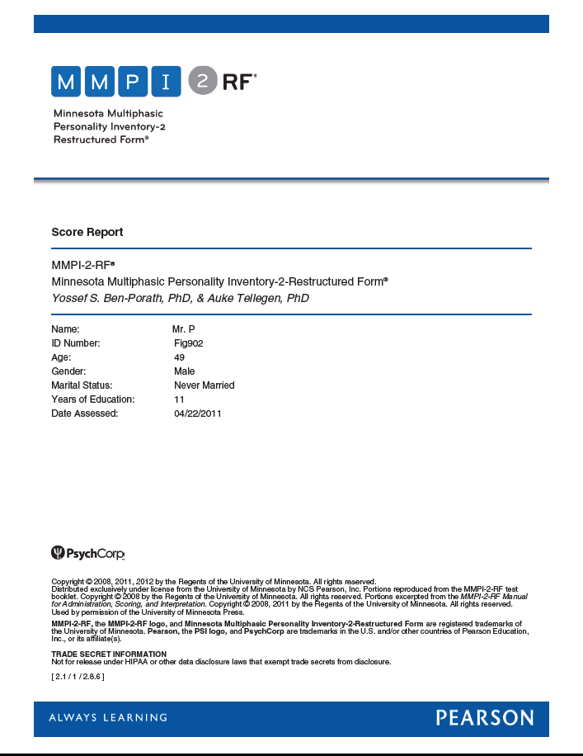

Slide 17
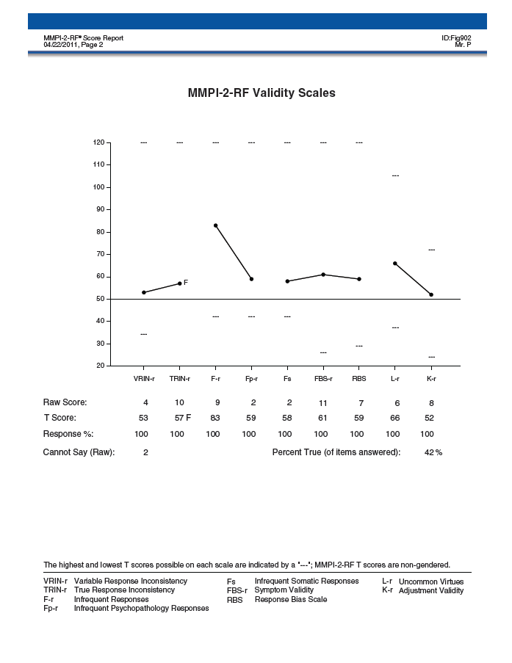

Slide 18
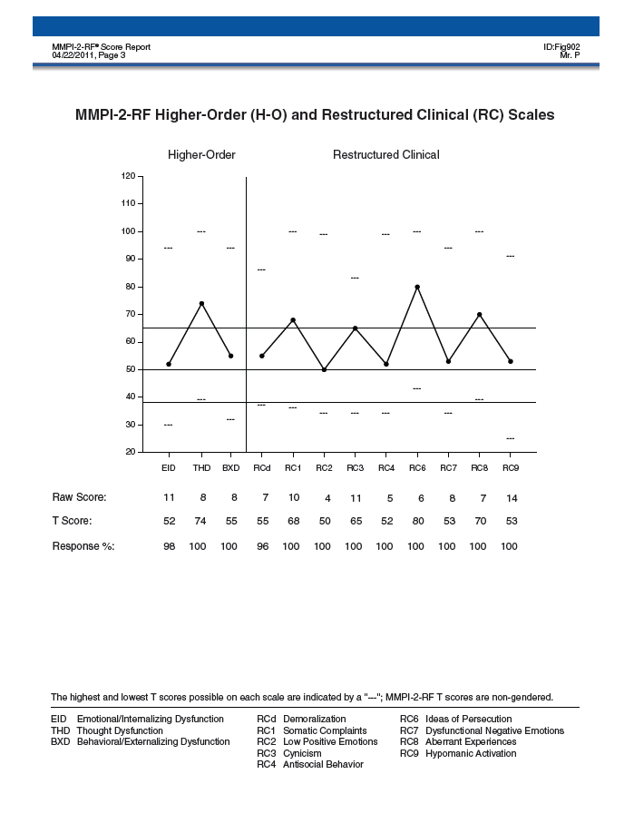

Slide 19
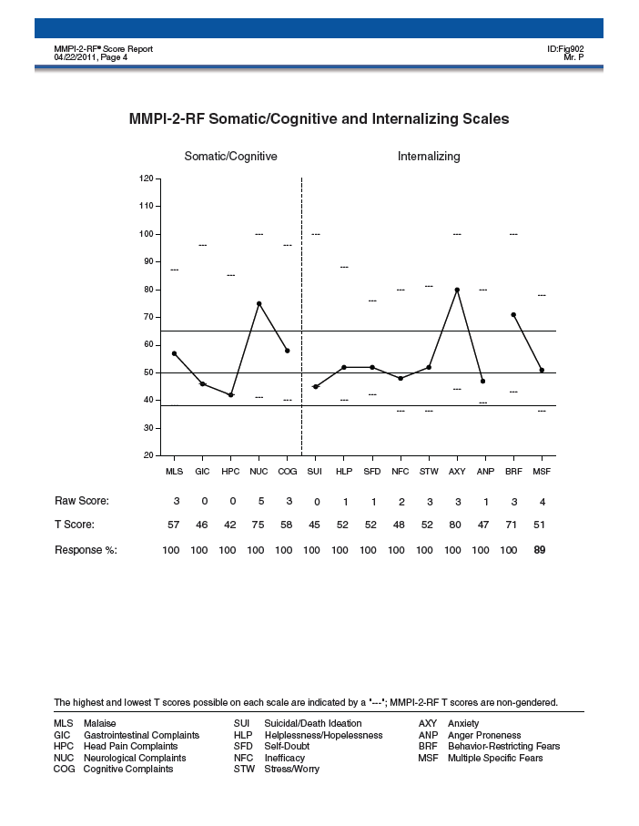

Slide 20
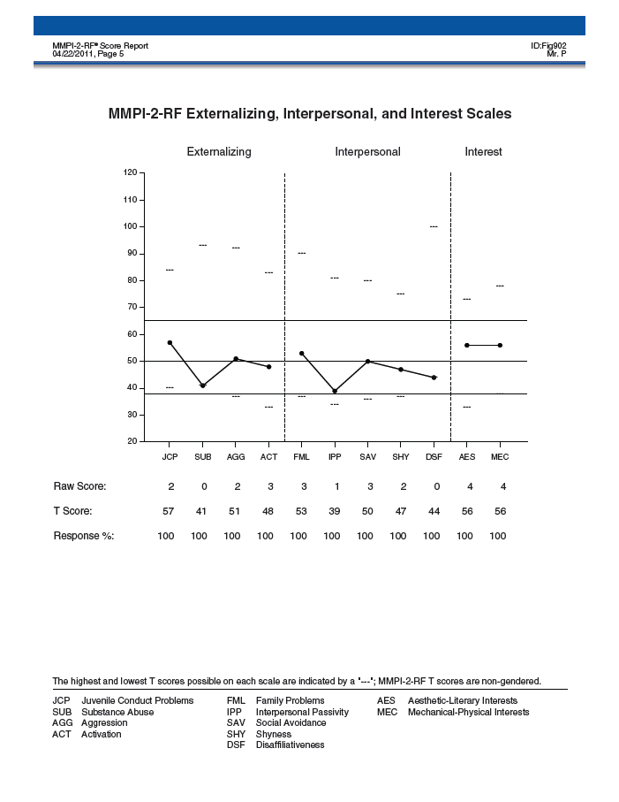

Slide 21
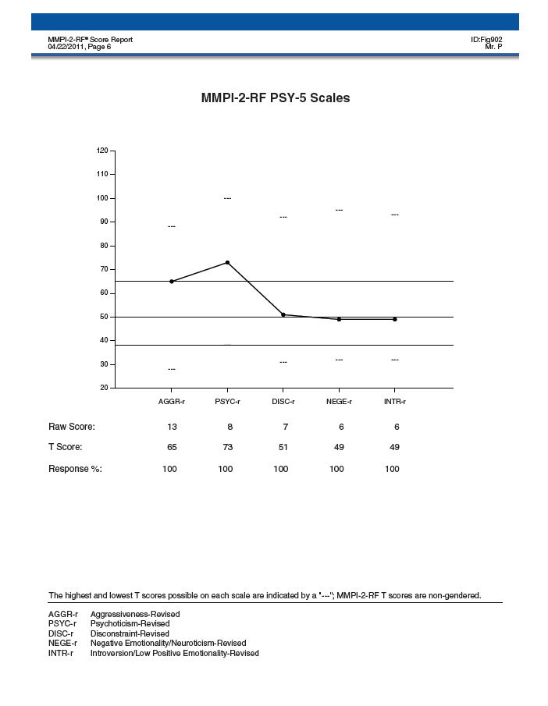

Slide 22
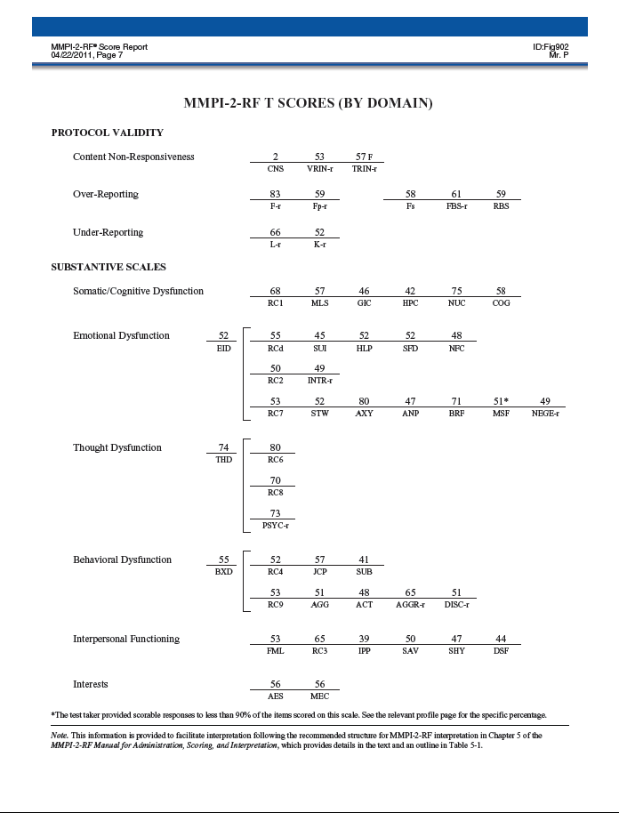

Slide 23
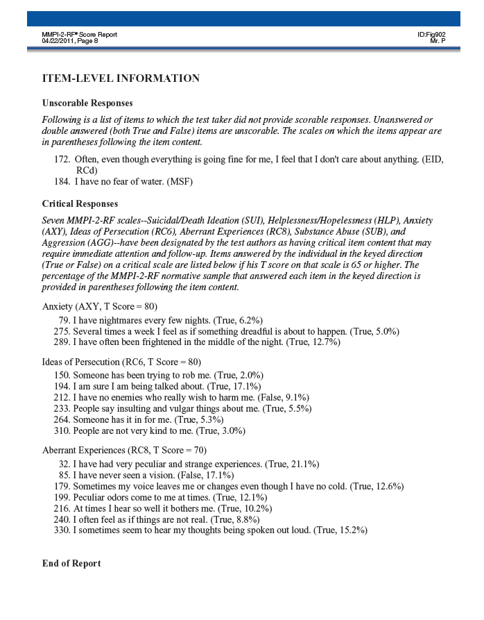
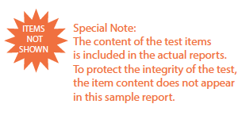

Slide 24
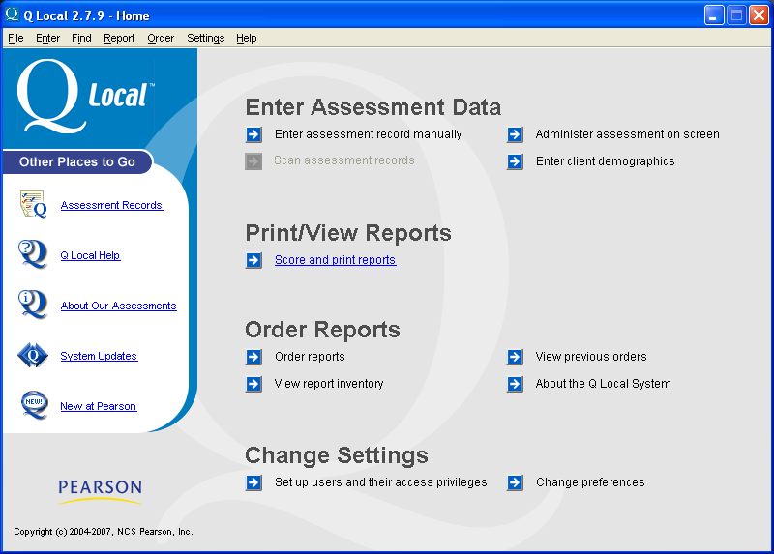

Slide 25
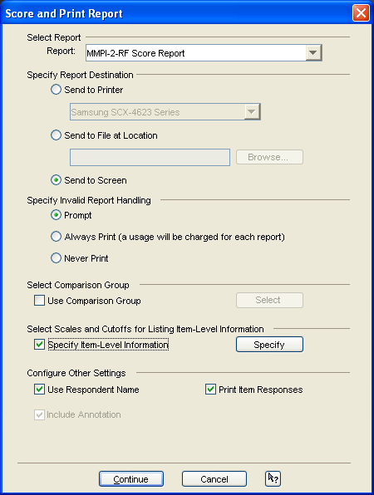

Slide 26
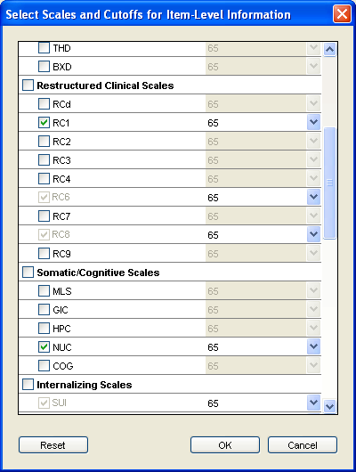

Slide 27
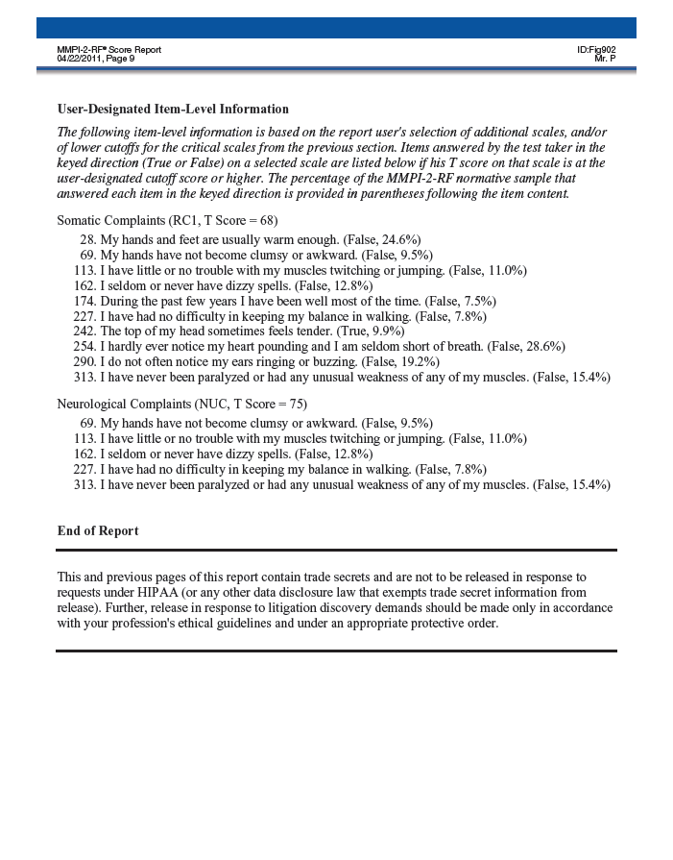

Slide 28
Administering and Scoring the MMPI-2-RF
Scoring:
Standard Scoring Modalities:
Hand scoring
Computer
Score Report
Comparison Groups (Standard and Custom)

Slide 29
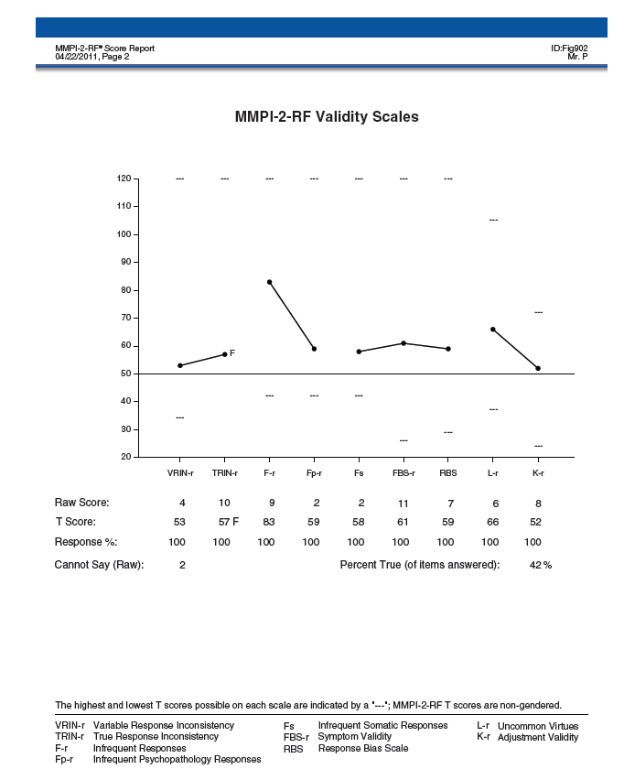

Slide 30
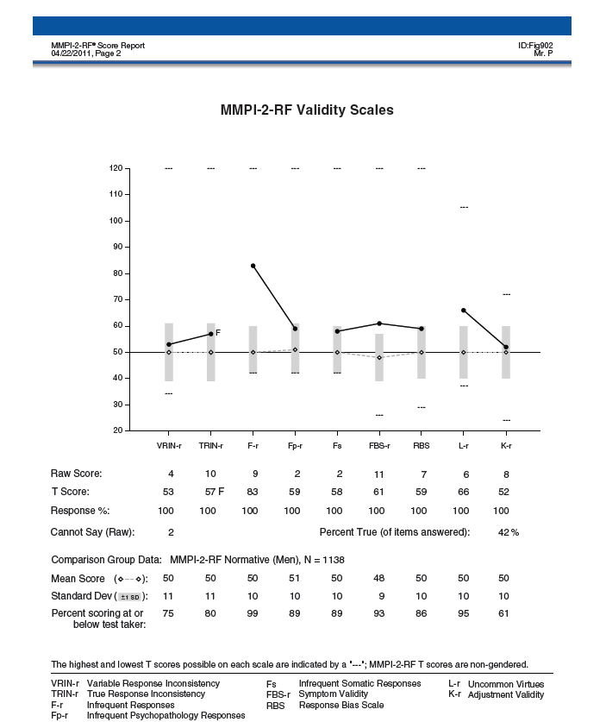

Slide 31
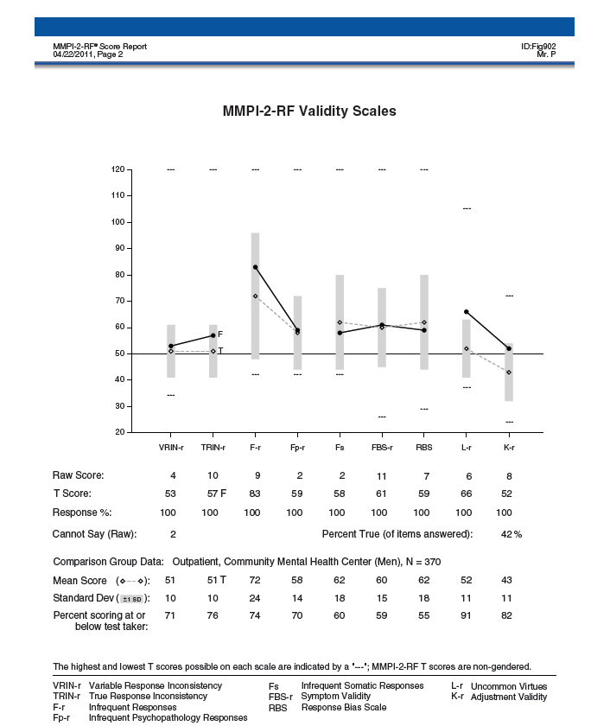

Slide 32
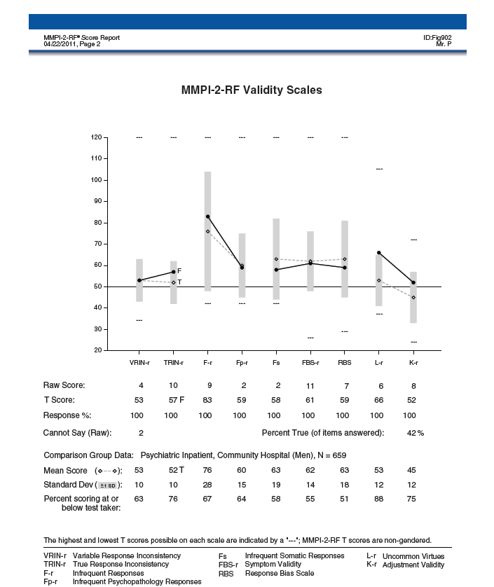

Slide 33
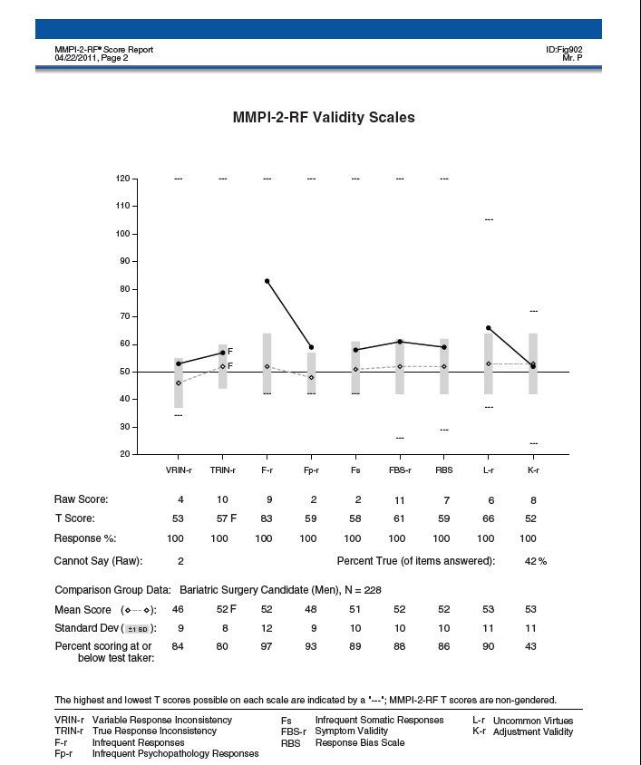

Slide 34
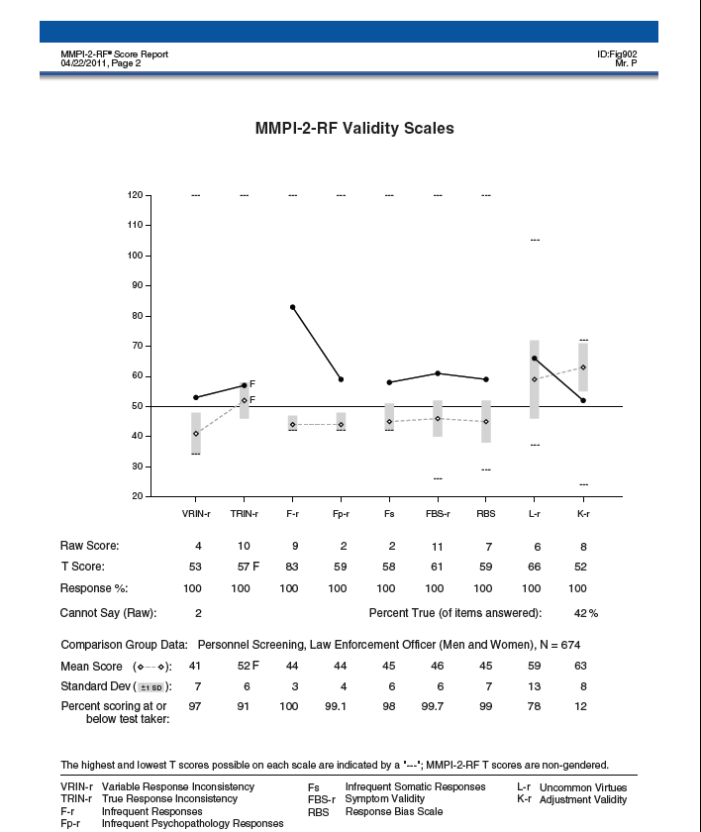

Slide 35
Comparison Group Generator

Slide 37
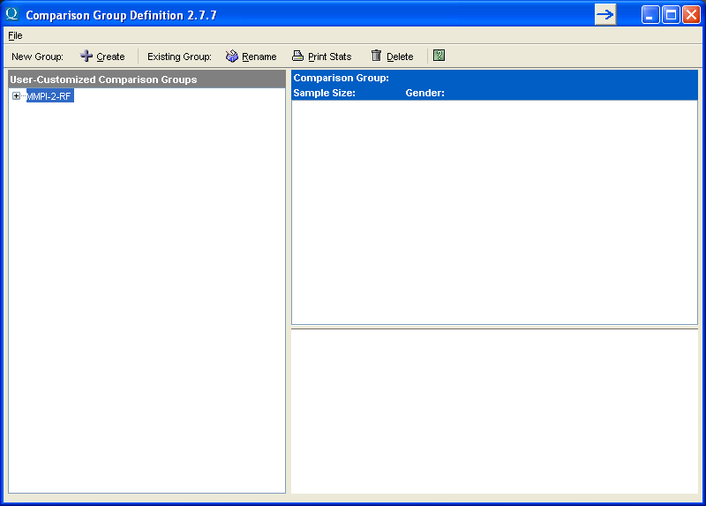

Slide 38
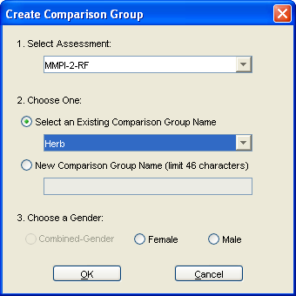

Slide 39
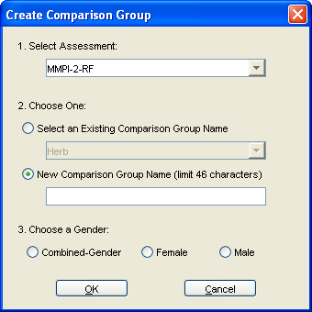

Slide 40
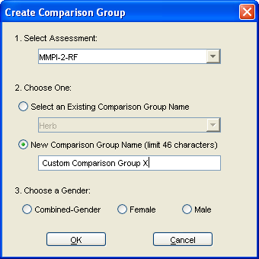

Slide 41
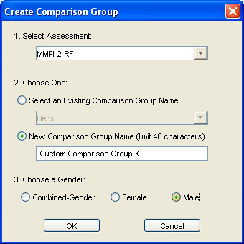

Slide 42
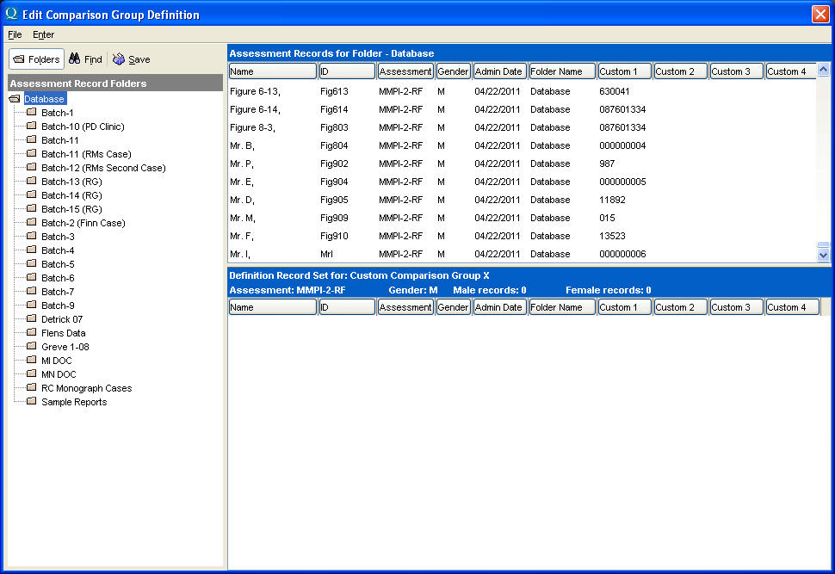

Slide 43
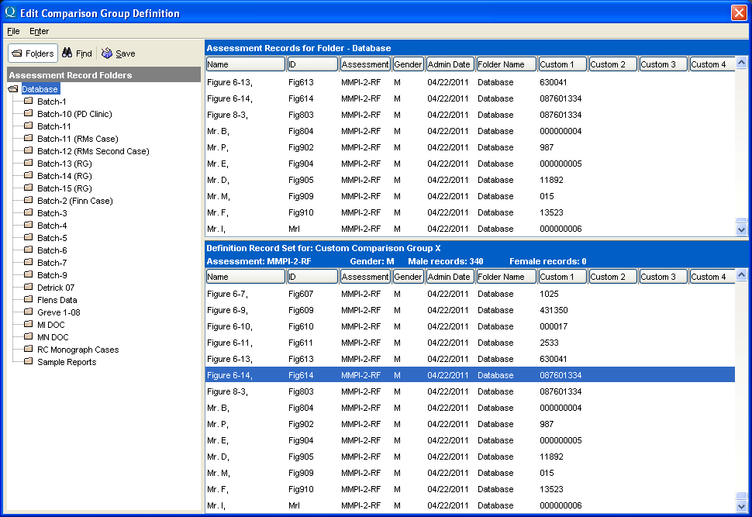

Slide 45
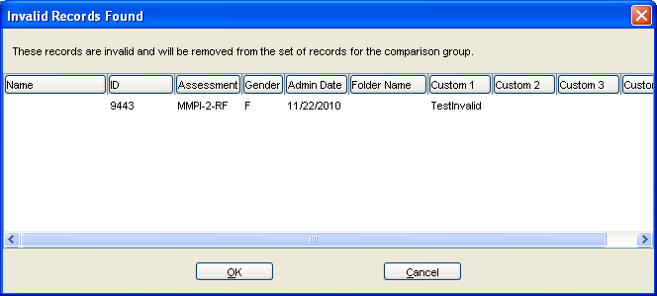

Slide 46
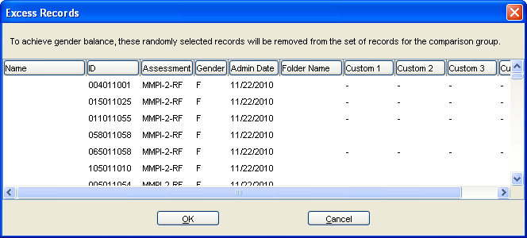

Slide 47
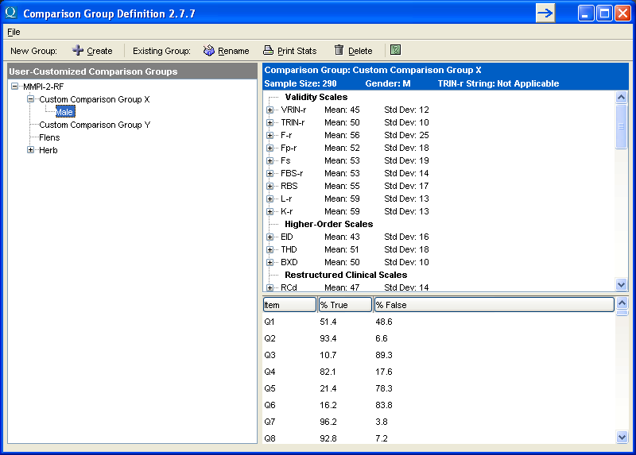

Slide 48
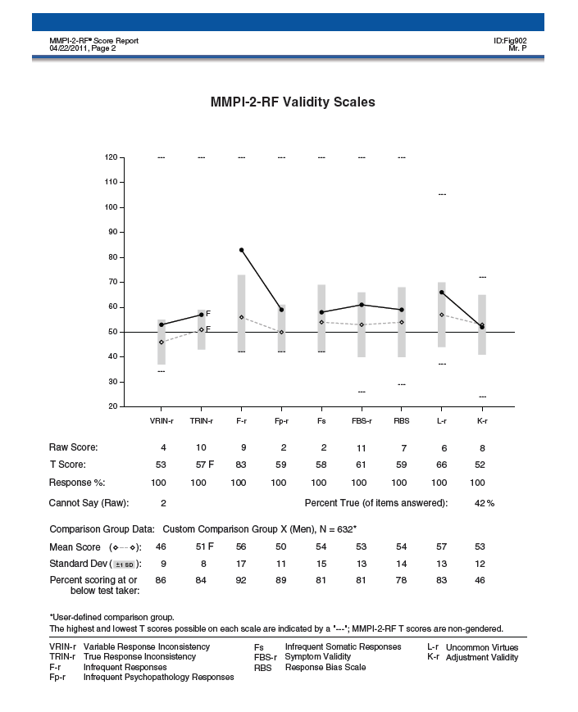

Slide 49
Administering and Scoring the MMPI-2-RF
Scoring:
Standard Scoring Modalities:
Hand scoring
Computer
Score Report
Comparison Groups
Interpretive Report

Slide 50
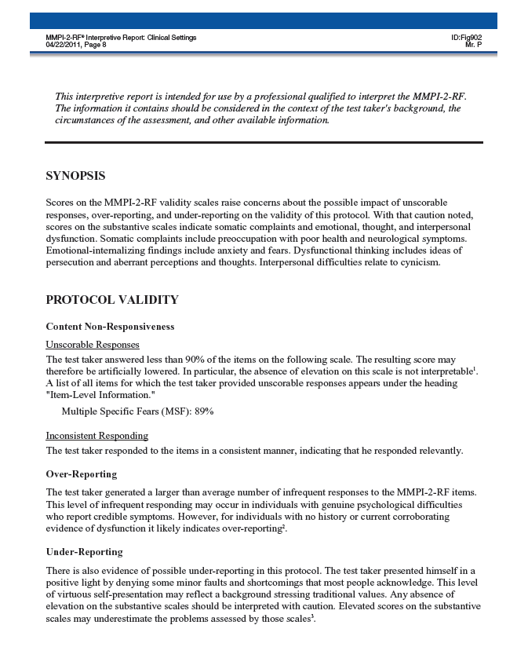

Slide 51
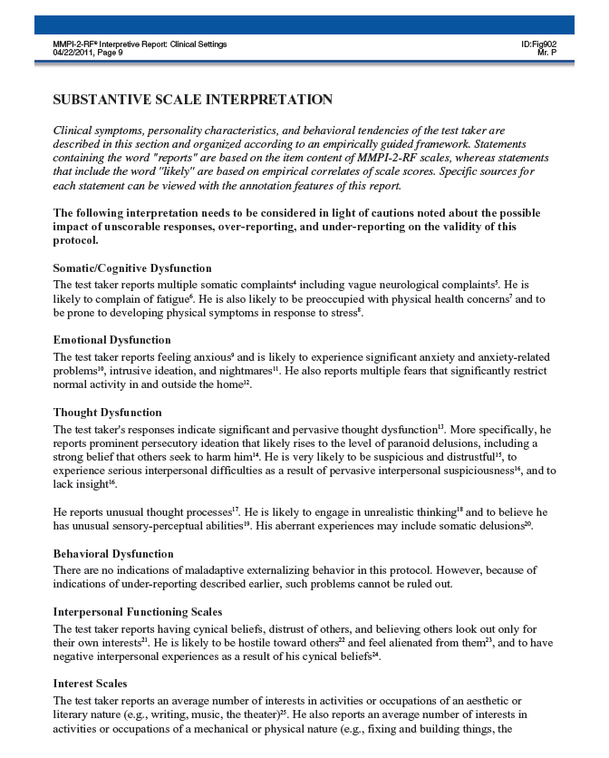

Slide 52
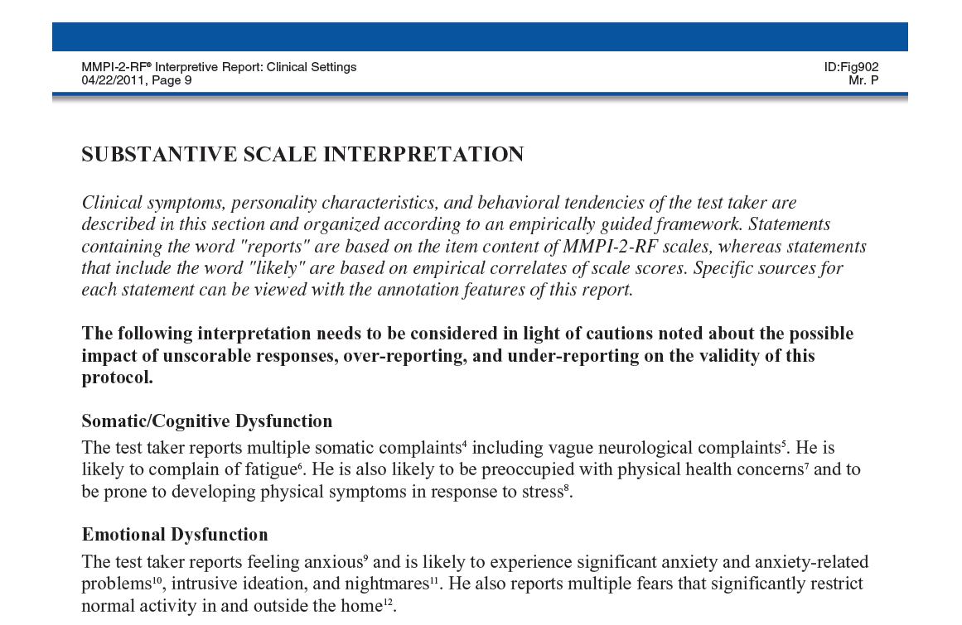

Slide 53
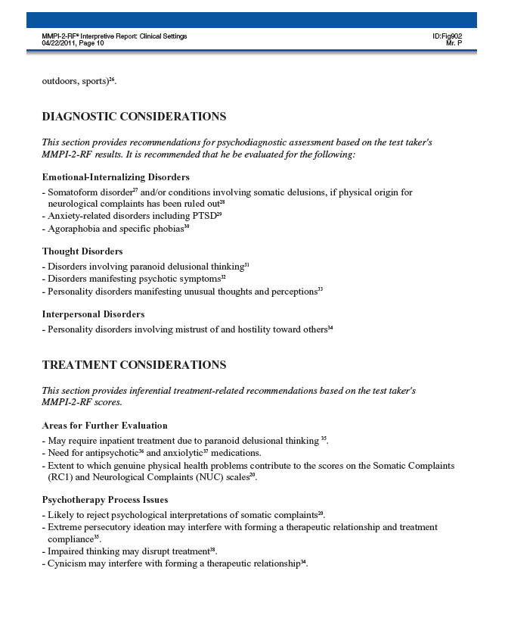

Slide 54
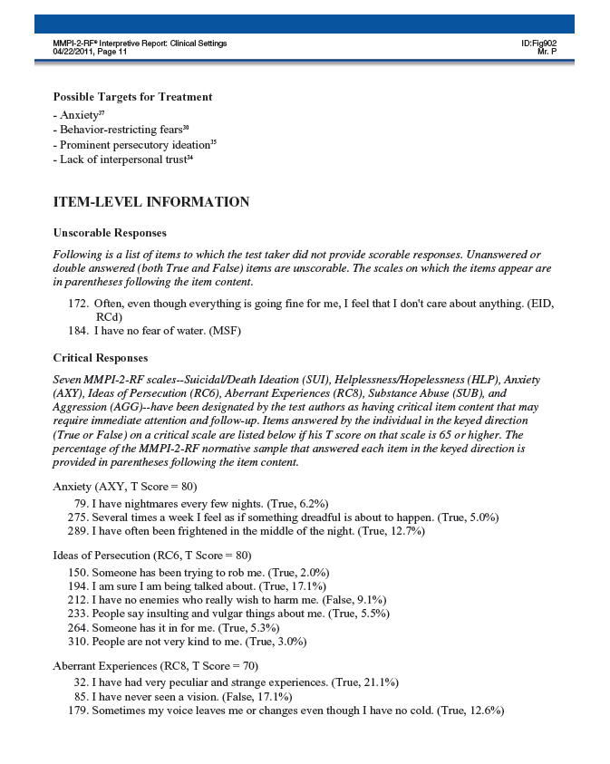

Slide 55
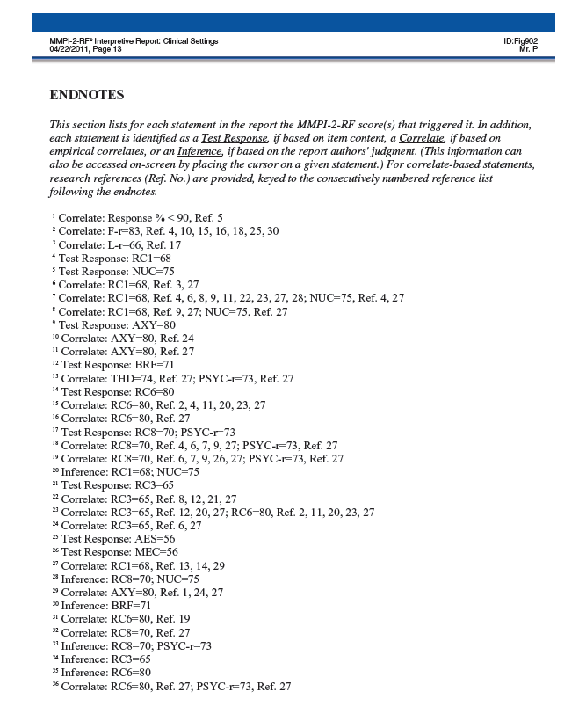

Slide 56
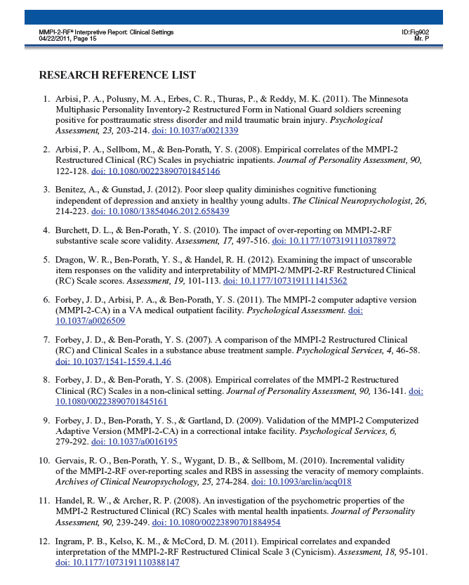

Slide 57
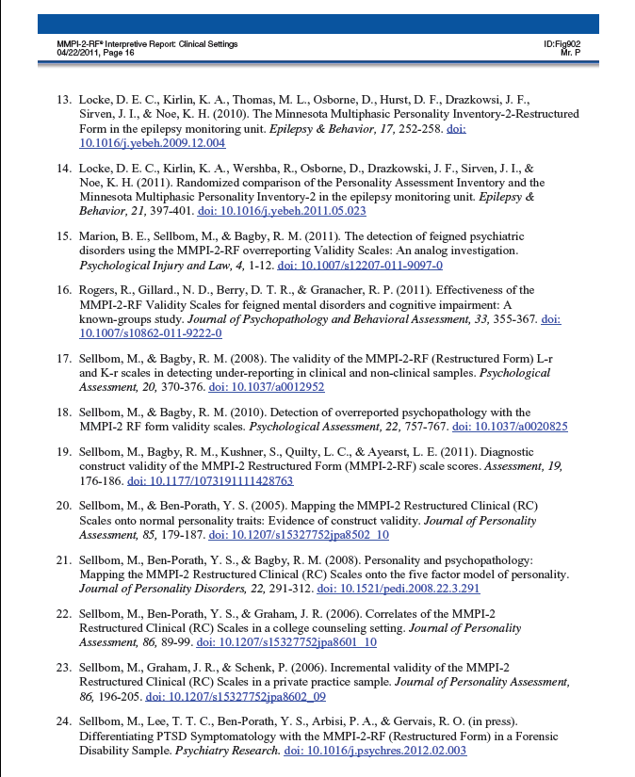

Slide 58
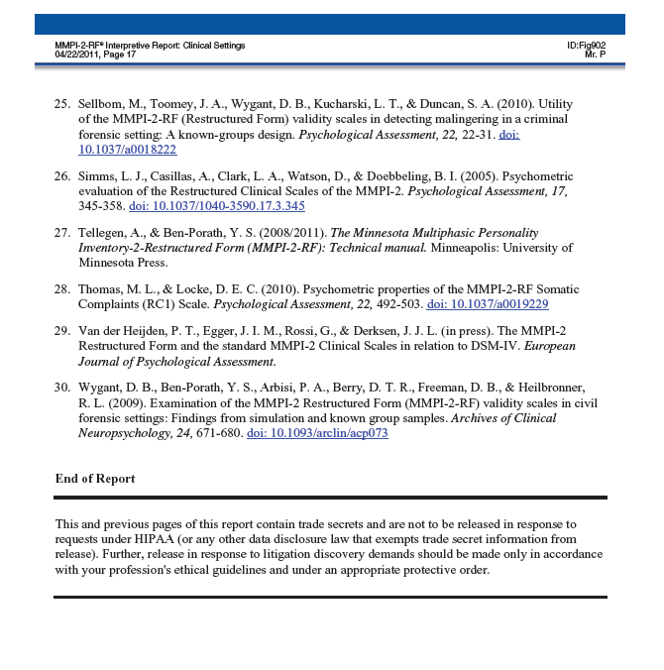

Slide 59
Administering and Scoring the MMPI-2-RF
Scoring:
Standard Scoring Modalities:
Hand scoring
Computer
Score Report
Comparison Groups
Interpretive Report
Comparison Groups (Do not alter interpretation)

Slide 60
For additional information on this chapter, please reference:
Ben-Porath, Y.S. (2012). Interpreting the MMPI-2-RF. Minneapolis: University of Minnesota Press.

