Slide 1
Instructor Training Slides
MMPI®-3 Instructor Training Slides, University of Minnesota Press,
Copyright for all MMPI® materials are held by the Regents of the University of Minnesota

Slide 2
Part 1:
Unit 1: MMPI History Unit 2: MMPI-3 Development
Unit 3: New Norms
Unit 4: Documentation
Unit 5: Administration, Scoring, and Reporting
Unit 6: Setting- Specific Applications
Part 1:
Introduction to the MMPI-3

Slide 3
Unit 1: MMPI History

Slide 4
MMPI Background
Developed in 1930s by Hathaway and McKinley
Intended to function as a differential diagnostic instrument
Clinical scales designed to assess common “Kraepelinian” syndromes
  Hypochondriasis, Depression, Hysteria, Psychopathic Deviate, Paranoia, Psychasthenia, Schizophrenia, Hypomania
Published in 1943
  Outcome:
      Empirically-based classification, description, and prediction with Clinical Scales-based code types
      Validity Scales
      Supplementary measures
      Norms represent late-1930s to early-1940s MN

Slide 5
MMPI Background
Theoretical Foundations:
  Kraepelinian descriptive nosology
  Items as stimuli for behavioral responses, the aggregates of which may have certain empirical correlates, including diagnostic group membership
  Rejection of content-based test interpretation as overly susceptible to misleading responding
  #3 notwithstanding, test takers do attend to item content and may intentionally or unintentionally respond in a misleading manner

Slide 6
MMPI Background
Scale Development:
  Follows methodology used by Strong to develop his Vocational Interest Blank
  Responses (to an assembled pool of items) of eight criterion groups diagnosed with the targeted disorders (n=20-50) contrasted with those of a “normal” group
  Result: Eight original Clinical Scales
    Later augmented by Masculinity/Femininity and Social Introversion scales

Slide 7
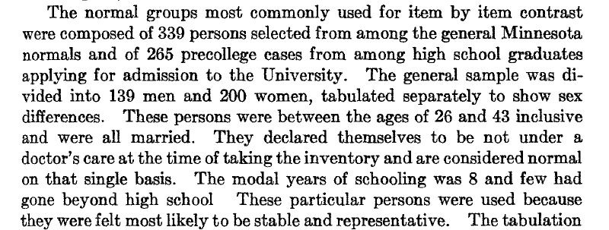
Hathaway & McKinley 1944, p. 155

Slide 8
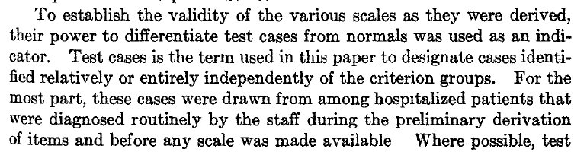
Hathaway & McKinley 1944, p. 155

Slide 9
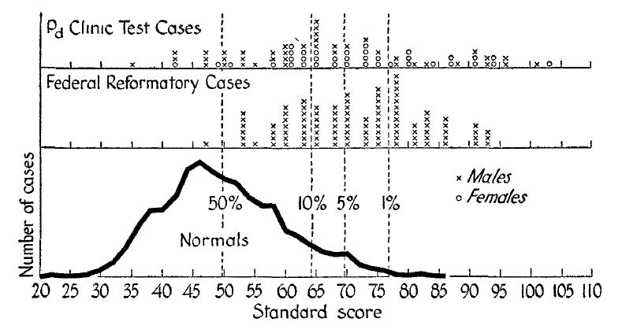
Hathaway & McKinley 1944, p. 170

Slide 10
MMPI Background
By mid-1940s, clear that the scales did not work as intended
  Non-discriminating profiles (i.e., multiple elevations)
  Excessive False Positives
Paradigm Shift 1- Code Types:
  Focus shifts to pattern of scores
  Scales names replaced with numbers to facilitate code typing
  Empirical studies conducted to identify code-type correlates

Slide 11
MMPI Background
Paradigm Shift 2 – Content-Based Assessment
  Item content largely ignored in Clinical Scale construction
  Began to play role in interpretation with several developments in the 1950s:
    Welsh Factor Scales
    Harris-Lingoes subscales
    Weiner-Harmon subscales
  Content used by Wiggins to construct a set of scales in the 1960s

Slide 12
MMPI Background
  The viewpoint that a personality test protocol represents a communication between the subject and the tester (or the institution he represents) has much to commend it, not the least of which is the likelihood that this is the frame of reference adopted by the subject himself. (Wiggins, 1966, p.2)

Slide 13
MMPI Background
Appraisals and Thoughts about Revision:
  By late 1950s, MMPI becomes most widely used and studied objective measure of personality
  Scholarly appraisals are more negative
  Including Hathaway himself:

Slide 14
MMPI Background
Hathaway (1960)
  Our most optimistic expectation was that the methodology of the new test would be so clearly effective that there would soon be better devices with refinements of scales and general validity. We rather hoped that we ourselves might, with five years experience, greatly increase its validity and clinical usefulness, and perhaps even develop more solidly based constructs or theoretical variables for a new inventory.

Slide 15
MMPI Background
Hathaway (1972)
  If another twelve years were to go by without our having gone on to a better instrument or procedure for the practical needs [it fulfills,] I fear that the MMPI, like some other tests, might have changed from a hopeful innovation to an aged obstacle.

Slide 16
MMPI Background
Appraisals and Thoughts about Revision:
  In 1970, Fifth Annual MMPI Research Symposium, convened in honor of Hathaway, devoted to discussion of whether and, if so, how to revised the MMPI
    Produces book: Objective Personality Assessment: Changing Perspectives (Butcher, 1972)
    Includes chapters by conference attendees
    Jackson (1971) also weighs in
    Meehl responds in final chapter (his last word on the MMPI)

Slide 17
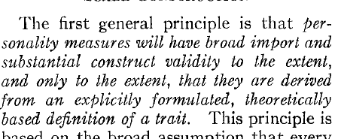
Jackson (1971, p. 232)

Slide 18
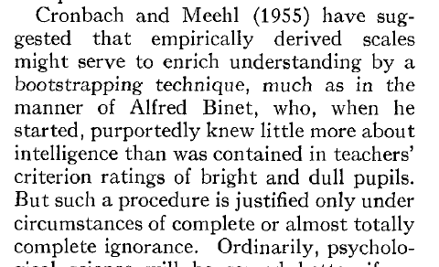
Jackson (1971, p. 232)

Slide 19
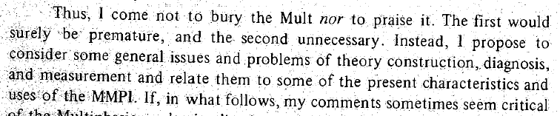
Norman (1972, p. 60)

Slide 20
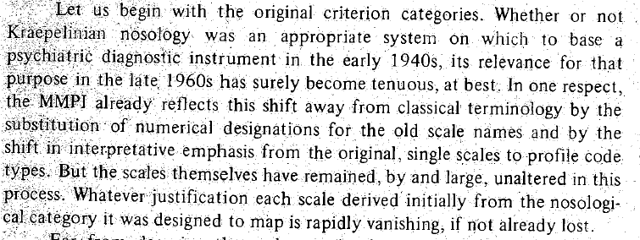
Norman (1972, p. 64)

Slide 21
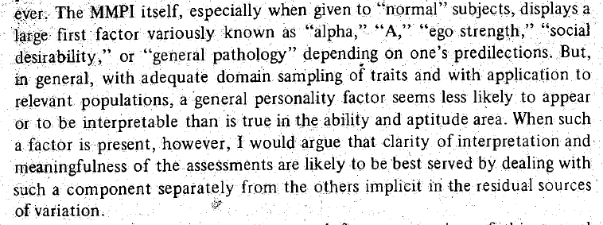
Norman (1972, p. 82)

Slide 22
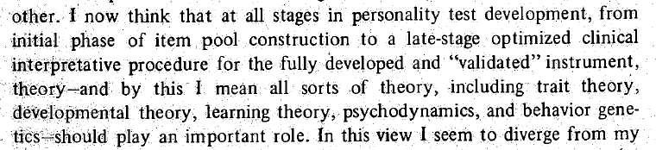
Meehl (1972, p. 150)

Slide 23
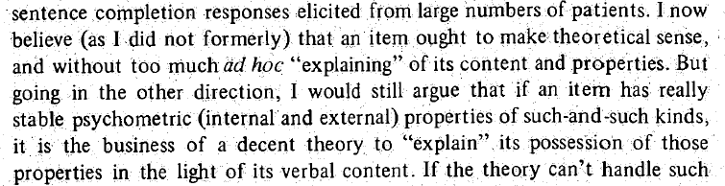
Meehl (1972, p. 155)

Slide 24
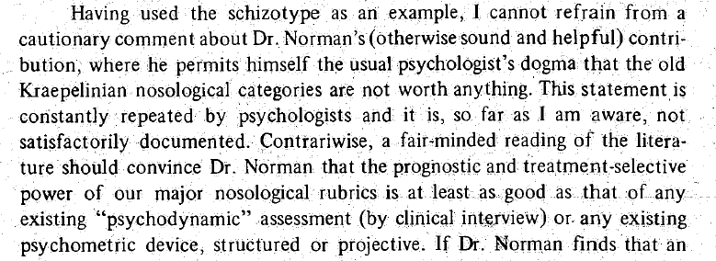
Meehl (1972, p. 157)

Slide 25

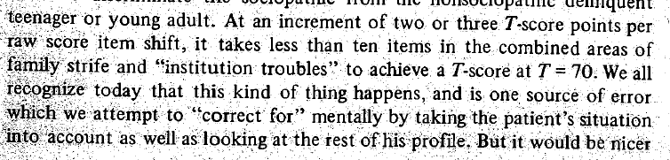
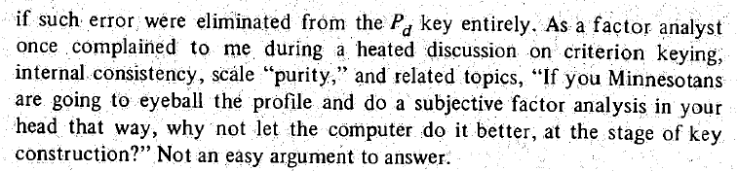
Meehl (1972, pp. 170-171)

Slide 26
MMPI-2 (1989)
New Norms (collected in mid-1980s)
Clinical Scales left intact
New items introduced via Content Scales
New Validity Scales (VRIN, TRIN, F_{b})
Initial Skepticism
Relatively quick acceptance by clinicians
Disappointment by (some of) the scholarly community

Slide 27
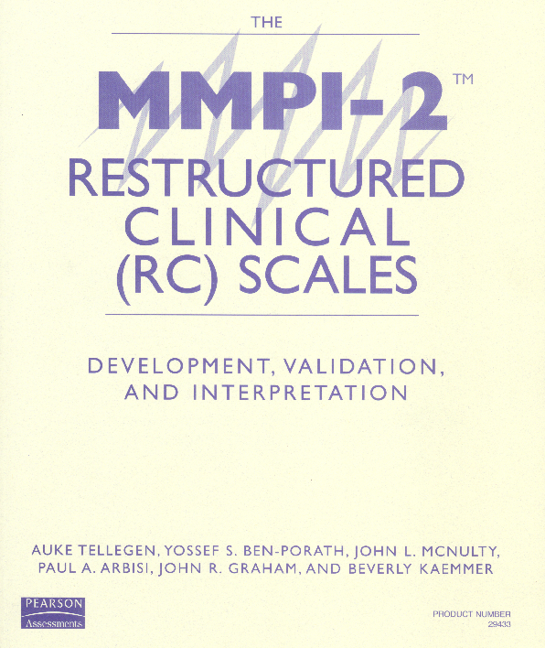

Slide 28
Why Restructure the Clinical Scales?
While they contain compelling informative items, it was long recognized that as aggregate measures the Clinical Scales were not psychometrically optimal:
  Excessive intercorrelations
  Item overlap
  Over-inclusive content (including “subtle” items)
Pre-RC Scale Solutions:
  Code types
  Subscales
  Supplementary Scales

Slide 29
Developing the RC Scales
Step 1: Defining and Capturing Demoralization
    it is generally the case that correlations between measures of adjustment tend to be substantial, giving rise to a large—sometimes very large—general demoralization or subjective discomfort factor in such inventories as the MMPI. . . . One challenge in developing new self-report scales is to find ways of not measuring this general factor. (Tellegen, 1985, p. 692)

Slide 30
Developing the RC Scales
Step 1: Defining and Capturing Demoralization
  Tellegen’s concept of Demoralization similar to that of Jerome Frank:
    only a small proportion of persons with psychopathology come to therapy; apparently something else must be added that interacts with their symptoms. This state of mind, which may be termed “demoralization,” results from persistent failure to cope with internally or externally induced stresses. . . . Its characteristic features, not all of which need to be present in any one person, are feelings of impotence, isolation, and despair. ( Frank, 1974 p. 271)
  Capturing Demoralization guided by Tellegen’s research on Mood

Slide 31
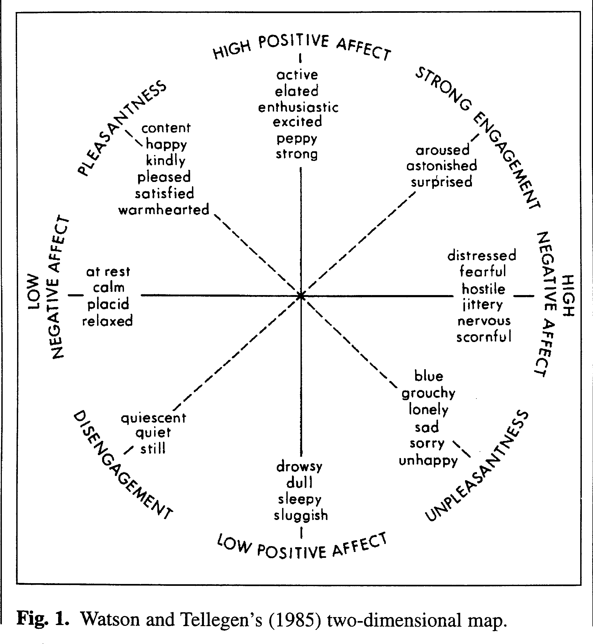

Slide 32
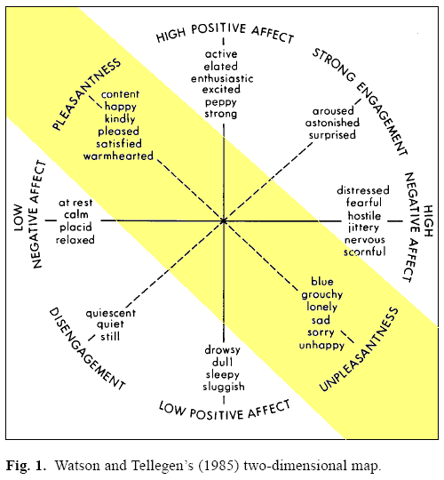

Slide 33
Developing the RC Scales
Step 1: Defining and Capturing Demoralization
  Factor analysis of items of Clinical Scales 2 and 7 (measures of depression and anxiety) leads to identification of a set of items that load on a common factor
  Identified items denote features of demoralization:
    Unhappiness
    Poor self-concept
    Feeling overwhelmed
    Desire to give up
  Consistent with Tellegen’s and Frank’s conceptualizations

Slide 34
Developing the RC Scales
Step 2: Identifying Clinical Scale Core Components
  Assumption: Each clinical scale includes at least one major distinctive core component
  Method: Factor analyses of the items of each of the ten Clinical Scales along with the Demoralization markers identified in Step 1
  Outcome: Subset of Clinical Scale items marking a major distinctive core component of each scale of the ten scales (2 sets for Scale 5)

Slide 35
Developing the RC Scales
Step 3: Deriving Seed Scales
  Goal: Optimize internal coherence and mutual distinctiveness of eventual RC Scales
  Method:
    Only items with highest loading on the component marker for which they were designated are retained (yields 11 non-overlapping provisional seed scales)
    Deletion of items that did not correlate sufficiently, or consistently highest with designated provisional seed scale
    Addition of 12th seed scale representing Demoralization (deleting 4 weakest items from demoralization markers used in Step 2)
  Outcome: 12 Seed Scales made up of relatively small, mutually exclusive subsets of original Clinical Scale items

Slide 36
Developing the RC Scales
Step 4: Deriving the Final RC Scales
  Goal: Build on structural changes attained in Steps 1-3 by recruiting additional items from the entire MMPI-2 pool (including new MMPI-2 items)
  Method:
    Calculate correlations between the 12 Seed Scales and 567 MMPI-2 items in four samples
    Add item to Seed Scale if:
      Correlation with that seed higher than the 11 others
      Correlation with that seed was “high enough”
      Correlations with the remaining seeds were “low enough”
    Calculate correlations between resulting items and available external criteria for some scales (small number deleted at this point)
  Outcome: 9 RC Scales (Seeds for Clinical Scales 5 and 0 not used to derive final RC Scales)

Slide 37
Delineating the RC Scale Constructs
RCd – Demoralization
  Happy/Unhappy Pleasant/Unpleasant dimension of mood
  Dohrendwend: Analogous to taking patient’s temperature in medicine (i.e., indicates a problem and its severity, but not etiology)
  Items reflect dysphoric affect, distress, self-attributed inefficacy, low self esteem, and a sense of having given up
  Associated with increased risk for suicidal ideation and recent suicide attempt

Slide 38
Delineating the RC Scale Constructs
RCd – Demoralization
  Considerable phenotypic overlap with depression, however
    Vegetative symptoms such as poor sleep, low appetite, and anhedonia are more specific to depression
    Dysphoric affect found in medical patients more likely to be a product of demoralization, than depression
    When asked about their mood, patients/clients who are demoralized are more likely to complain about depression and anxiety

Slide 39
Delineating the RC Scale Constructs
RC1 – Somatic Complaints
  Unexplained somatic complaints long a focus of medicine (e.g., Hysteria=wandering uterus in ancient Egypt)
  19th century French psychiatrist Briquet attributes symptoms to nervous system
  Charcot and Janet, after collaborating with Freud conceptualize as a disease of the mind, adopting his notion of conversion – psychological trauma converted into physical symptoms
  In DSM-IV conditions labeled Somatoform Disorders
  DSM-5 rebranded Somatic Symptom Disorders

Slide 40
Delineating the RC Scale Constructs
RC2 – Low Positive Emotions
  Lack of positive emotional responsiveness, anhedonia, is a core personological risk factor for depression
  But not unique to depression; can also occur in Schizophrenia, PTSD, and certain medical conditions
  In depression, low positive emotions associated with greater likelihood of biologically (rather than situationally)-linked depression, and hence may be more amenable to treatment with antidepressant medication (Klein, 1974)

Slide 41
Delineating the RC Scale Constructs
RC3 – Cynicism
  Degree to which individual holds misanthropic, negativistic, and mistrusting view of others
  Beliefs are non-self-referential
  Dysfunction is largely interpersonal
  “Active ingredient” in Type A Personality associated with increased risk for cardiovascular disease
  Risk factor for burnout and misconduct in law enforcement officers

Slide 42
Delineating the RC Scale Constructs
RC4 – Antisocial Behavior
  Core feature of Antisocial Personality Disorder and, depending upon model, either core feature or consequence of Psychopathy
  Item pool includes several elements of diagnostic criteria for ASPD, but not all
  Also includes substance abuse and familial discord items that are not associated with specific ASPD diagnostic criteria
  Hence, Antisocial Behavior and ASPD are not veridical

Slide 43
Delineating the RC Scale Constructs
RC6 – Ideas of Persecution
  Self-referential beliefs that one is being singled out for mistreatment
  Persecutory beliefs are a feature of Paranoia, but can stem from other causes as well
    Actually being persecuted (refugees, racial minorities)
    Projection of blame for shortcomings or difficulties onto others
    Alienation

Slide 44
Delineating the RC Scale Constructs
RC6 – Ideas of Persecution
  Freeman (2007) characterized paranoia as a hierarchical phenomenon, characterized by five levels of perceived threat ranging from
    Social evaluative concerns (fear of rejection and feelings of vulnerability)
    Ideas of reference (being talked about or watched by others)
    Mild threat (people trying to cause minor distress such as irritation)
    Moderate threat (people going out of their way to get at the individual)
    Severe threat (people trying to cause significant physical, psychological, or social harm to the individual)
  RC6 items fall mainly in mild to severe range

Slide 45
Delineating the RC Scale Constructs
RC7 – Dysfunctional Negative Emotions
  A personality trait characterized by a tendency to worry, be anxious, feel victimized and resentful, be angry, and appraise situations generally in ways that foster negative emotions
  Is correlated with, but distinct from Demoralization, which is associated more specifically with dissatisfaction, unhappiness, and distress
  Associated with increased risk for anxiety-related psychopathology

Slide 46
Delineating the RC Scale Constructs
RC8 – Aberrant Experiences
  Sensory, perceptual, cognitive, and motor experiences that fall well outside the range of normal experiences
  Associated with, but not unique to thought disturbance
  Items include positive symptoms of Schizophrenia, such as hallucinations (e.g., visual, auditory), and non-persecutory delusions (e.g., thought broadcasting)
  Associated with increased risk for psychotic disorder, but can co-occur with other conditions (e.g., dissociative symptoms of PTSD)

Slide 47
Delineating the RC Scale Constructs
RC9 – Hypomanic Activation
  Focuses primarily on Kraepelin’s:
    Manic Temperament, marked by constitutional excitability, carelessness, and marked self-confidence
    Irritable Temperament, marked by irritability, volatility, and occasional outbursts of violence
  Some items also focus on Kraepelin’s manic states, associated with pressure of activity
  Most individuals with hypomanic personality traits do not go on to develop a full fledged bi-polar disorder, but it is associated with elevated risk for this condition

Slide 48
Empirical Findings with the RC Scales
Reported in MMPI-2-RF Technical Manual and an extensive peer-reviewed literature
  Adequate reliability
  Good evidence of construct validity
  Broad range of replicable empirical correlates reflected in interpretive recommendations in MMPI-2-RF Manual for Administration, Scoring, and Interpretation

Slide 49
Appraisals of the RC Scales
Positive appraisals based on data analyses that included external criteria
Negative appraisals based on beliefs about the nature of the constructs assessed by the Clinical Scales and “internal” analyses limited to correlations between subsets of MMPI-2 items
  Smaller number of elevated scales does not reflect low sensitivity, but rather greater discriminant validity
  “Construct Drift” is actually “Construct Shift”

Slide 50
MMPI-2-RF Substantive Scales
The introduction of the RC Scales may stimulate additional MMPI-2 scale development. It may prove worthwhile to search for and measure distinctive core features of important MMPI-2 scales other than the MMPI-2 Clinical Scales, some of which may also be confounded with a strong Demoralization component. Investigations along these lines may lead to additional measures that are incrementally informative beyond the RC Scales. Through such efforts it may be possible eventually to capture the full range of attributes represented by the large body of MMPI-2 constructs with a set of new scales more transparent and effective than those currently available. (Tellegen, Ben-Porath, McNulty, Arbisi, Graham & Kaemmer, 2003, pp. 85–86)

Slide 51
MMPI-2-RF
MMPI-2-RF
  Ben-Porath & Tellegen (2008)
    Overall Objective: Represent the clinically significant substance of the MMPI-2 item pool with a comprehensive set of psychometrically adequate measures:
      Improve efficiency
      Enhance construct validity
    Overall Strategy:
      First restructure the Clinical Scales (resulting in the Restructured Clinical [RC] Scales)
      Then augment the RC Scales with needed additional measures

Slide 52
MMPI-2-RF Substantive Scales
RC Scales not intended to assess everything that can be measured with the MMPI-2 item pool
Goal in completing the MMPI-2-RF:
  A comprehensive set of measures representing the clinically significant substance of the entire MMPI-2 item pool
Five additional sets of scales:
  Higher-Order
  Specific Problems
  Interest
  PSY-5
  Validity

Slide 53
MMPI-2-RF Substantive Scales
Higher-Order Scales – Background:
  Ongoing search for meaningful structural model to provide an organizing descriptive framework for psychological assessment and psychodiagnosis
  Factor analyses of “normal” and clinical personality measures yield similar structures:
    Primary constructs to emerge from factor analyses:
      Clinical: Internalizing and Externalizing Psychopathology
      Normal: Positive Emotionality, Negative Emotionality, Constraint
    Missing Construct: Thought Dysfunction

Slide 54
MMPI-2-RF Substantive Scales
Higher-Order Scales – Development:
  RC Scales provide an opportunity for a “fresh” analysis
  Factor analyses of the RC Scales identify three higher-order dimensions marked by
    RCd, RC2, RC7
    RC6, RC8
    RC4, RC9
  Combined items of these scales factor analyzed and three factor scores generated
  Three factor scores correlated with 567 MMPI-2 items
  A set of items selected for each scale to produce diverse and distinctive markers associated statistically and conceptually with one, but not the other two higher-order factors

Slide 55
MMPI-2-RF Substantive Scales
Higher-Order Scales - Outcome:
  EID - Emotional/Internalizing Dysfunction
  THD – Thought Dysfunction
  BXD – Behavioral/Externalizing Dysfunction
Two applications of H-O Scales:
  Dimensional measures allow for identification of more than one broad domains of dysfunction (and indication of relative prominence)
  Organizing framework for MMPI-2-RF interpretation

Slide 56
MMPI-2-RF Substantive Scales
Specific Problems and Interest Scales - Objectives:
  Augment H-O and RC Scales with measures needed to achieve comprehensive instrument that assesses the broad range of constructs measurable with the MMPI-2 item pool:
    Constructs assessed by Clinical Scales 5 and 0
    Clinical Scale components not assessed by the RC Scales (e.g., a “social anxiety” component contained in the items of Clinical Scale 3)
    More narrowly-focused facets of some RC Scales (e.g., substance abuse within the item pool of RC4)
    Clinically significant attributes not represented in either the Clinical or RC Scales (e.g., suicidality)

Slide 57
MMPI-2-RF Substantive Scales
Specific Problems and Interest Scales – Development:
  Iterative process relying on methods similar to those used in developing the RC Scales
  A set of items representing targeted constructs factor analyzed along with Demoralization markers
  Seed Scales assembled by selecting items not overly correlated with Demoralization or other targeted item sets
  Seed scales correlated with 567 MMPI-2 items to identify ones sufficiently correlated with a specific seed and more so than with the others
  Deletion of items that reduced internal consistency
  Examination of empirical correlates

Slide 58
MMPI-2-RF Substantive Scales
Specific Problems and Interest Scales – Outcome:
  5 Somatic/Cognitive Scales
  9 Internalizing Scales
  4 Externalizing Scales
  5 Interpersonal Functioning Scales
  2 Interest Scales

Slide 59
MMPI-2-RF Substantive Scales
Somatic/Cognitive
  MLS: Malaise – Overall sense of physical
  debilitation, poor health (perceived functional incapacity)
  GIC: Gastrointestinal Complaints – Nausea,
  recurring upset stomach, and poor appetite
  HPC: Head Pain Complaints – Head and
  neck pain
  NUC: Neurological Complaints – Dizziness,
  weakness, paralysis, loss of balance, etc.
  COG: Cognitive Complaints – Memory problems,
  difficulties concentrating

Slide 60
MMPI-2-RF Substantive Scales
Internalizing (RCd Facets):
  SUI: Suicidal/Death Ideation – Direct reports of
  suicidal ideation and recent attempts
  HLP: Helplessness/Hopelessness – Belief that goals
  cannot be reached or problems solved
  SFD: Self-Doubt – Lack of self-confidence, feelings
  of uselessness
  NFC: Inefficacy – Belief that one is indecisive
  and inefficacious

Slide 61
MMPI-2-RF Substantive Scales
Internalizing (RC7 Facets):
  STW: Stress/Worry – Preoccupation with
  disappointments, difficulty with time pressure
  AXY: Anxiety – Pervasive anxiety, frights, frequent
  nightmares
  ANP: Anger Proneness – Becoming easily angered,
  impatient with others
  BRF: Behavior-Restricting Fears – Fears that
  significantly inhibit normal behavior
  MSF: Multiple Specific Fears – Fears of blood, fire,
  thunder, etc.

Slide 62
MMPI-2-RF Substantive Scales
Externalizing:
RC4 Facets
  JCP: Juvenile Conduct Problems – Difficulties
  at school and at home, stealing
  SUB: Substance Abuse – Current and past misuse of alcohol and drugs
  RC9 Facets
  AGG: Aggression – Physically aggressive,
  violent behavior
  ACT: Activation – Heightened excitation
  and energy level

Slide 63
MMPI-2-RF Substantive Scales
Interpersonal:
  FML: Family Problems – Conflictual family relationships
  IPP: Interpersonal Passivity – Being unassertive and submissive
  SAV: Social Avoidance – Avoiding or not enjoying social events
  SHY: Shyness – Bashful, prone to feel inhibited
  and anxious around others
  DSF: Disaffiliativeness – Disliking people and being around them

Slide 64
MMPI-2-RF Substantive Scales
Interests:
  AES: Aesthetic-Literary Interests – Literature, music, the theater
  MEC: Mechanical-Physical Interests – Fixing and building things, the outdoors, sports

Slide 65
MMPI-2-RF Substantive Scales
PSY-5 – Personality Psychopathology-5
  Developed by Harkness and McNulty (1994) as a dimensional model of Axis II features
  Began with DSM-III-R Axis II criteria
  Augmented with items describing psychopathy features and Tellegen’s higher-order dimensions of Negative Emotionality, Positive Emotionality, and Constraint
  Data reduction analyses identify five dimensions
  Harkness, McNulty, and Ben-Porath (1995) develop MMPI-2 PSY-5 Scales using replicated rational selection
    Lay judges select MMPI-2 items guided by descriptions of the five dimensions

Slide 66
MMPI-2-RF Substantive Scales
MMPI-2-RF PSY-5 Scales
  Revised versions of their MMPI-2 measures of the PSY-5 dimensional model of personality (Axis II) pathology developed by Harkness and McNulty:
  AGGR-r: Aggressiveness-Revised – Instrumental, goal-directed aggression
  PSYC-r: Psychoticism-Revised – Disconnection
  from reality
  DISC-r: Disconstraint-Revised – Under-controlled behavior
  NEGE-r: Negative Emotionality/Neuroticism-Revised – Anxiety, insecurity, worry, and fear
  INTR-r: Introversion/Low Positive Emotionality-Revised – Social disengagement and anhedonia

Slide 67
MMPI-2-RF Substantive Scales
MMPI-2-RF PSY-5 Scales
  Provide a validated, dimensional perspective on personality disorder features
    Very similar to a model considered for DSM-5 (now designated as the Alternative Model of Personality Disorders [AMPD]):
      Negative Affectivity
      Detachment
      Antagonism
      Disinhibit ion vs. Compulsivity
      Psychoticism

Slide 68
MMPI-2-RF Substantive Scales
MMPI-2-RF PSY-5 Scales
    Can be linked to clusters of DSM-5 Personality disorders:
      Aggressiveness – Cluster B
      Psychoticism – Cluster A
      Disconstraint – Custer B
      Negative Emotionality/Neuroticism – Cluster C
      Introversion/Low Positive Emotionality – Cluster C

Slide 69
Empirical Findings Substantive Scales
Reported in MMPI-2-RF Technical Manual and peer-reviewed literature
  Technical Manual
    Adequate reliability
    Good evidence of construct validity
    Broad range of replicable empirical correlates reflected in interpretive recommendations in MMPI-2-RF Manual for Administration, Scoring, and Interpretation

Slide 70
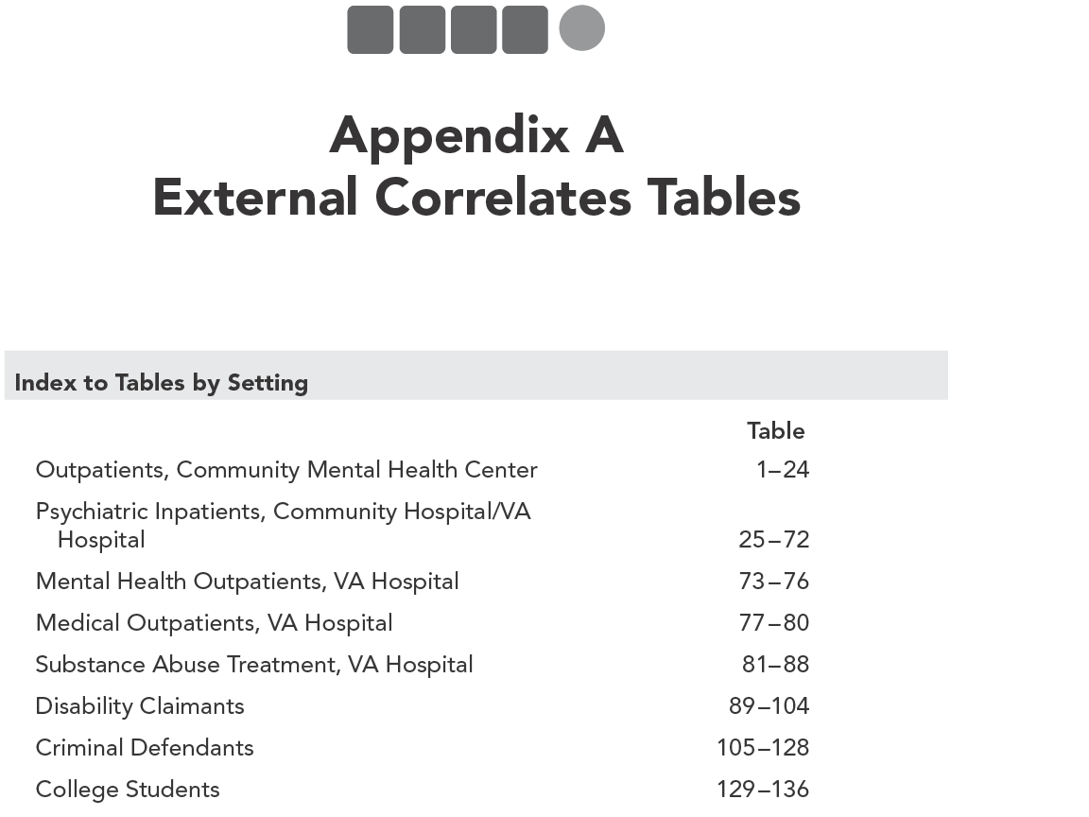

Slide 71
MMPI-2-RF Technical Manual: Appendix A
Empirical Correlates in
  Mental Health
    Outpatient
    Inpatient
  Medical
  Substance Abuse Treatment
  Forensic- Civil
  Forensic- Criminal
  Non-Clinical
N= 4,336 Men; 2,337 Women
605 Criteria
53,970 Correlations

Slide 72
Empirical Findings Substantive Scales
Peer-reviewed literature:
  Over 530 publications report empirical correlates of the MMPI-2-RF scales in various settings
    Mental health
    Medical
    Forensic
    Public Safety Personnel Screening

Slide 73
MMPI-2-RF Validity Scales
Protocol Validity versus Instrument Validity
Threats to Protocol Validity
  Non-Content-Based Invalid Responding
    Non-responding
    Random Responding
      Intentional
      Unintentional
        Reading Difficulties
        Comprehension Deficits
          Low verbal abilities
          Non-native English speaker
        Disorganization
        Mismarked answer sheets
    Fixed Responding
      Acquiescence or Counter-acquiescence
      Problems with double negatives

Slide 74
MMPI-2-RF Validity Scales
Threats to Protocol Validity
  Content-Based Invalid Responding
    Over-reporting
      Intentional
        Malingering
        Factitious Disorder
      Unintentional
        Catastrophizing
        Somatoform Disorder
    Under-reporting
      Intentional
        Denial or minimization
      Unintentional
        Distorted self-concept

Slide 75
MMPI Validity Scales
Original MMPI Validity Scales (1943)
  “It is almost as though we inventory-makers were afraid to say too much about the problem because we had no effective solution for it, but it was too obvious a fact to be ignored so it was met by a polite nod.” (Meehl & Hathaway, 1946, p. 526)
  Cannot Say (CNS) – Non-responding
    Changes dramatically with switch to Group Form
  Lie (L) – Under-reporting
    Fashioned after Hartshorne and May Honesty Research
  Infrequency (F) – Random Protocol
    Initially designed as a measure of random responding or clerical error
    Found by military psychologists to be sensitive to over-reporting

Slide 76
MMPI Validity Scales
Original MMPI Validity Scales - K
  K-correction and K Scale added in 1946
  Developed by Meehl and Hathaway (1946) to serve only as a correction factor to account for under-reporting and over-reporting
  K Scale adopted as the final standard validity scale of the MMPI in 1946

Slide 77
MMPI Validity Scales
Original MMPI Validity Scales and Threats to Protocol Validity:
  CNS
    Non-responding
  L
    Under-reporting
      Intentional and unintentional
  F
    Content non-responsiveness
    Over-reporting
      Intentional and unintentional
  K
    Under-reporting
      Intentional and unintentional

Slide 78
MMPI-2 Validity Scales
MMPI-2 Validity Scales:
  MMPI Validity Sales carried over:
    CNS, L, F, K carried over
      F loses four items
  MMPI-2 Validity Scales introduced in 1989:
    Variable Response Inconsistency – VRIN – Random Responding
    True Response Inconsistency – TRIN – Fixed Responding
    F Back (F_{B}) – Over-reporting
  MMPI-2 Validity Scales added later:
    Infrequency Psychopathology – F_{P} - Over-reporting
    Superlative Self-Presentation – S – Under-reporting
    Symptom Validity Scale – FBS (previously Fake Bad Scale) – Over-reporting

Slide 79
MMPI-2-RF Validity Scales: Development
VRIN-r/TRIN-r
  Based on inconsistent responses to item pairs
  Pairs selected on the basis of statistical and semantic analyses of possible response combinations (composites):
    Both True (TT)
    Both False (FF)
    First True and the second False (TF)
    First False and the second True (FT)

Slide 80
MMPI-2-RF Validity Scales: Development
VRIN-r/TRIN-r
  Each composite chosen for VRIN-r or TRIN-r had to meet five criteria:
    The items had to be sufficiently correlated with each other (positively for VRIN-r, negatively for TRIN-r) in two clinical samples (seeking statistical inconsistency)
    The observed frequency of the composite had to be low when compared to the frequency expected by chance if the two responses making up the composite were independent (seeking unlikely response combinations)
    The combination of responses in a composite had to be judged by the authors to be inconsistent (seeking semantic inconsistency)
    The correlation between a composite and a mini-scale made up of the two items keyed in the direction they were scored on the composite was low (seeking “content-free” composites)
    Neither item in a composite could belong to another composite of the same type (eliminate overlap)

Slide 81
MMPI-2-RF Validity Scales: Development
TRIN-r:
  Responses are negatively correlated (-.23)
  Observed/Expected .27 for TT and .93 for FF (TT combination much more unlikely than FF)
  TT combination is semantically inconsistent
  Correlation with mini-scale reflecting family problems is -.10 for TT and -.70 for FF (indicating TT combination is content-free)
  Neither 269 nor 314 could be scored in another TT combination

Slide 82
MMPI-2-RF Validity Scales: Development
Over-reporting Scales:
  F-r (Infrequent Responses):
    32 items answered infrequently (10% or less) of the men and women in the normative sample
  Fp-r (Infrequent Psychopathology Responses):
    21 items answered infrequently (20% or less) by psychiatric inpatients, outpatients, and non-clinical samples
  Fs (Infrequent Somatic Responses):
    16 items with somatic content answered infrequently (25% or less) of medical samples
  FBS-r (Symptom Validity):
    30 of 43 FBS items included in 338-item booklet
  RBS (Response Bias Scale):
    28 items correlated with failure on performance validity tests

Slide 83
MMPI-2-RF Validity Scales: Development
Under-reporting Scales:
  L-r (Uncommon Virtues):
    14 items describing uncommon moral virtues
  K-r (Adjustment Validity):
    14 items describing good psychological adjustment

Slide 84
MMPI-3
Needs not addressed with the MMPI-2-RF:
  Expanding the MMPI-2 item pool
  Updating the test norms
MMPI-3 Goals:
  Enhance content
  Collect new norms

Slide 85
Unit 2: MMPI-3 Development

Slide 86
Development: Preliminary Studies
Response format
  True/False versus Polytomous

Slide 93
Development: Preliminary Studies
Response format
  True/False versus Polytomous
  Outcome: Retain T/F format
Item Improvement
  Awkward/dated wording
  Simplification
      I love to go to dances dancing.
      I am apt to take likely to feel disappointments so keenly strongly that I can't put them out of my mind.
    43 simplified items retained for MMPI-3 development

Slide 94
Development: Preliminary Studies
New item development
  Objective: Identify content missing from, or insufficiently represented by the MMPI-2-RF item pool
  Method:
    Consultation with 12 MMPI-2-RF experts
    Review of existing measures
    Development of 135 Trial Items
  Outcome:
    95 trial items; candidates for inclusion on the MMPI-3

Slide 95
Development Plan
MMPI-2-RF-EX
  Brief biographical questionnaire
  338 MMPI-2-RF items (43 updated)
  95 trial items
  Booklet and answer sheet
Q Local EX
All new material translated into Spanish
  Garcia/Azan MMPI-2/RF translation starting point
  Rewritten and trial items translated by Dr. Antonio E. Puente and team at UNC–Wilmington

Slide 96
Development Plan
Data Collection:
  Field Data
    Sites represent settings in which MMPI is used
      Mental health, medical, forensic, public safety
      Used for:
        Scale development
        Validation
        Comparison groups
  College Studies
    Initial psychometric analyses
    Detailed validation analyses
  Normative Data
    English
    Spanish
    Bilingual

Slide 97
Development: Data Collection
Field Data Collection
  Public Safety 10,200
  Mental Health 2,400
  Medical 2,000
  Forensic/Corrections 1,200
  Forensic Disability 800
  Total 16,600
College Studies ~8,000

Slide 98
Development: Data Collection
Normative
  English 2,382
  English re-test 280
  Spanish 664
  Spanish re-test 60
  Bilingual 45
  Total 3,423
Overall Total ~28,000

Slide 99
Excerpted from the MMPI-3 Technical Manual by Yossef S. Ben-Porath and Auke Tellegen. Copyright © 2020 by the Regents of the University of Minnesota. Reproduced by permission of the University of Minnesota Press.

Slide 100
Excerpted from the MMPI-3 Technical Manual by Yossef S. Ben-Porath and Auke Tellegen. Copyright © 2020 by the Regents of the University of Minnesota. Reproduced by permission of the University of Minnesota Press.

Slide 101
Development: Scales
Scale Development Process
  Using Field Data
    RC Scales shortened
    Some SP Scales lengthened and expanded
      Item analyses used to identify items that could be deleted without loss of reliability
      Candidate items for deletion were inspected for content to make sure deletion would not limit the content scope of the scale
      External correlates examined to make sure shortened scales did not lose validity (some items “reinstated to retain validity)
      Correlations calculated between shortened scales and 95 trial items – items added

Slide 102
Development: Scales
Scale Development Process
  Using Field Data
    RC Scales shortened
    Some SP Scales lengthened and expanded
    H-O and PSY-5 Scales revised to address deleted items and incorporate new ones
    Validity Scales updated
  Using Spanish Normative and Bilingual Samples
    All rewritten and new items selected for MMPI-3 examined
    One item dropped

Slide 103
Excerpted from the MMPI-3 Technical Manual by Yossef S. Ben-Porath and Auke Tellegen. Copyright © 2020 by the Regents of the University of Minnesota. Reproduced by permission of the University of Minnesota Press.

Slide 104
Excerpted from the MMPI-3 Technical Manual by Yossef S. Ben-Porath and Auke Tellegen. Copyright © 2020 by the Regents of the University of Minnesota. Reproduced by permission of the University of Minnesota Press.

Slide 105
Excerpted from the MMPI-3 Technical Manual by Yossef S. Ben-Porath and Auke Tellegen. Copyright © 2020 by the Regents of the University of Minnesota. Reproduced by permission of the University of Minnesota Press.

Slide 106
Outcome: Scales
New Scales:
  Combined Response Inconsistency (CRIN)
  Eating Concerns (EAT)
  Compulsivity (CMP)
  Impulsivity (IMP)
  Self-Importance (SFI)

Slide 107
Outcome: Scales
Substantially Modified:
  Anxiety (AXY) Anxiety-Related Experiences (ARX)
  Stress/Worry (STW) Stress (STR); Worry (WRY)
  Interpersonal Passivity (IPP) Dominance (DOM)
Dropped:
  Gastrointestinal Complaints (GIC), Head Pain Complaints (HPC)
  Multiple Specific Fears (MSF)
  Aesthetic/Literary Interests (AES)
  Mechanical/Physical Interests (MEC)

Slide 108
Outcome: Items
72 new items added
75 MMPI-2-RF items dropped
MMPI-3: 335 items
  220 original MMPI (47 revised for MMPI-2 or MMPI-3)
  43 MMPI-2 items (5 revised for MMPI-3)
  72 new MMPI-3
Reading level remains grade 4.5
  (Flesch-Kincaid)

Slide 109
MMPI-3 Scales
52 Scales
  10 Validity Scales
  3 Higher-Order Scales
  8 RC Scales
  26 Specific Problems Scales
    4 Somatic/Cognitive
    10 Internalizing
    7 Externalizing
    5 Interpersonal
  5 PSY-5 Scales

Slide 111
Unit 3: New Norms

Slide 112

MMPI-3 Norms
EurekaFacts
  Social science and market research firm located in Washington, DC
  Experienced in nation-wide data collection
  Expertise in working with hard-to-reach populations
  Particular expertise in collecting data with Hispanic, including Spanish-speaking populations

Slide 113
MMPI-3 Norms
Normative Data
  Collected:
    September 2017 - December 2018
    Recruited via social media, ads, word of mouth
    Thousands screened by phone
    3,000+ tested
  Paid $50 (per session)
  ~98% tested by computer
  Data available to development team in “real time”

Slide 114
MMPI-3 Norms
English-language normative sample
  Selected to approximate 2020 census projections for
    Race
    Education
    Age
  Final Sample N=1,620
    810 men, 810 women
    Non-gendered T scores

Slide 115
MMPI-3 Norms
Excerpted from the MMPI-3 Manual for Administration, Scoring, and Interpretation by Yossef S. Ben-Porath and Auke Tellegen. Copyright © 2020 by the Regents of the University of Minnesota. Reproduced by permission of the University of Minnesota Press.

Slide 116
MMPI-3 Norms
Excerpted from the MMPI-3 Technical Manual by Yossef S. Ben-Porath and Auke Tellegen. Copyright © 2020 by the Regents of the University of Minnesota. Reproduced by permission of the University of Minnesota Press.

Slide 117
MMPI-3 Norms
Excerpted from the MMPI-3 Technical Manual by Yossef S. Ben-Porath and Auke Tellegen. Copyright © 2020 by the Regents of the University of Minnesota. Reproduced by permission of the University of Minnesota Press.

Slide 118
MMPI-3 Norms
Excerpted from the MMPI-3 Technical Manual by Yossef S. Ben-Porath and Auke Tellegen. Copyright © 2020 by the Regents of the University of Minnesota. Reproduced by permission of the University of Minnesota Press.

Slide 119
Have the norms changed?

Slide 125
Have the norms changed?
Yes:
  Largest Validity Scale changes (5-6 T score points difference in means) on F-r, Fs, FBS-r (women), and L-r
    However these are offset, to some extent, by the larger SDs (12-14 versus 10)
    Nevertheless, T scores are lower on the updated and re-normed F, Fs, FBS (women), and L scales
  Largest Substantive Scale changes (6-8 T score points difference in means) on BXD (men), RC1 (women), RC4 (men), RC6 (men), MLS, NUC (women), DISC (men)
    These are less offset by larger SDs
    T scores are lower on updated re-normed Somatization scales

Slide 126
Technical Manual

Slide 127
Spanish-Language Norms

Slide 128
Spanish-Language Norms
Excerpted from the MMPI-3 Manual Supplement for the U.S. Spanish Translation by Yossef S. Ben-Porath, Auke Tellegen, and Antonio E. Puente. Copyright © 2020 by the Regents of the University of Minnesota. Reproduced by permission of the University of Minnesota Press.

Slide 129
Spanish-Language Norms
Excerpted from the MMPI-3 Manual Supplement for the U.S. Spanish Translation by Yossef S. Ben-Porath, Auke Tellegen, and Antonio E. Puente. Copyright © 2020 by the Regents of the University of Minnesota. Reproduced by permission of the University of Minnesota Press.

Slide 130
Spanish-Language Norms
Excerpted from the MMPI-3 Manual Supplement for the U.S. Spanish Translation by Yossef S. Ben-Porath, Auke Tellegen, and Antonio E. Puente. Copyright © 2020 by the Regents of the University of Minnesota. Reproduced by permission of the University of Minnesota Press.

Slide 131
Spanish-Language Norms
Excerpted from the MMPI-3 Manual Supplement for the U.S. Spanish Translation by Yossef S. Ben-Porath, Auke Tellegen, and Antonio E. Puente. Copyright © 2020 by the Regents of the University of Minnesota. Reproduced by permission of the University of Minnesota Press.

Slide 132
Spanish-Language Norms
Excerpted from the MMPI-3 Manual Supplement for the U.S. Spanish Translation by Yossef S. Ben-Porath, Auke Tellegen, and Antonio E. Puente. Copyright © 2020 by the Regents of the University of Minnesota. Reproduced by permission of the University of Minnesota Press.

Slide 138
Spanish-Language Norms
Most means fall within 5 T score points of English-language normative sample
Exceptions:
  L (10 T score points higher – both genders)
  BXD, RC4, JCP, DISC (7-9 points lower – women only)
  MLS (6-7 points lower – both genders)
  BRF (9-13 points higher – both genders)
Somewhat reduced variability
Separate norms are needed

Slide 139
Unit 4: Documentation

Slide 140
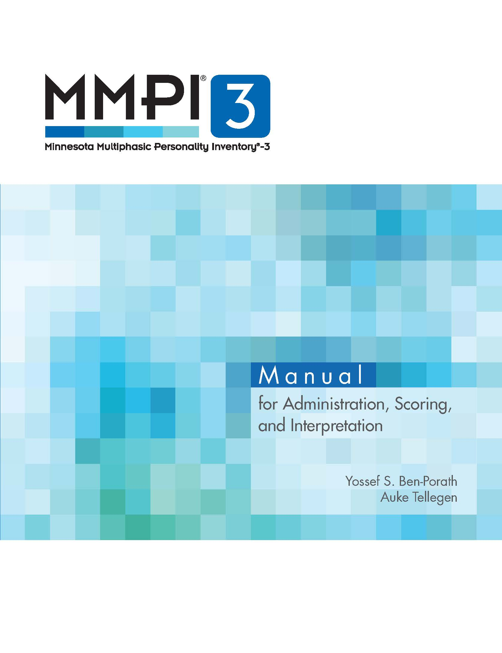
MMPI-3 Manuals
Manual for Administration, Scoring, and Interpretation

Slide 141
Manual for Administration, Scoring, and Interpretation
User qualifications
Normative sample
Administration and scoring
Comprehensive interpretive guidelines
Case illustrations
Scoring keys and T score conversions
Itemmetrics

Slide 142
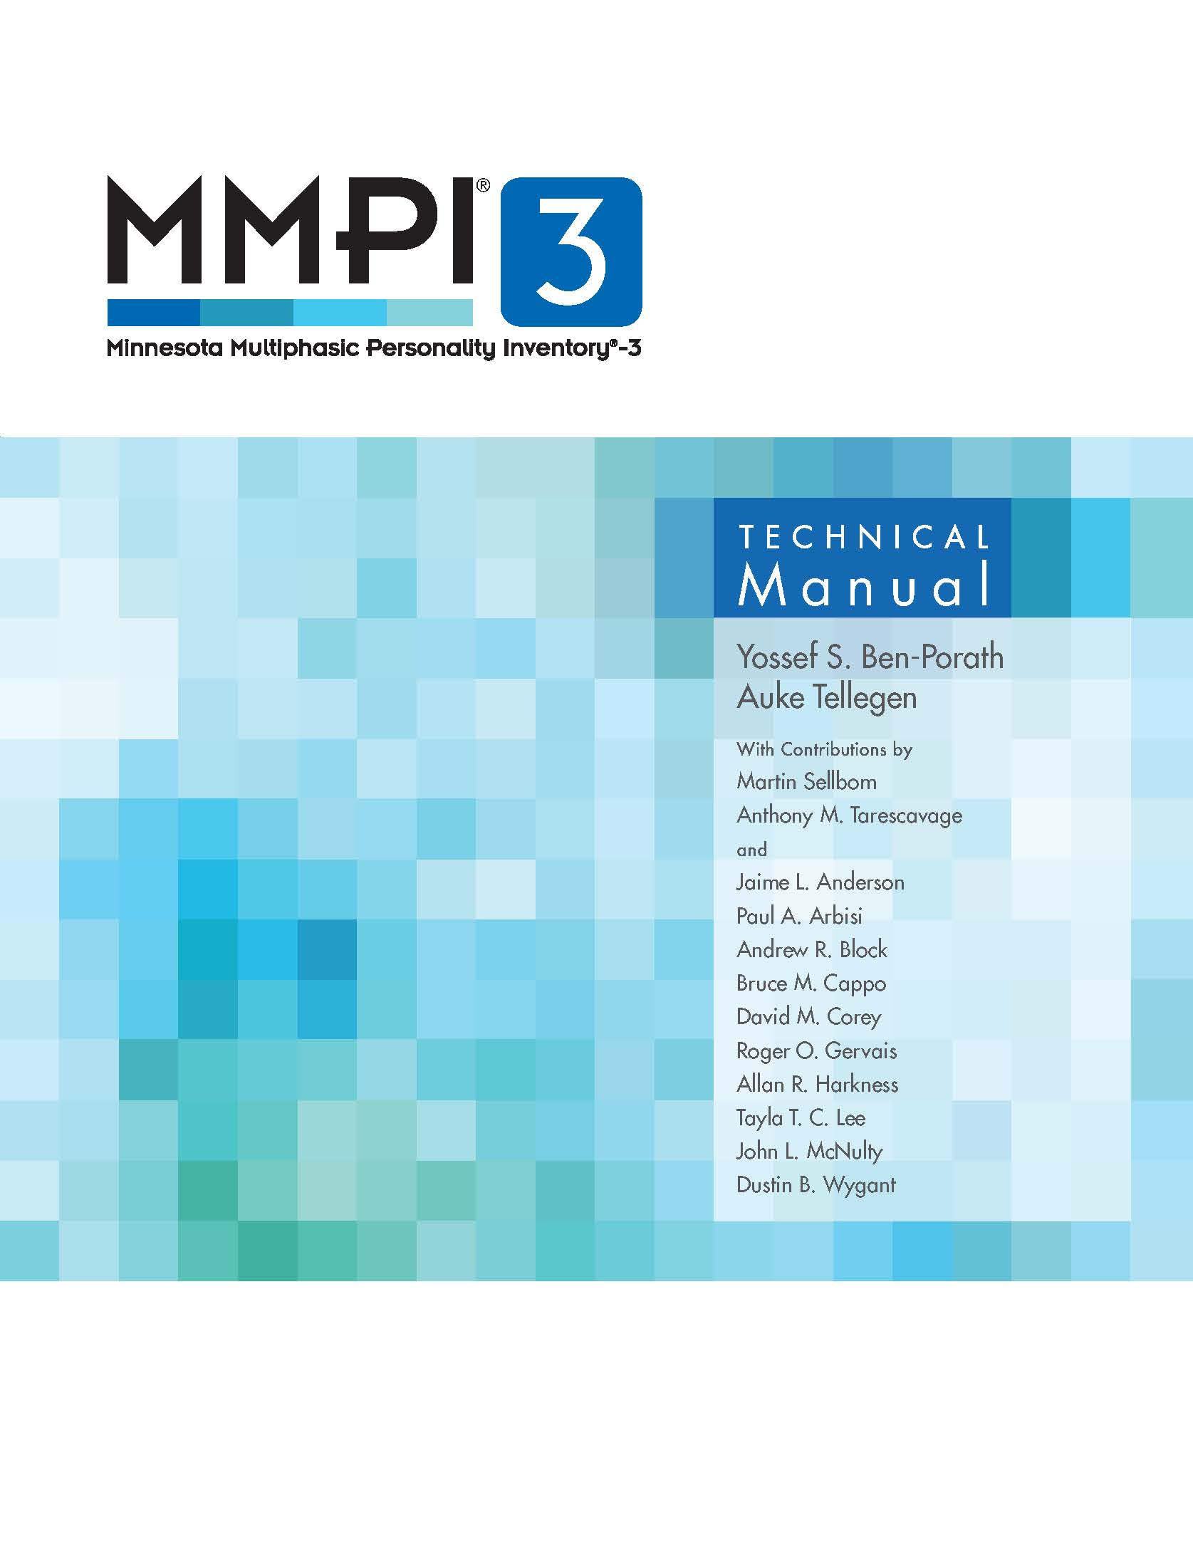
MMPI-3 Manuals
MMPI-3 Technical Manual

Slide 143
Technical Manual
Test development
Reliability and SEM data
Empirical correlates (Appendix D)
  Mental health
  Medical
  Forensic
  Public safety

Slide 144
Technical Manual
Appendix D
TOTAL = 37,968 Validity Coefficients

Slide 145
Technical Manual
Test development
Reliability and SEM data
Empirical correlates (Appendix D)
Comparability with MMPI-2-RF correlates (Appendix E)
  Mental health
  Medical
  Forensic
  Public safety

Slide 146
Technical Manual
Technical Manual - Appendix E
MMPI-2-RF/MMPI-3 Correlates: 38,850

Slide 147
Technical Manual
Test development
Reliability and SEM data
Empirical correlates (Appendix D)
Comparability with MMPI-2-RF correlates (Appendix E)
  MMPI-2-RF findings apply to MMPI-3 versions of MMPI-2-RF scales
  Including:
    Findings from MMPI-2-RF Technical Manual (~54,000 empirical correlates)
    530+ peer-reviewed publications

Slide 148
Technical Manual
Test development
Reliability and SEM data
Empirical correlates (Appendix D)
Comparability with MMPI-2-RF correlates (Appendix E)
Comparison groups (Appendix F)
  22 at release
  Ongoing data collection
  Custom comparison groups

Slide 149
Technical Manual
Standard Comparison Groups
MMPI-3 Normative (Men & Women)
Outpatient, Community Mental Health Center (Men & Women)
Outpatient, Private Practice (Men & Women)
College Counseling Clinic (Women)
Sexual Addiction Treatment Evaluee (Men)
Spine Surgery/Spinal Cord Stimulator Candidates (Men & Women)
Forensic, Disability Claimant (Men & Women)
Prison Inmate (Men)
Personnel Screening, Police Candidate (Combined)
Personnel Screening, Corrections Officer (Combined)
Personnel Screening, Dispatcher Candidate (Combined)
College Student (Men & Women)
MMPI-3 Spanish-Language Normative Sample (Men & Women)

Slide 150
MMPI-3 Manuals
MMPI-3 Manual Supplement for the U.S. Spanish Translation

Slide 151
Manual Supplement for U.S. Spanish Translation
Need for Spanish-language translation and norms
Development
  Norms
Reliability and SEM data
Validity data
Best practices

Slide 152
MMPI-3 User’s Guides
MMPI-3 Score and Clinical Interpretive Reports

Slide 161
User’s Guide for the Score and
Clinical Interpretive Reports
Score Report
Clinical Interpretive Report
  Includes annotation and references

Slide 173
User’s Guide for the Score and
Clinical Interpretive Reports
Score Report
Clinical Interpretive Report
  Includes annotation and references
Customization options
  Comparison groups
  Item-level information

Slide 178
User’s Guide for the Score and
Clinical Interpretive Reports
Score Report
Clinical Interpretive Report
  Includes annotation and references
Customization options
  Comparison groups
  Item-level information
Interface with Pearson software

Slide 179

MMPI-3 User’s Guide
  MMPI-3 Public Safety Candidate Interpretive
  Reports (PSCIRs):
    Police Candidate Interpretive Report (PCIR)
    Correctional Candidate Interpretive Report (CCIR)
    Dispatcher Candidate Interpretive Report (DCIR)
    Firefighter Candidate Interpretive Report (FCIR)

Slide 180
MMPI-3 PSCIR User’s Guide
Overview of preemployment psychological evaluation (PEPE)
History of using the MMPI instruments in PEPE
Empirical foundations of the PSCIRs
Structure and content of PSCIRs
Using Pearson software to generate and customize PSCIRs

Slide 181
Unit 5: Administration, Scoring, and Reporting

Slide 182





Administration, Scoring & Reporting Options
Digital
Paper
Hybrid
Administration
Scoring
Reporting

Slide 183
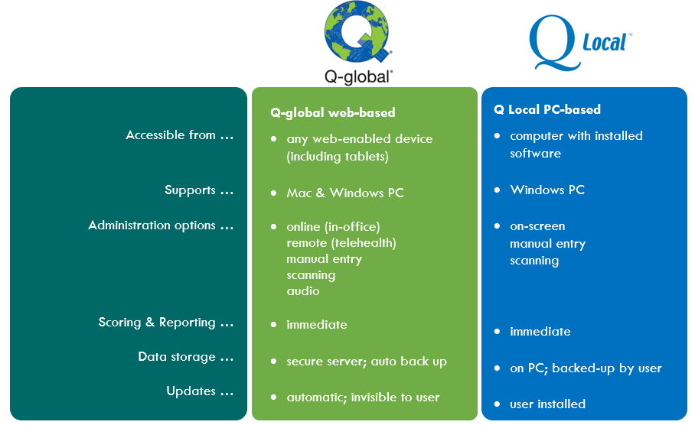
Digital options

Slide 184



Test Booklets

Slide 185
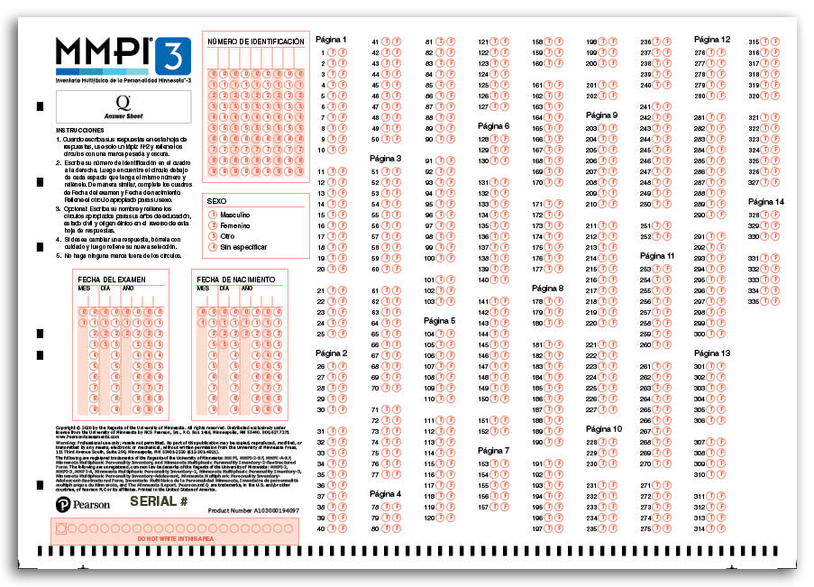
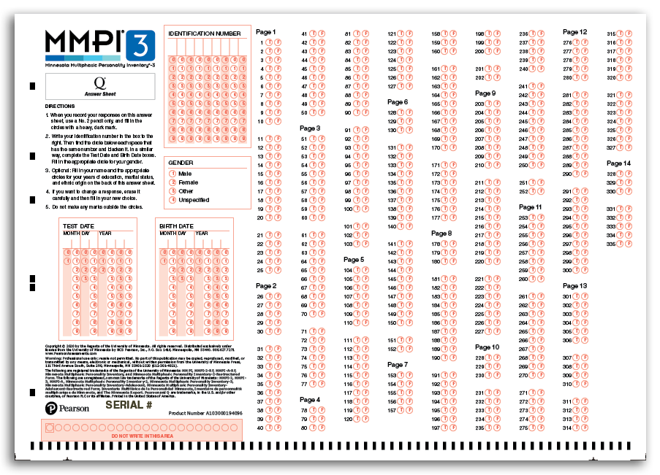
Q Answer Sheets

Slide 186
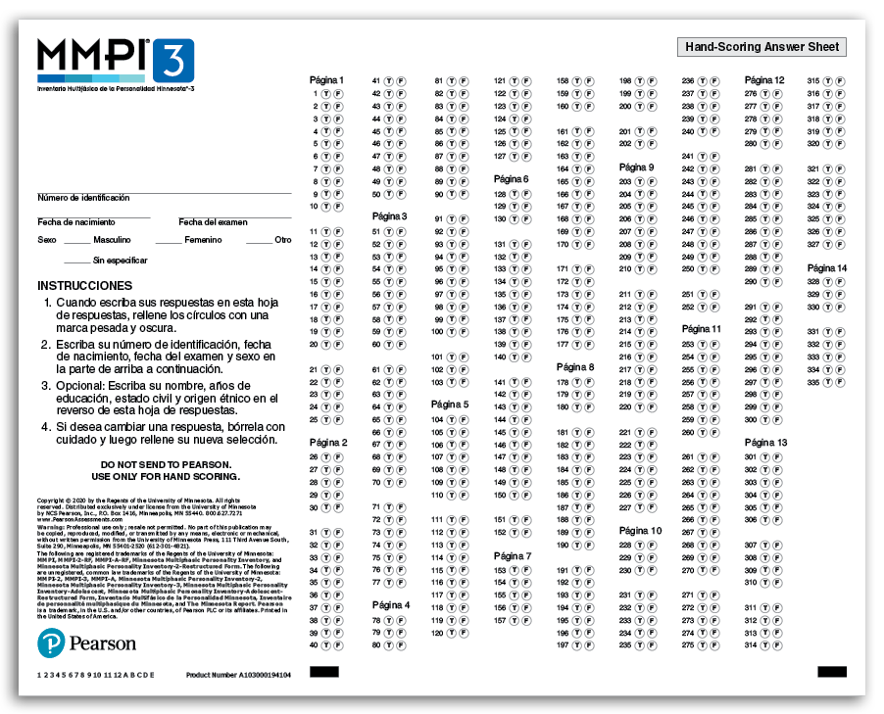
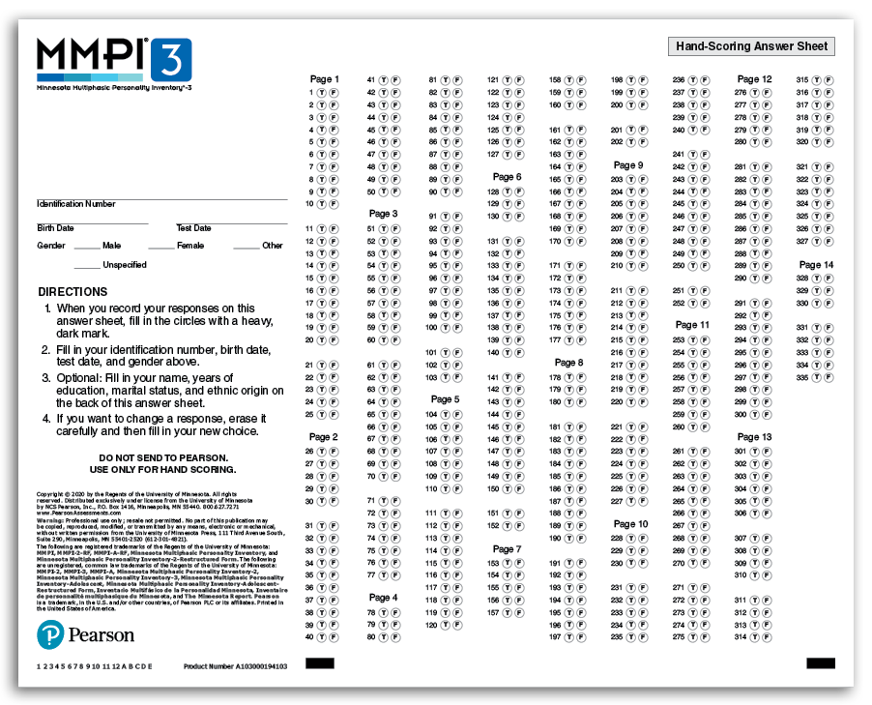
Hand-Scoring Answer Sheets

Slide 187
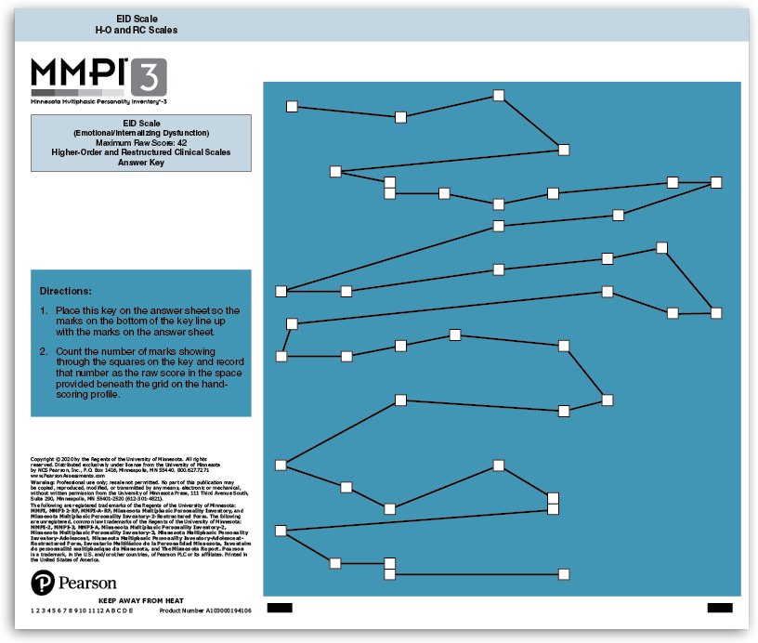
Hand-Scoring Answer Keys

Slide 188
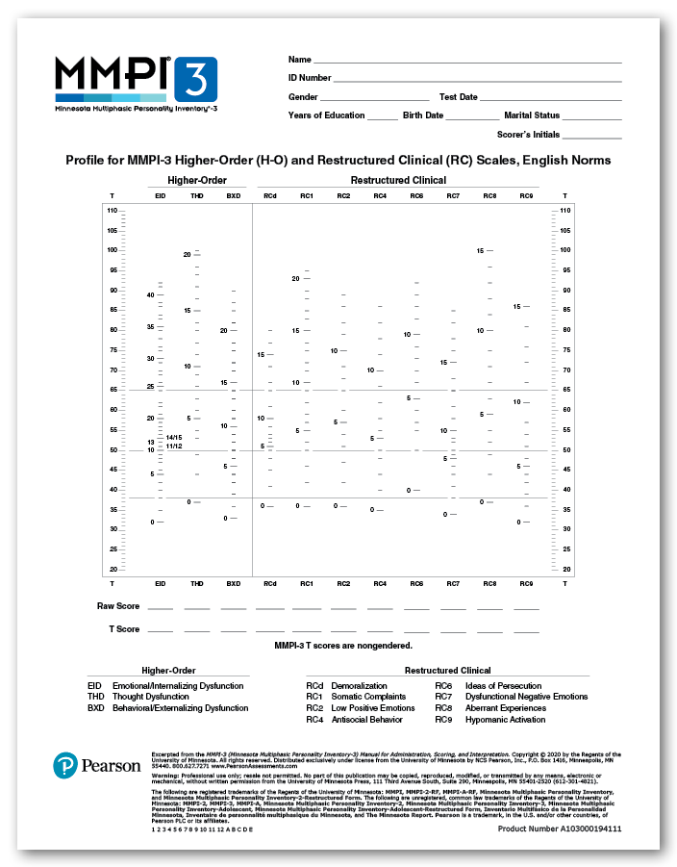
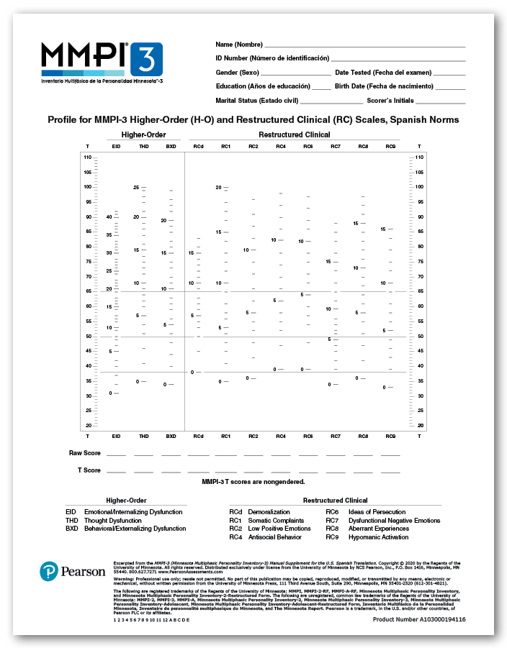
Hand-Scoring Profiles

Slide 189
Administering the MMPI-3
Standard Procedures delineated in the MMPI-3 Manual for Administration, Scoring, and Interpretation
Administration:
  Before Testing
    Consider age
    Inquire about prior testing experience
    Assess Testability
      Cognitive wherewithal
      Vision
      Reading Level
  Use Standard Administration Modalities
    Booklet and answer sheet
    Computer
    Audio
    Remote

Slide 192
Unit 6: Setting-Specific Applications

Slide 193
Non-clinical Applications
Forensic
  Criminal
    Competence to Stand trial
    Criminal Responsibility
    Pre-sentence
    Post-sentence
    Conditional Release
  Correctional
    MH screening
    Sex Offender
    Pre-release

Slide 194
Non-clinical Applications
Forensic
  Civil Commitment
  Personal Injury
  Disability
  Family Court
    Child Custody
    Parental Fitness

Slide 195
Non-clinical Applications
Pre-surgical
  Bariatric
  Spine/Spinal cord Stimulator
  Organ Transplant
Public Safety
  Preemployment
  Fitness for Duty

Slide 196
End of Part 1

