Slide 1

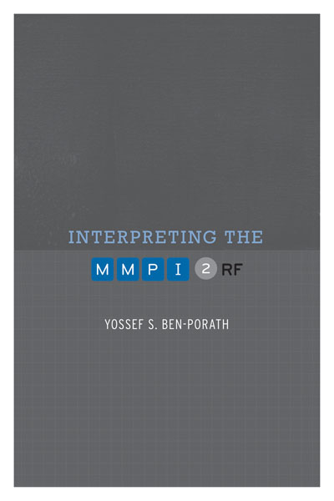

TRAINING SLIDES FOR:
INTERPRETING THE MMPI-2-RF
MMPI-2-RF Training Slides, University of Minnesota Press, 2015. Copyright for all MMPI® and MMPI-2-RF® materials are held by the Regents of the University of Minnesota.

Slide 2
Chapter 9:
MMPI-2-RF Case Studies

Slide 3
Ms. G: Obsessive-Compulsive Symptoms
35 year old, single, woman
Self-referred for outpatient treatment at a community mental health center
Recently lost her job owing to obsessive-compulsive behavior
Preoccupied with worry that her apartment will catch fire or be burglarized
Engaged to repeated checking behavior of increasing intensity that interfered with job performance (tardiness, productivity)
After repeated warnings, let go

Slide 4
Ms. G: Obsessive-Compulsive Symptoms
Raised in an intact family with no reported abuse history
Had been involved in long-term relationship that ended a few moths prior to seeking services
Had resided with ex-boyfriend most of her adult life
No prior contact with the mental health system
At intake, reported feeling anxious, depressed, embarrassed, and guilty over job loss

Slide 12
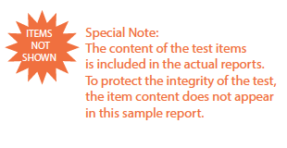

Slide 13
Mr. P: Chronic and Severe Disorder
49 year old, single, male
Assessed at intake to an inpatient psychiatric unit of a community hospital
Long standing diagnosis of Schizophrenia, Paranoid Type
Diagnosed during later teens and resided with parents most of his adult life
Father passed away when Mr. P was in his late 20s
Continues to reside with mother, now in her late 70s
Receives case management services in the community

Slide 14
Mr. P: Chronic and Severe Disorder
Periodically employed as an unskilled laborer under the auspices of local community mental health agency
Several weeks prior to hospitalization, became embroiled in conflict with co-worker
Employment suspended following physical altercation
Because upset and discontinued medication
Mother reported fairly rapid deterioration, marked by preoccupation with government conspiracy to deprive him of disability benefits
Threatened retaliation against supervisor and co-worker

Slide 23
Ms. L: An Abusive Relationship Ends
20 year old, single, female college student
Presented at college counseling center complaining of academic difficulties following breakup
Reported involvement in an abusive relationship for over a year
Frequent arguments culminated in physical altercations
Often triggered by Ms. L’s suspicions regarding boyfriend’s infidelity
Altercations would often leave both with bruises
Typically occurred when both were intoxicated
Boyfriend terminated relationships three weeks prior to intake

Slide 24
Ms. L: An Abusive Relationship Ends
Ms. L went on a two-week drinking binge following breakup
Had sexual relationships with several men she met at bars while using forged identification
Stopped attending classes and missed several exams
After friend threatened to inform her parents about activities, she stopped going to bars and started attending classes
When she explained her absence to one of her professors, she recommended that Ms. L seek assistance at the counseling clinic

Slide 34
Mr. E: Substance-Induced Psychotic Symptoms
28 year old, single male
Admitted to inpatient psychiatric unit of community hospital after presenting with suspected psychotic symptoms
Extensive history of alcohol and drug abuse and unsuccessful treatments
Assault led to arrest and current evaluation
At intake described as still intoxicated following recent cocaine binge
Thinking characterized as paranoid and suspicious, with religious preoccupation and obsessive rumination

Slide 35
Mr. E: Substance-Induced Psychotic Symptoms
No prior involvement with mental health system, but several failed substance abuse treatment programs
Recent breakup
Arrest followed altercation at a bar
Caused serious injuries to stranger who had asked him to lower his voice
Arresting officer noted Mr. P’s religious preoccupation
Taken to crisis stabilization unit where staff diagnosed intoxication following crack cocaine binge
Possibly independent psychotic symptoms noted, with recommendation for inpatient observation

Slide 44
For additional information on this chapter, please reference:
Ben-Porath, Y.S. (2012). Interpreting the MMPI-2-RF. Minneapolis: University of Minnesota Press.

