Slide 1
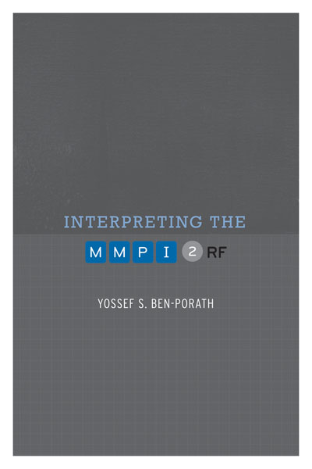
TRAINING SLIDES FOR:
INTERPRETING THE MMPI-2-RF
MMPI-2-RF Training Slides, University of Minnesota Press, 2015. Copyright for all MMPI® and MMPI-2-RF® materials are held by the Regents of the University of Minnesota.

Slide 2
Chapter 4: Validity Scales

Slide 3
MMPI-2-RF Validity Scales
Protocol Validity versus Instrument Validity
Threats to Protocol Validity
Non-Content-Based Invalid Responding
Non-responding
Random Responding
Intentional
Unintentional
Reading Difficulties
Comprehension Deficits
Low verbal abilities
Non-native English speaker
Disorganization
Mismarked answer sheets
Fixed Responding
Acquiescence or Counter-acquiescence
Problems with double negatives

Slide 4
MMPI-2-RF Validity Scales
Threats to Protocol Validity
Content-Based Invalid Responding
Over-reporting
Intentional
Malingering
Factitious Disorder
Unintentional
Catastrophizing
Somatoform Disorder
Under-reporting
Intentional
Denial or minimization
Unintentional
Distorted self-concept

Slide 5
MMPI Validity Scales
Original MMPI Validity Scales (1943)
“It is almost as though we inventory-makers were afraid to say too much about the problem because we had no effective solution for it, but it was too obvious a fact to be ignored so it was met by a polite nod.” (Meehl & Hathaway, 1946, p. 526)
Cannot Say (CNS) – Non-responding
Changes dramatically with switch to Group Form
Lie (L) – Under-reporting
Fashioned after Hartshorne and May Honesty Research
Infrequency (F) – Random Protocol
Initially designed as a measure of random responding or clerical error
Found by military psychologists to be sensitive to over-reporting

Slide 6
MMPI Validity Scales
Original MMPI Validity Scales - K
K-correction and K Scale added in 1946
Developed by Meehl and Hathaway (1946) to serve only as a correction factor to account for under-reporting and over-reporting
K Scale adopted as the final standard validity scale of the MMPI in 1946

Slide 7
MMPI Validity Scales
Original MMPI Validity Scales and Threats to Protocol Validity:
CNS
Non-responding
L
Under-reporting
Intentional and unintentional
F
Content non-responsiveness
Over-reporting
Intentional and unintentional
K
Under-reporting
Intentional and unintentional

Slide 8
MMPI-2 Validity Scales
MMPI-2 Validity Scales:
MMPI Validity Sales carried over:
CNS, L, F, K carried over
F loses four items
MMPI-2 Validity Scales introduced in 1989:
Variable Response Inconsistency – VRIN – Random Responding
True Response Inconsistency – TRIN – Fixed Responding
F Back (F_{B}) – Over-reporting
MMPI-2 Validity Scales added later:
Infrequency Psychopathology – F_{P} - Over-reporting
Superlative Self-Presentation – S – Under-reporting
Symptom Validity Scale – FBS (previously Fake Bad Scale) – Over-reporting

Slide 9
MMPI-2-RF Validity Scales: Development
VRIN-r/TRIN-r
Based on inconsistent responses to item pairs
Pairs selected in the basis of statistical and semantic analyses of possible response combinations (composites):
Both True (TT)
Both False (FF)
First True and the second False (TF)
First False and the second True (FT)

Slide 10
MMPI-2-RF Validity Scales: Development
VRIN-r/TRIN-r
Each composite chosen for VRIN-r or TRIN-r had to meet five criteria:
The items had to be sufficiently correlated with each other (positively for VRIN-r, negatively for TRIN-r) in two clinical samples (seeking statistical inconsistency)
The observed frequency of the composite had to be low when compared to the frequency expected by chance if the two responses making up the composite were independent (seeking unlikely response combinations)
The combination of responses in a composite had to be judged by the authors to be inconsistent (seeking semantic inconsistency)
The correlation between a composite and a mini-scale made up of the two items keyed in the direction they were scored on the composite was low (seeking “content-free” composites)
Neither item in a composite could belong to another composite of the same type (eliminate overlap)

Slide 11
MMPI-2-RF Validity Scales: Development
TRIN-r Example:
269. When things get really bad, I know I can count on my family for help.
314. I hate my whole family
Responses are negatively correlated (-.23)
Observed/Expected .27 for TT and .93 for FF (TT combination much more unlikely than FF)
TT combination is semantically inconsistent
Correlation with mini-scale reflecting family problems is -.10 for TT and -.70 for FF (indicating TT combination is content-free)
Neither 269 nor 314 could be scored in another TT combination

Slide 12
MMPI-2-RF Validity Scales: Development
Over-reporting Scales:
F-r (Infrequent Responses):
32 items answered infrequently (10% or less) of the men and women in the normative sample
Fp-r (Infrequent Psychopathology Responses):
21 items answered infrequently (20% or less) by psychiatric inpatients, outpatients, and non-clinical samples
Fs (Infrequent Somatic Responses):
16 items with somatic content answered infrequently (25% or less) of medical samples
FBS-r (Symptom Validity):
30 of 43 FBS items included in 338-item booklet
RBS (Response Bias Scale):
28 items correlated with failure on performance validity tests

Slide 13
MMPI-2-RF Validity Scales: Development
Under-reporting Scales:
L-r (Uncommon Virtues):
14 items describing uncommon moral virtues
K-r (Adjustment Validity):
14 items describing good psychological adjustment

Slide 14
MMPI-2-RF Validity Scales: Empirical Findings

Slide 15
Psychometric Findings with the MMPI-2-RF Validity Scales

Slide 16
Reliability
Reported in Chapter 3 of MMPI-2-RF Technical Manual

Slide 17
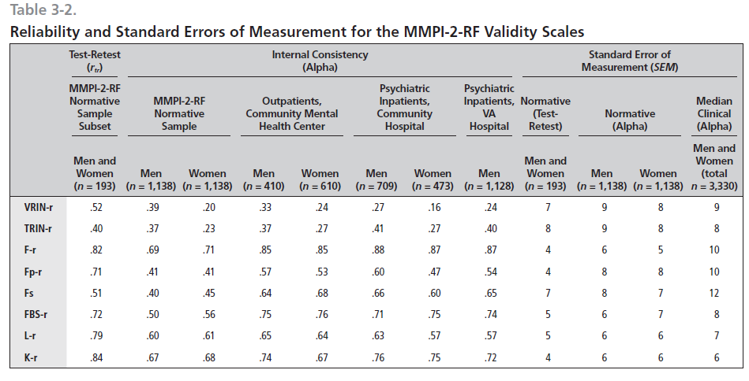

Slide 18
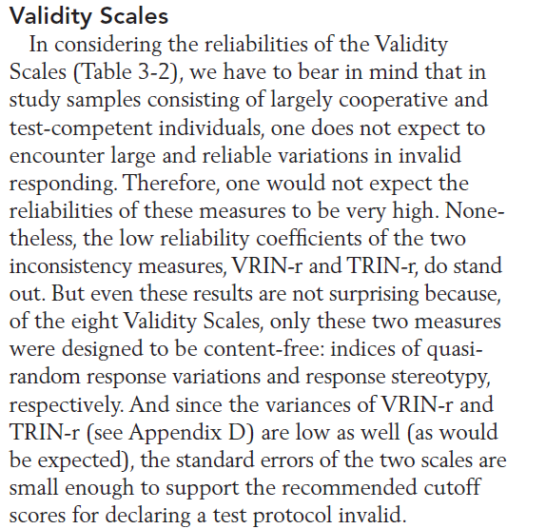

Slide 19
Validity
Validation studies reported in peer-reviewed literature
Examples:

Slide 20
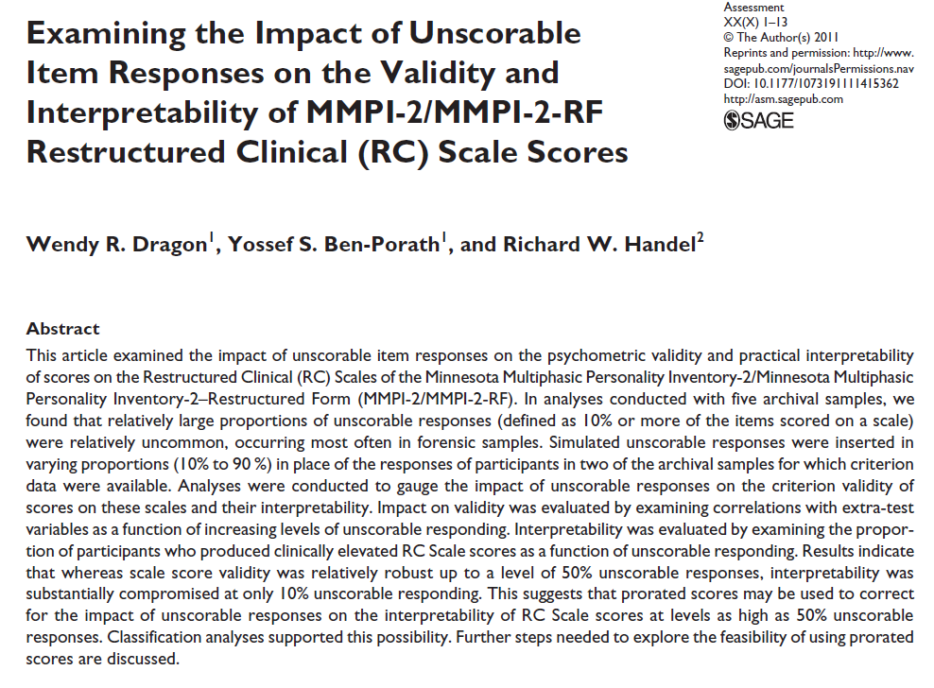

Slide 21
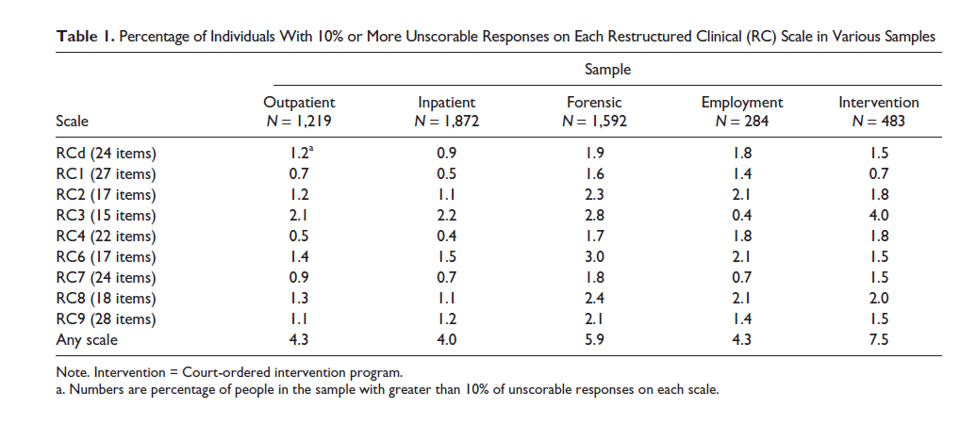

Slide 22
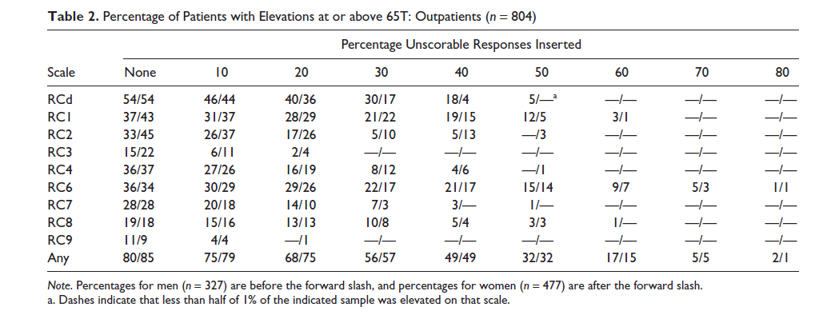

Slide 23
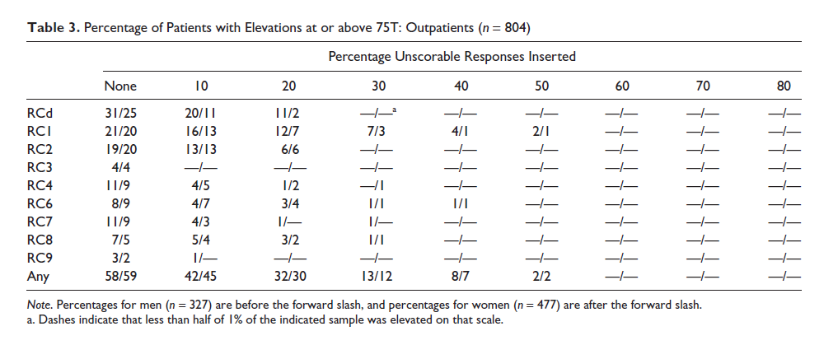

Slide 24
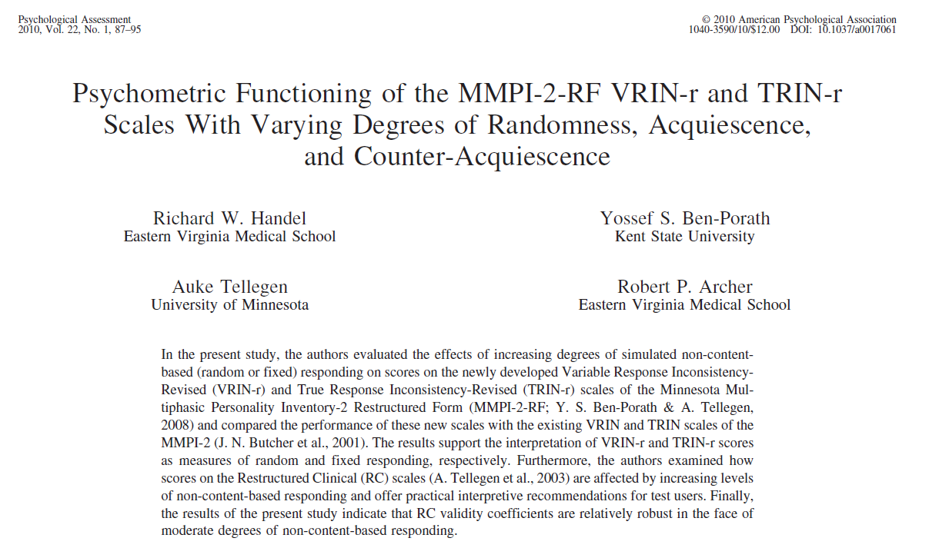

Slide 25
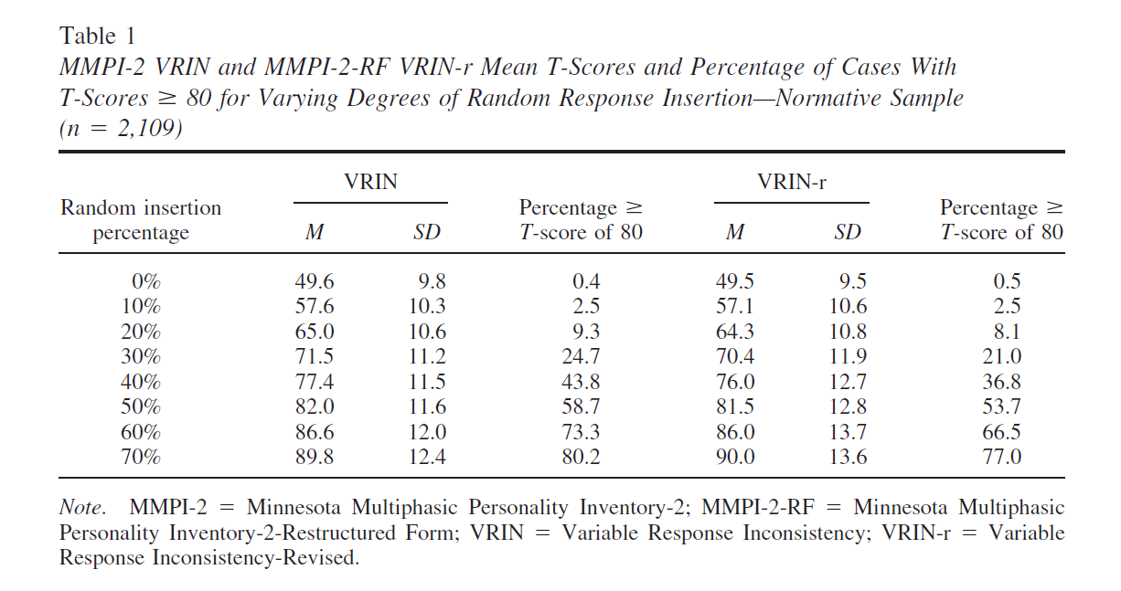

Slide 26
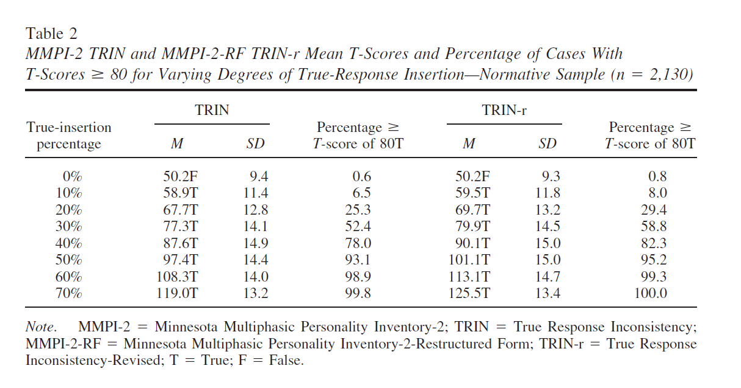

Slide 27
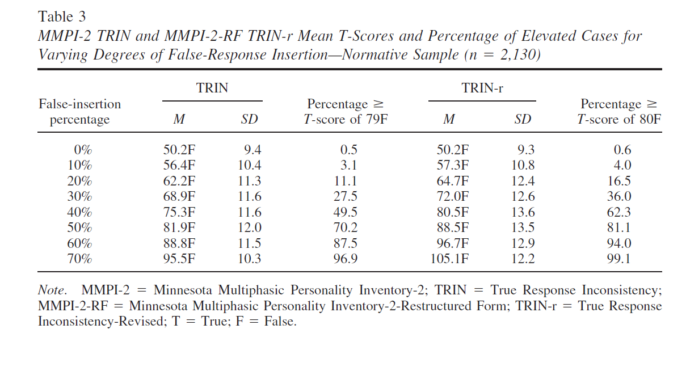

Slide 28
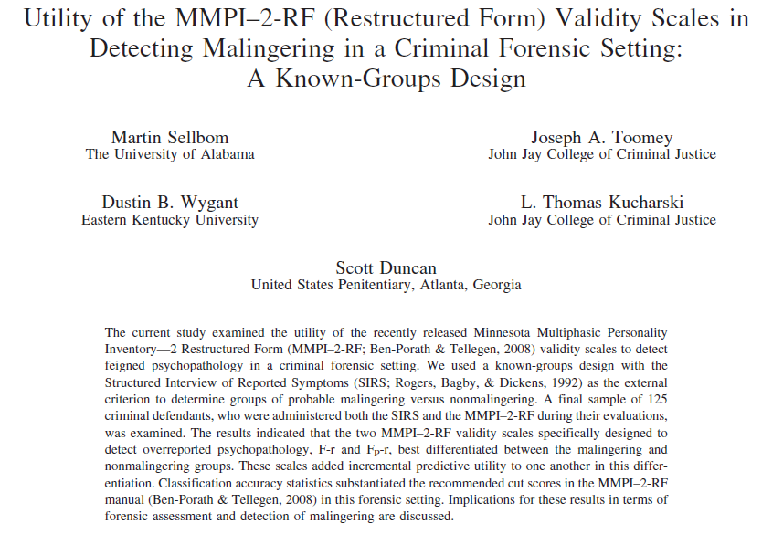

Slide 30
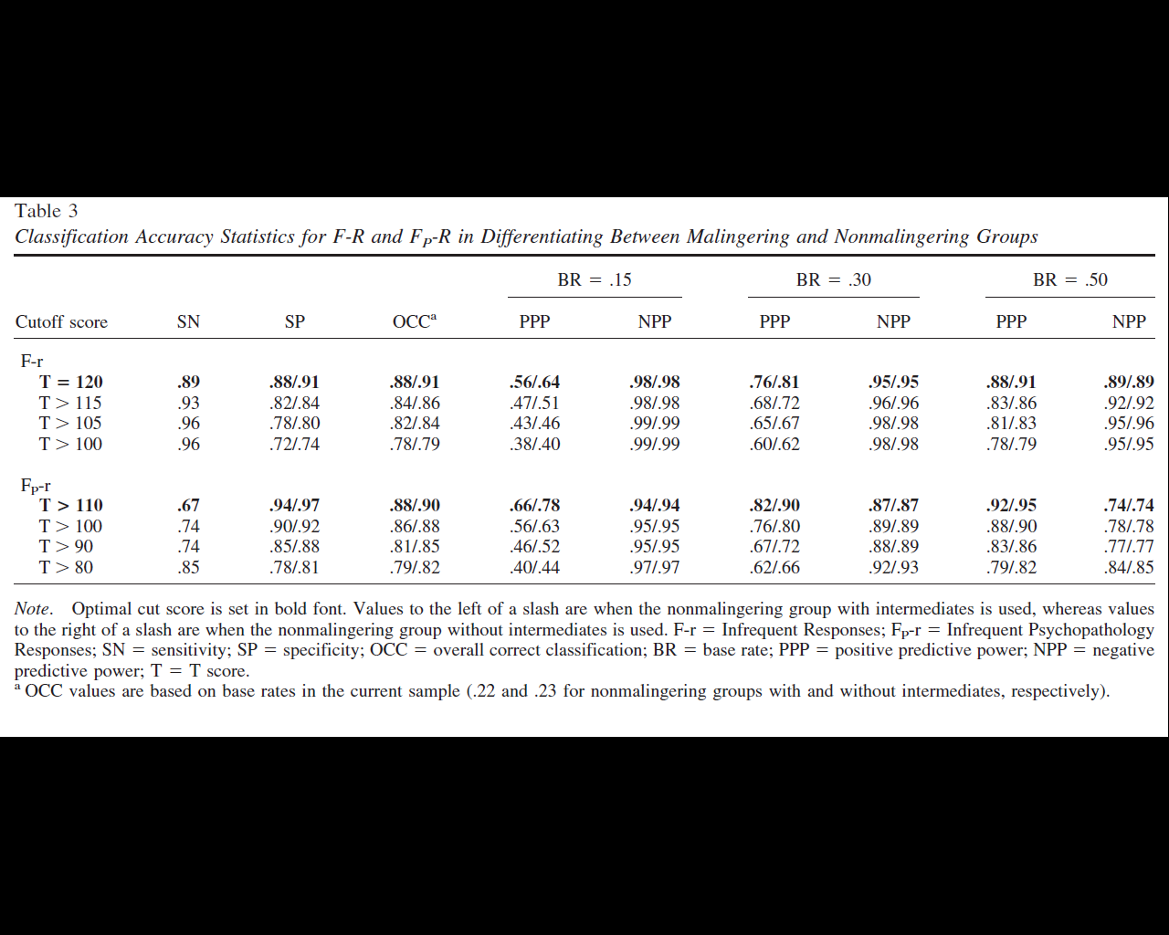

Slide 31
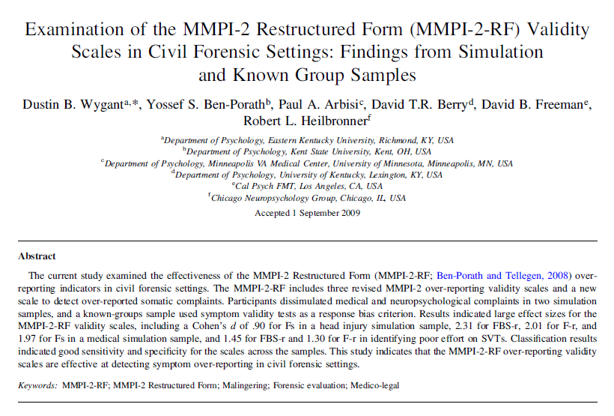

Slide 32
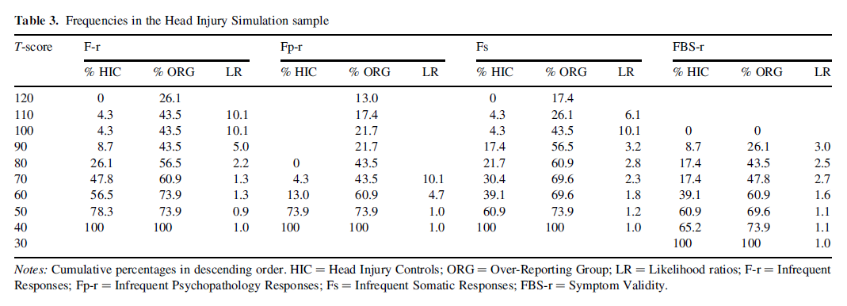

Slide 33
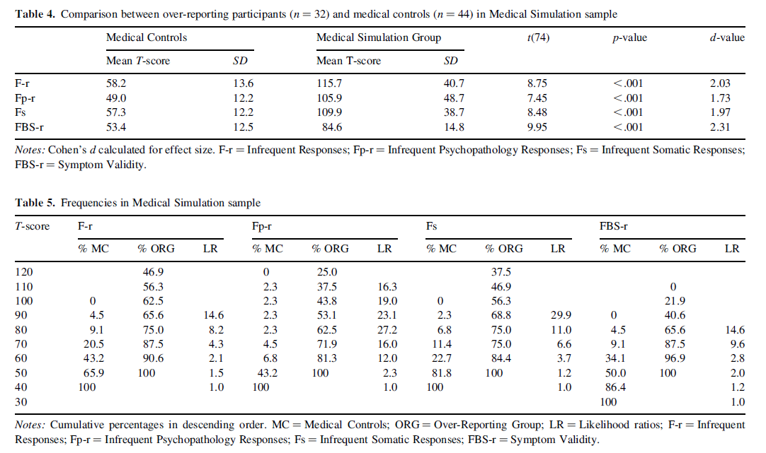

Slide 34
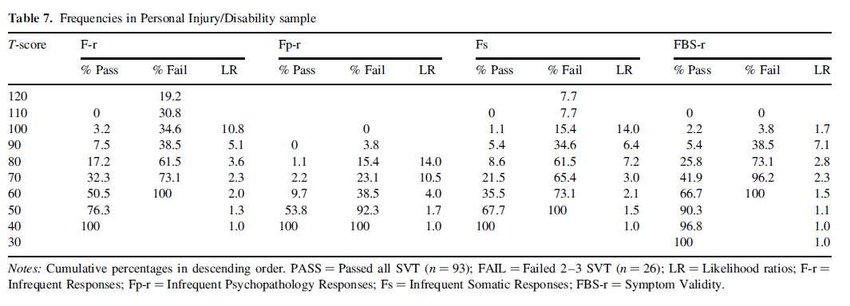

Slide 35
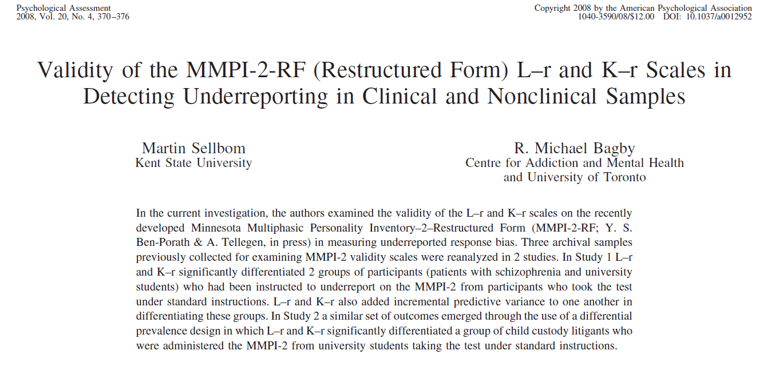

Slide 36
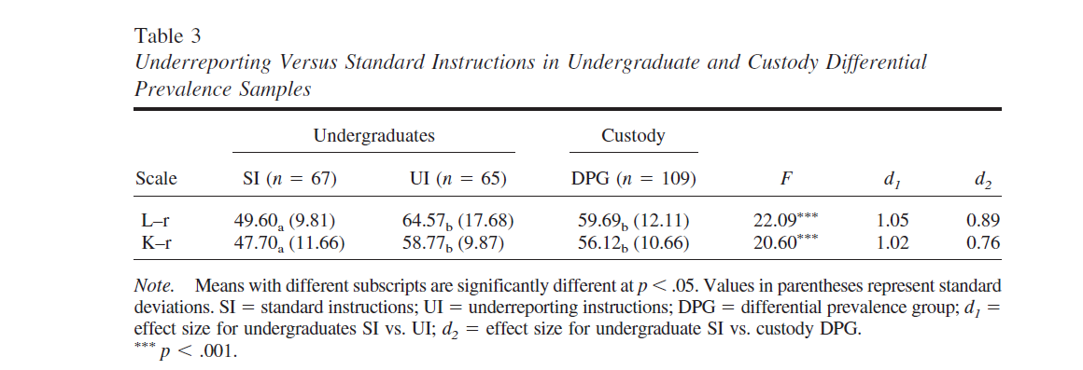

Slide 37
Malingering

Slide 38
Malingering
Cannot be determined by self-report alone
External incentive?
Factitious disorder?
When integrated with other sources
Collateral information
PVTs
Other testing
Interview
MMPI-2-RF indications of over-reporting can support the evaluator’s conclusions about malingering
MMPI-2-RF over-reporting indicators have been validated primarily in the context of identifying malingering

Slide 39
Malingering
Malingering and psychopathology are not mutually exclusive
i.e., malingering is not an indication of the absence of psychopathology
Regardless of malingering, MMPI-2-RF findings of significant over-reporting
Raise questions about the validity of scores on the substantive scales
And therefore indicate that scores on the substantive scales cannot be relied upon to assess for psychological dysfunction
Raise general questions about the validity of the test-taker’s self-reported symptoms

Slide 40
For additional information on this chapter, please reference:
Ben-Porath, Y.S. (2012). Interpreting the MMPI-2-RF. Minneapolis: University of Minnesota Press.

