Slide 1
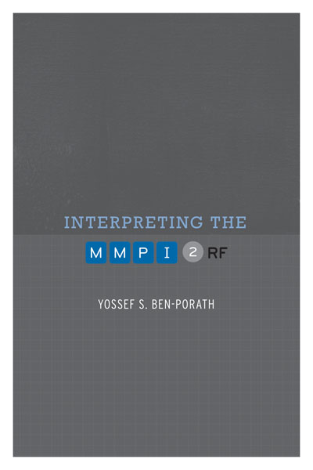
TRAINING SLIDES FOR:
INTERPRETING THE MMPI-2-RF
MMPI-2-RF Training Slides, University of Minnesota Press, 2015. Copyright for all MMPI® and MMPI-2-RF® materials are held by the Regents of the University of Minnesota.

Slide 2
Chapter 3: MMPI-2-RF Substantive Scales

Slide 3
MMPI-2-RF Substantive Scales
The introduction of the RC Scales may stimulate additional MMPI-2 scale development. It may prove worthwhile to search for and measure distinctive core features of important MMPI-2 scales other than the MMPI-2 Clinical Scales, some of which may also be confounded with a strong Demoralization component. Investigations along these lines may lead to additional measures that are incrementally informative beyond the RC Scales. Through such efforts it may be possible eventually to capture the full range of attributes represented by the large body of MMPI-2 constructs with a set of new scales more transparent and effective than those currently available. (Tellegen, Ben-Porath, McNulty, Arbisi, Graham & Kaemmer, 2003, pp. 85–86)

Slide 4
MMPI-2-RF Substantive Scales
RC Scales not intended to assess everything that can be measured with the MMPI-2 item pool
Goal in completing the MMPI-2-RF:
A comprehensive set of measures representing the clinically significant substance of the entire MMPI-2 item pool
Five additional sets of scales:
Higher-Order
Specific Problems
Interest
PSY-5
Validity

Slide 5
MMPI-2-RF Substantive Scales
Higher-Order Scales – Background:
Ongoing search for meaningful structural model to provide an organizing descriptive framework for psychological assessment and psychodiagnosis
Factor analyses of “normal” and clinical personality measures yield similar structures:
Primary constructs to emerge from factor analyses:
Clinical: Internalizing and Externalizing Psychopathology
Normal: Positive Emotionality, Negative Emotionality, Constraint
Missing Construct: Thought Dysfunction

Slide 6
MMPI-2-RF Substantive Scales
Higher-Order Scales – Development:
RC Scales provide an opportunity for a “fresh” analysis
Factor analyses of the RC Scales identify three higher-order dimensions marked by
RCd, RC2, RC7
RC6, RC8
RC4, RC9
Combined items of these scales factor analyzed and three factor scores generated
Three factor scores correlated with 567 MMPI-2 items
A set of items selected for each scale to produce diverse and distinctive markers associated statistically and conceptually with one, but not the other two higher-order factors

Slide 7
MMPI-2-RF Substantive Scales
Higher-Order Scales - Outcome:
EID - Emotional/Internalizing Dysfunction
THD – Thought Dysfunction
BXD – Behavioral/Externalizing Dysfunction
Two applications of H-O Scales:
Dimensional measures allow for identification of more than one broad domains of dysfunction (and indication of relative prominence)
Organizing framework for MMPI-2-RF interpretation

Slide 8
MMPI-2-RF Substantive Scales
Specific Problems and Interest Scales - Objectives:
Augment H-O and RC Scales with measures needed to achieve comprehensive instrument that assesses the broad range of constructs measurable with the MMPI-2 item pool:
Constructs assessed by Clinical Scales 5 and 0
Clinical Scale components not assessed by the RC Scales (e.g., a “social anxiety” component contained in the items of Clinical Scale 3)
More narrowly-focused facets of some RC Scales (e.g., substance abuse within the item pool of RC4)
Clinically significant attributes not represented in either the Clinical or RC Scales (e.g., suicidality)

Slide 9
MMPI-2-RF Substantive Scales
Specific Problems and Interest Scales – Development:
Iterative process relying on methods similar to those used in developing the RC Scales
A set of items representing targeted constructs factor analyzed along with Demoralization markers
Seed Scales assembled by selecting items not overly correlated with Demoralization or other targeted item sets
Seed scales correlated with 567 MMPI-2 items to identify ones sufficiently correlated with a specific seed and more so than with the others
Deletion of items that reduced internal consistency
Examination of empirical correlates

Slide 10
MMPI-2-RF Substantive Scales
Specific Problems and Interest Scales – Outcome:
5 Somatic/Cognitive Scales
9 Internalizing Scales
4 Externalizing Scales
5 Interpersonal Functioning Scales
2 Interest Scales

Slide 11
MMPI-2-RF Substantive Scales
Somatic/Cognitive
MLS: Malaise – Overall sense of physical debilitation, poor health (perceived functional incapacity)
GIC: Gastrointestinal Complaints – Nausea, recurring upset stomach, and poor appetite
HPC: Head Pain Complaints – Head and neck pain
NUC: Neurological Complaints – Dizziness, weakness, paralysis, loss of balance, etc.
COG: Cognitive Complaints – Memory problems, difficulties concentrating

Slide 12
MMPI-2-RF Substantive Scales
Internalizing (RCd Facets):
SUI: Suicidal/Death Ideation – Direct reports of suicidal ideation and recent attempts
HLP: Helplessness/Hopelessness – Belief that goals cannot be reached or problems solved
SFD: Self-Doubt -- Lack of self-confidence, feelings of uselessness
NFC: Inefficacy – Belief that one is indecisive and inefficacious

Slide 13
MMPI-2-RF Substantive Scales
Internalizing (RC7 Facets):
STW: Stress/Worry -- Preoccupation with disappointments, difficulty with time pressure
AXY: Anxiety – Pervasive anxiety, frights, frequent nightmares
ANP: Anger Proneness -- Becoming easily angered, impatient with others
BRF: Behavior-Restricting Fears -- Fears that significantly inhibit normal behavior
MSF: Multiple Specific Fears -- Fears of blood, fire, thunder, etc.

Slide 14
MMPI-2-RF Substantive Scales
Externalizing: RC4 Facets
JCP: Juvenile Conduct Problems – Difficulties at school and at home, stealing
SUB: Substance Abuse – Current and past misuse of alcohol and drugs
RC9 Facets
AGG: Aggression – Physically aggressive, violent behavior
ACT: Activation – Heightened excitation and energy level

Slide 15
MMPI-2-RF Substantive Scales
Interpersonal:
FML: Family Problems – Conflictual family relationships
IPP: Interpersonal Passivity – Being unassertive and submissive
SAV: Social Avoidance – Avoiding or not enjoying social events
SHY: Shyness – Bashful, prone to feel inhibited and anxious around others
DSF: Disaffiliativeness – Disliking people and being around them

Slide 16
MMPI-2-RF Substantive Scales
Interests:
AES: Aesthetic-Literary Interests – Literature, music, the theater
MEC: Mechanical-Physical Interests – Fixing and building things, the outdoors, sports

Slide 17
MMPI-2-RF Substantive Scales
PSY-5 – Personality Psychopathology-5
Developed by Harkness and McNulty (1994) as a dimensional model of Axis II features
Began with DSM-III-R Axis II criteria
Augmented with items describing psychopathy features and Tellegen’s higher-order dimensions of Negative Emotionality, Positive Emotionality, and Constraint
Data reduction analyses identify five dimensions
Harkness, McNulty, and Ben-Porath (1995) develop MMPI-2 PSY-5 Scales using replicated rational selection
Lay judges select MMPI-2 items guided by descriptions of the five dimensions

Slide 18
MMPI-2-RF Substantive Scales
MMPI-2-RF PSY-5 Scales
Revised versions of their MMPI-2 measures of the PSY-5 dimensional model of personality (Axis II) pathology developed by Harkness and McNulty:
AGGR-r: Aggressiveness-Revised – Instrumental, goal-directed aggression
PSYC-r: Psychoticism-Revised – Disconnection from reality
DISC-r: Disconstraint-Revised – Under-controlled behavior
NEGE-r: Negative Emotionality/Neuroticism-Revised – Anxiety, insecurity, worry, and fear
INTR-r: Introversion/Low Positive Emotionality-Revised – Social disengagement and anhedonia

Slide 19
MMPI-2-RF Substantive Scales
MMPI-2-RF PSY-5 Scales
Provide a validated, dimensional perspective on personality disorder features
Very similar to PID-5 model considered for DSM-5 (now designated as needing further research):
Negative Affectivity
Detachment
Antagonism
Disinhibit ion vs. Compulsivity
Psychoticism

Slide 20
MMPI-2-RF Substantive Scales
MMPI-2-RF PSY-5 Scales
Can be linked to clusters of DSM-5 Personality disorders:
Aggressiveness – Cluster B
Psychoticism – Cluster A
Disconstraint – Custer B
Negative Emotionality/Neuroticism – Cluster C
Introversion/Low Positive Emotionality – Cluster C

Slide 21
Empirical Findings Substantive Scales
Reported in MMPI-2-RF Technical Manual and peer-reviewed literature
Adequate reliability

Slide 22
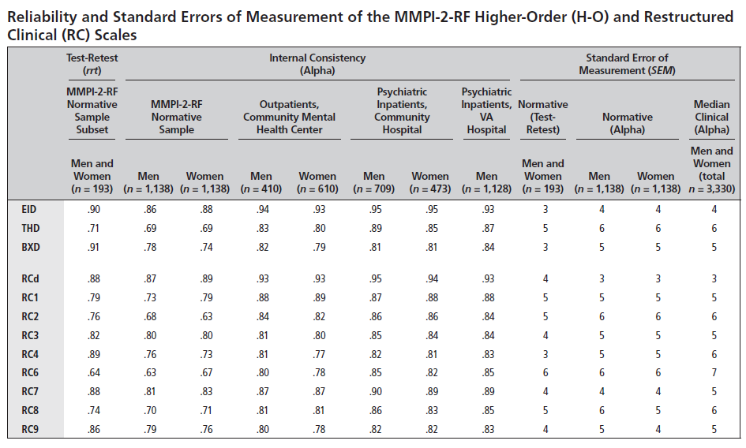

Slide 23
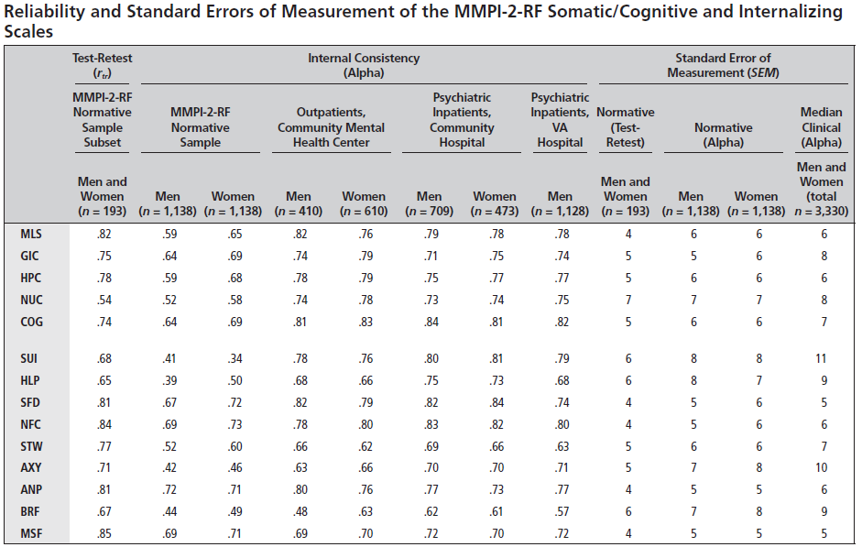

Slide 24
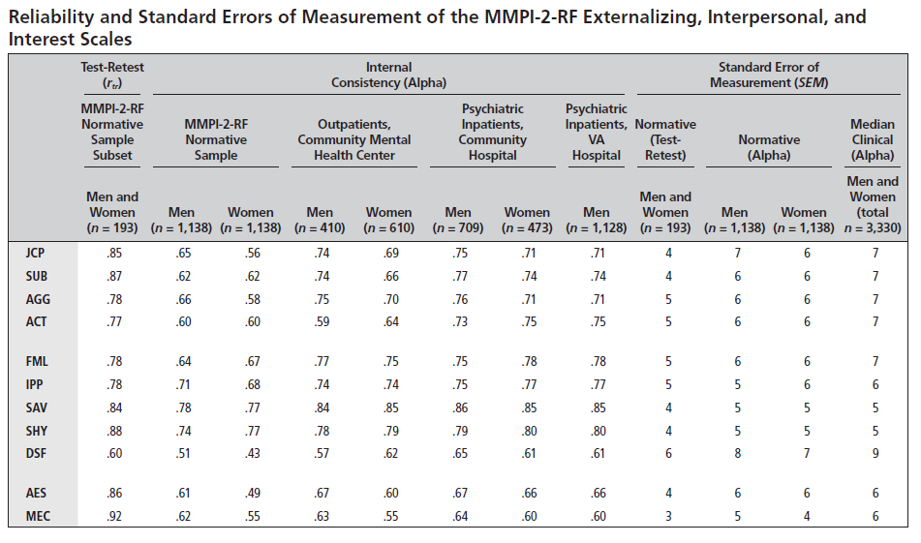

Slide 25
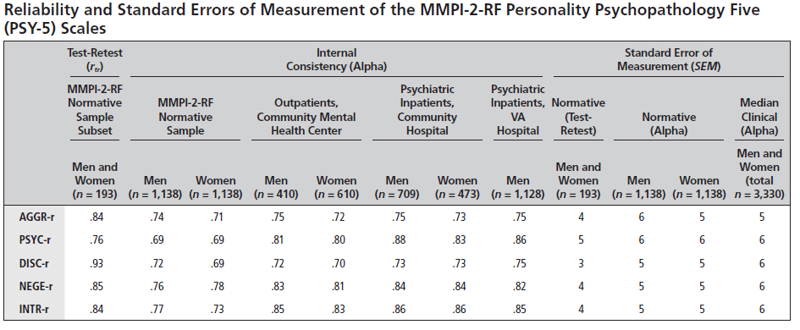

Slide 26
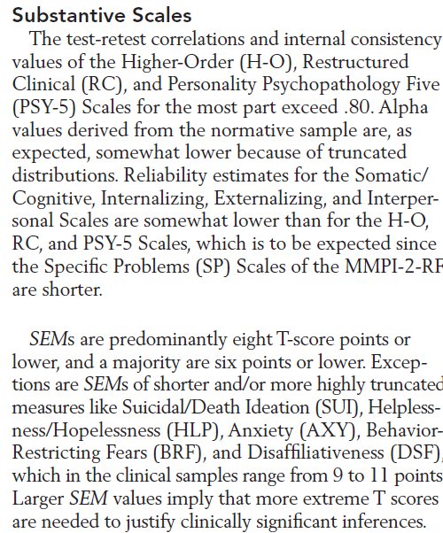

Slide 27
Empirical Findings Substantive Scales
Reported in MMPI-2-RF Technical Manual and peer-reviewed literature
Adequate reliability
Good evidence of construct validity
Broad range of replicable empirical correlates reflected in interpretive recommendations in MMPI-2-RF Manual for Administration, Scoring, and Interpretation

Slide 28
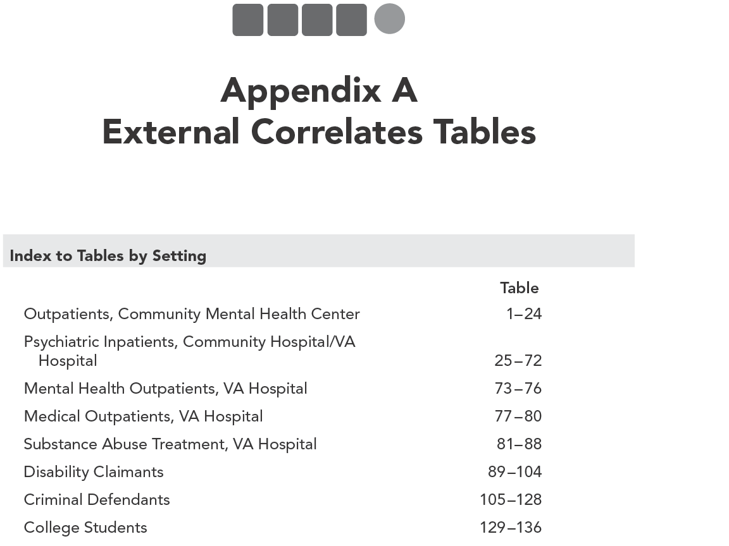

Slide 29
MMPI-2-RF Technical Manual: Appendix A
Empirical Correlates in
Mental Health
Outpatient
Inpatient
Medical
Substance Abuse Treatment
Forensic- Civil
Forensic- Criminal
Non-Clinical
N= 4,336 Men; 2,337 Women
605 Criteria
53,970 Correlations

Slide 30
For additional information on this chapter, please reference:
Ben-Porath, Y.S. (2012). Interpreting the MMPI-2-RF. Minneapolis: University of Minnesota Press.

